Slide 1
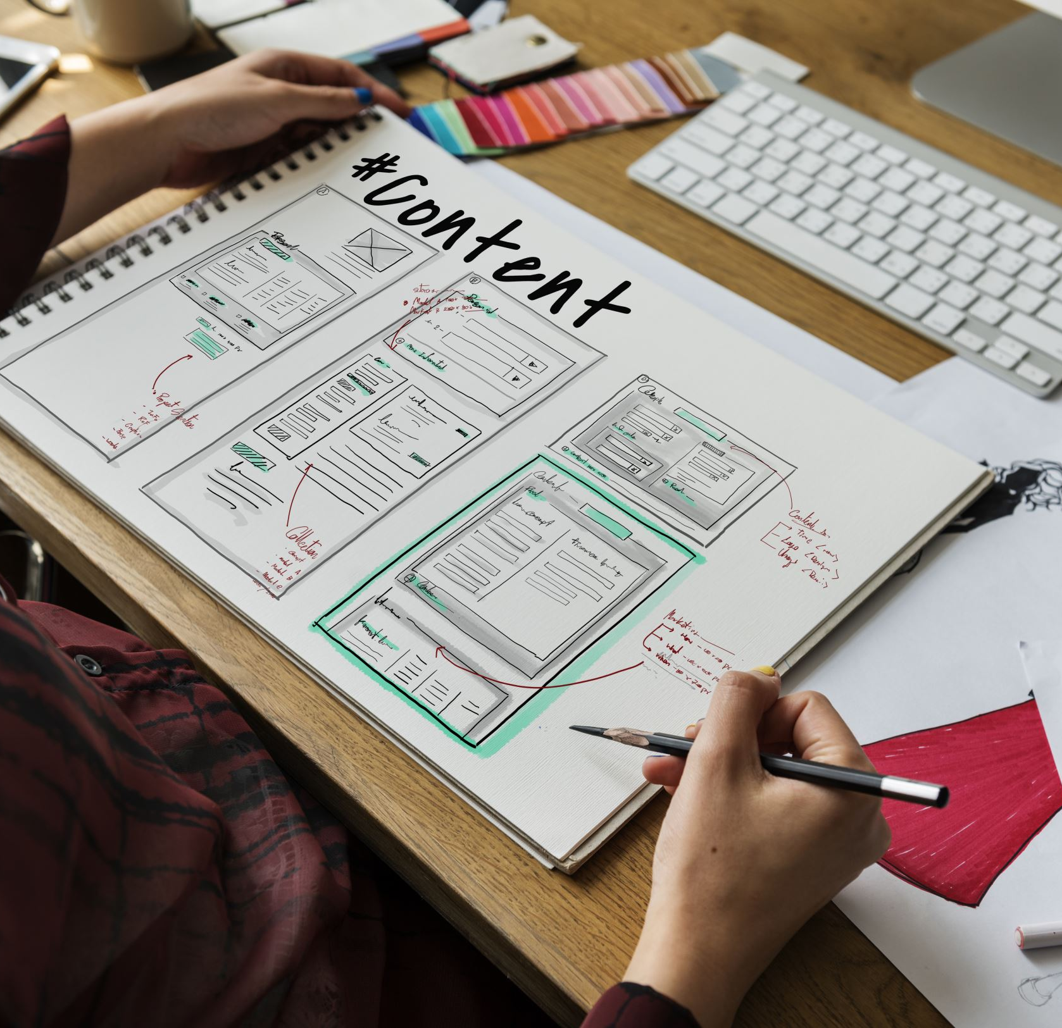
Comprehension Class
Developing Skills
English Department
Sophomore
2022-2023

Slide 2
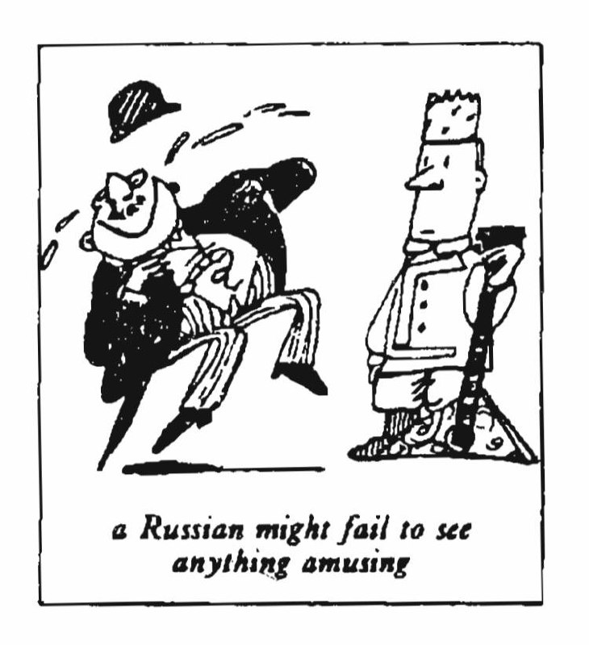
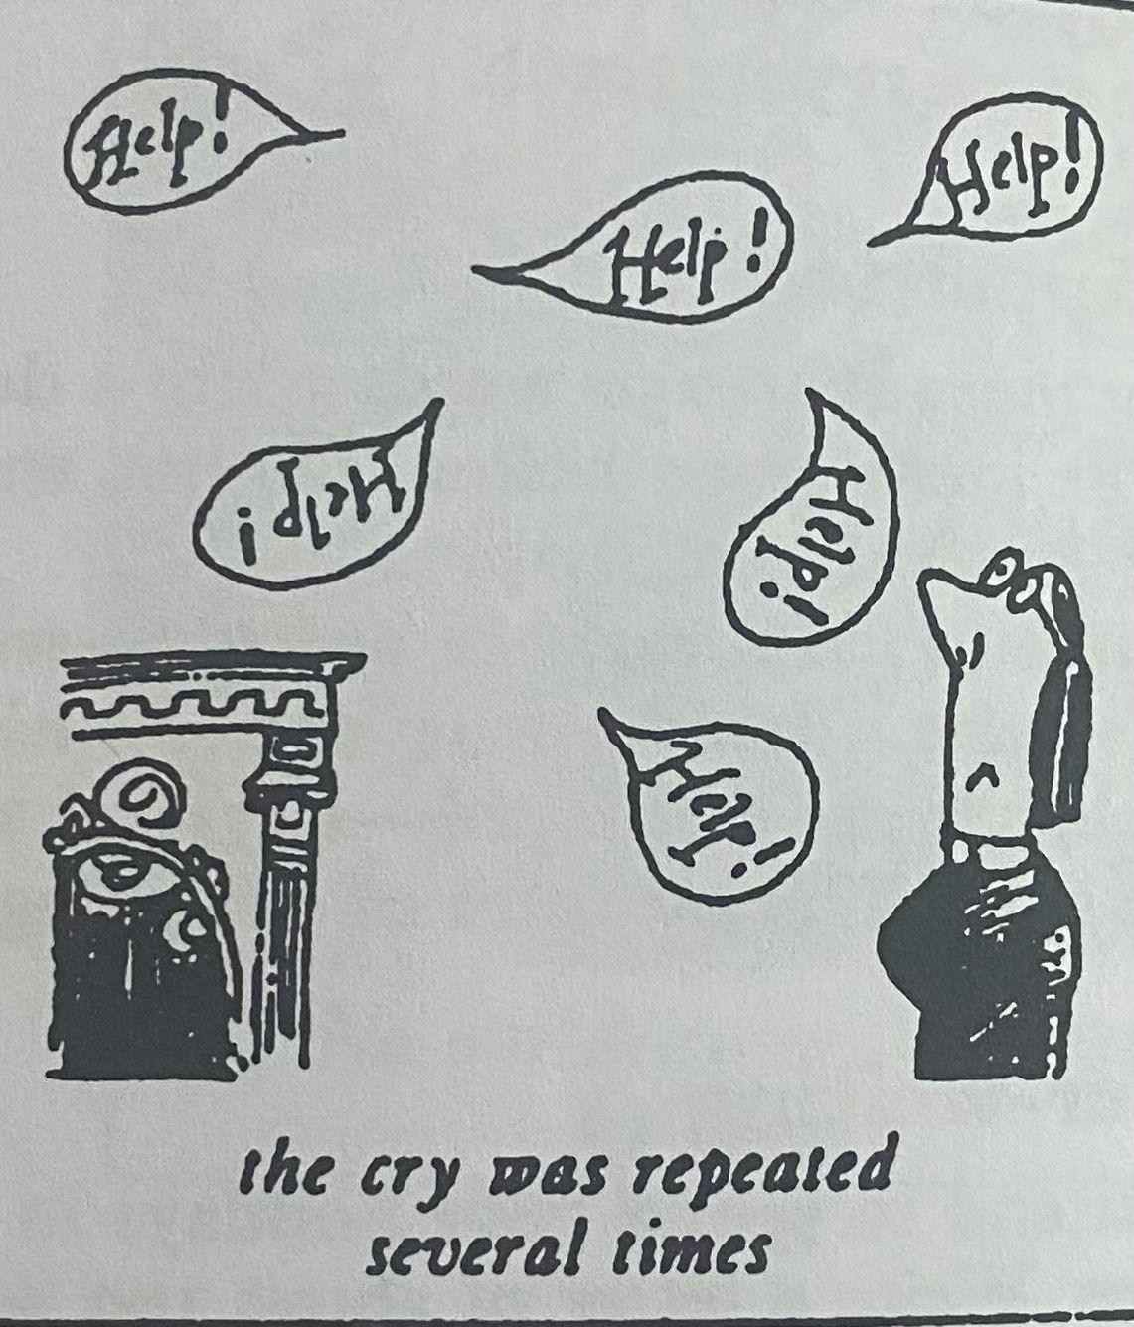
Justice Was Done!

Slide 3
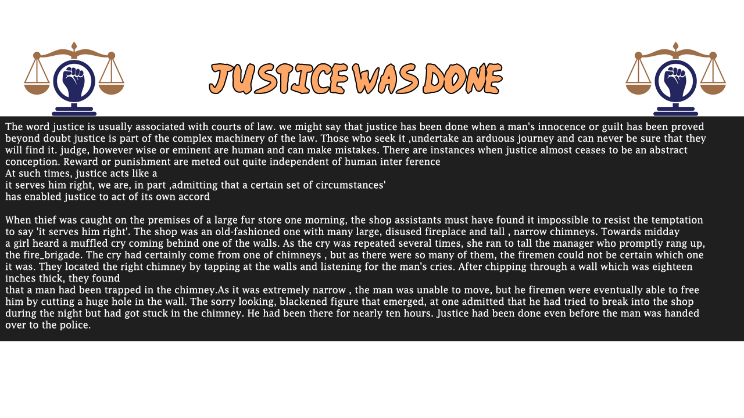

Slide 4
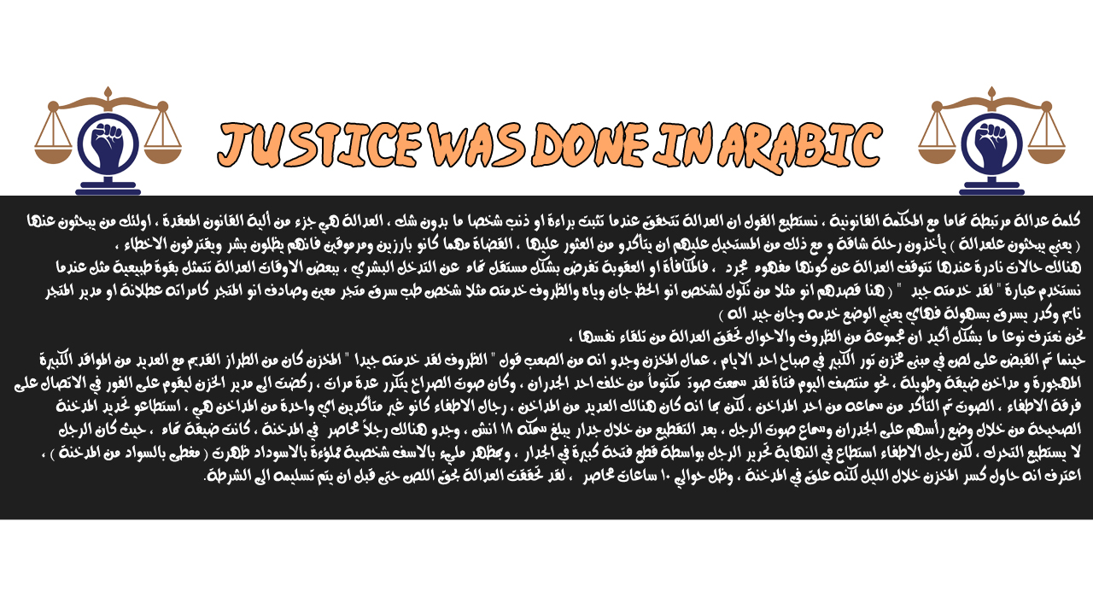

Slide 5
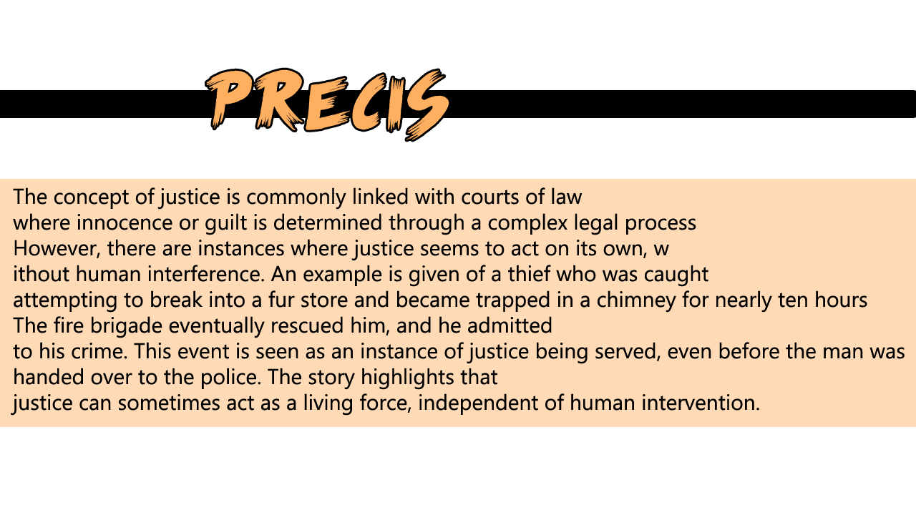

Slide 6
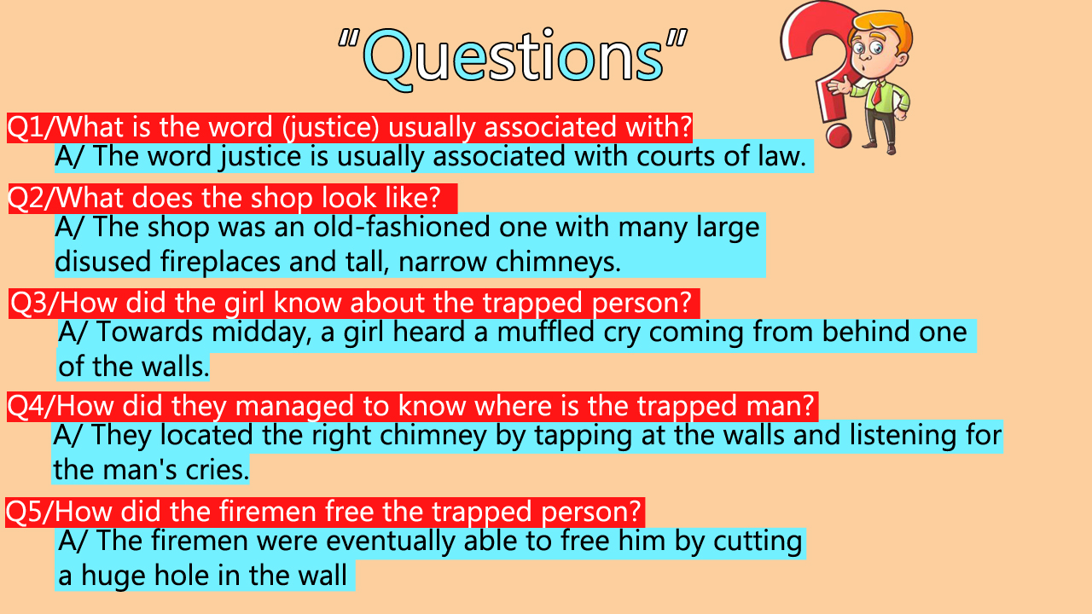

Slide 7
Q2/ T/F Questions:
1) The word justice is usually associated with courts of law. (T)
2) Those who seek justice, undertake an easy journey and can be sure that they will find it. (F)
3) The fireman could not be certain which one it was, the located the right chimney by tapping at the walls and listening for the man’s cries. (T)

Slide 8
vocabulary
1. Guilt = Responsibility for wrongdoingالذنب (N.)
2. Eminent = Prominent مشهور(Adj.)
3. Chimney = Pipe for smoke or gases مدخنة(N.)
4. Tapped = Unable to moveمحاصر (V.)
5. Innocence = Not guilty بريء(Adj.)
6. Arduous = Difficult صعب (Adj.)
7. Justice = Fairness عدالة(N.)
8. Cases = Claims قضية او دعوى(N.)
9. Law = Ruleقانون (N.)
10. Journey = Tripرحلة (N.)

Slide 9
Grammar
First sentences (present simple), second sentence (present perfect passive voice has/have+been+p.p.)
  He says that justice has been served.
  He wants to know if justice has been solved.
  He believes that justice has been done.
Present prefect (has/have+p.p.)
  The moment he has arrived, he was guilty.
  Now that you have finished, you are free.
Past prefect passive voice (had+been+p.p.)
  They found a man who had been trapped in the chimney which it was eighteen inches thick by they chipped through a wall.

Slide 10
Grammar
4. What is the plural of the following words:
  A. Valley – Valleys
  B. Baby – Babies
  C. Day – Days
  D. Bobby – Bobbies
  E. Army – Armies
  F. Money – Moneys
  G. Victory – Victories
  H. Turkey – Turkeys
  I. Story – Stories

Slide 11
Grammar
5. Choose the correct verb:
The sorry–looking blackened figure that emerged at once (admitted, admitting, admires). That he had (trying, tried, tries) to break into the shop during the night. But had (got, getting, get) stuck in the chimney, He (been, had been, be) there for nearly ten hours, justice had been (done, doing, did) even before the man was handed over to the police.

Slide 12
