Slide 1
Comprehension Class Developing Skills
English Department
Sophomore
2022-2023

Slide 2
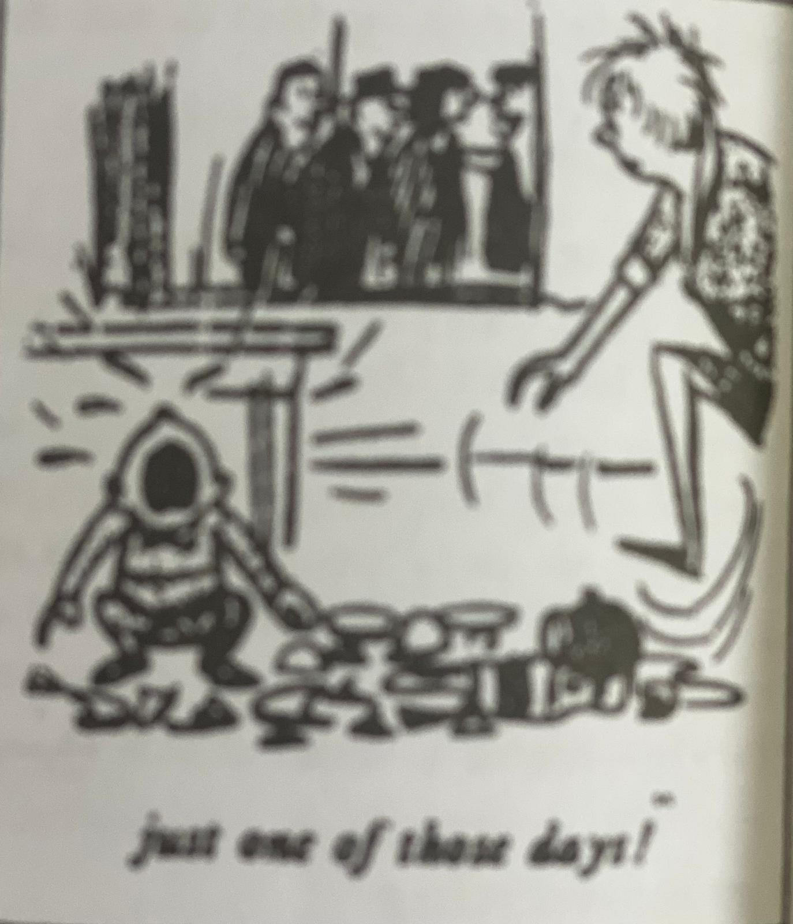
A Day to Remember!

Slide 3
We all have experienced days when everything goes wrong. A day may begin well enough, but suddenly everything seems to get out of control. What invariably happens is that a great number of things choose to go wrong at precisely the same moment. It is as if a single unimportant event set up a chain of reactions. Let us suppose that you are preparing a meal and keeping an eye on the baby at the same time. The telephone rings and this marks the prelude to an unforeseen series of catastrophes. While you are on the phone, the baby pulls the table-cloth off the table, smashing half your best crockery and cutting himself in the process. You hang up hurriedly and attend to the baby, crockery, etc. Meanwhile, the meal gets burnt. As if this were not enough to reduce you to tears, your husband arrives, unexpectedly bringing three guests to dinner.

Slide 4
Things can go wrong on a big scale as a number of people recently discovered in Parramatta, a suburb of Sydney. During rush hour one evening, two cars collided and both drivers began to argue. The woman immediately behind the two cars happened to be a learner. She suddenly got into a panic and stopped her car. This made the driver following her brake hard. His wife was sitting beside him holding a large cake. As she was thrown forward, the cake went right through the windscreen and landed on the road. Seeing a cake flying through the air, a lorry-driver who was drawing up alongside the car, pulled up all of a sudden. The lorry was loaded with empty beer bottles and hundreds of the slid off the back of the vehicle and on to the road. This led to yet another angry argument. Meanwhile, the traffic piled up behind. It took the police nearly an hour to get the traffic on the move again. In the meantime, the lorry-driver had to sweep up hundreds of broken bottles. Only two stray dogs benefited from all the confusion, for they greedily devoured what was left of the cake. It was just one of those days!

Slide 5
Precis:
In general, the paragraph talks about the negatives that we may encounter in our daily lives. Man is known for many annoying and difficult situations every day. Simple things can be the cause of big problems, or they can be the cause obstructing our entire day. As mentioned by the examples in the piece how a simple traffic jam was the cause of creating a big problem and suffocating congestion. Also, the presence of the child and his pulling of the cloth on the table led to the creation of major problems and the complete destruction of the household items. Therefore, we have to face such things in a positive way and try as much as possible to reduce them.

Slide 6
Comprehension Questions:
Q1/ Answer the following using what you have learned from the paragraph:
1. What can happen if you are distracted while doing something else?
-You may have an accident or make a mistake.
2. What can happen when everything seems to go wrong at the same time?
-It can create a chaotic situation.
3. Can unexpected events cause problems during daily activities?
-Yes, unexpected events can cause problems and lead to changes in plans.
4. What happened to the cake during the car collision in Parramatta?
-The cake was thrown through the windscreen and landed on the road.
5. What is the unexpected event?
- Husband arrives with three guests for dinner.

Slide 7
Q2/ T/F questions:
1. Was the wife carrying a big meal? ( F) She was carrying a big cake.
2. Is the woman behind the two cars a learner? ( T)
3. Only one stray dog benefited from all this confusion? (F) Two stray dogs.
4. Did the dogs greedily devour what was left of the cake? (T)
5. Does it take the police nearly a week to get the traffic on the move again?
( F) an hour.

Slide 8
Vocabulary
1-Discovere: find out (v.)
2-Beside: next to (pre.)
3-Suppose: assume (v.)
4- Prelude: introduction (n.)
5-Unforeseen: sudden (adj.)
6-Confusion: distraction (n.)
7-Chaos: a state of disorder (n.)
8-Collide: crash into each other (v.)
9-Panic: sudden fear (n.)
10-Devoure: eat quickly (v.)

Slide 9
Grammar
1. Write different sentences using the following words :
(experienced , a lot of experience)
(good enough , enough money, fairly)
We all have experienced (V.) bad and good memories in our life.
We gained a lot of experience (N.) in our last workshop.
They have enough money to buy a car.
It is not the best car but good enough for me.
He could not fairly (adv.) be accused of wasting police time.

Slide 10
Grammar
2. Write different sentences explaining the following:
(discover, invent)
(beside, besides)
Yesterday, she discovered the world of online forums.
Peter invented a new way to collect solar energy.
Come at sit beside me.
Besides Fay, who else went to the concert?

