Slide 1
Comprehension Class Developing Skills
English Department
Sophomore
2022-2023

Slide 2
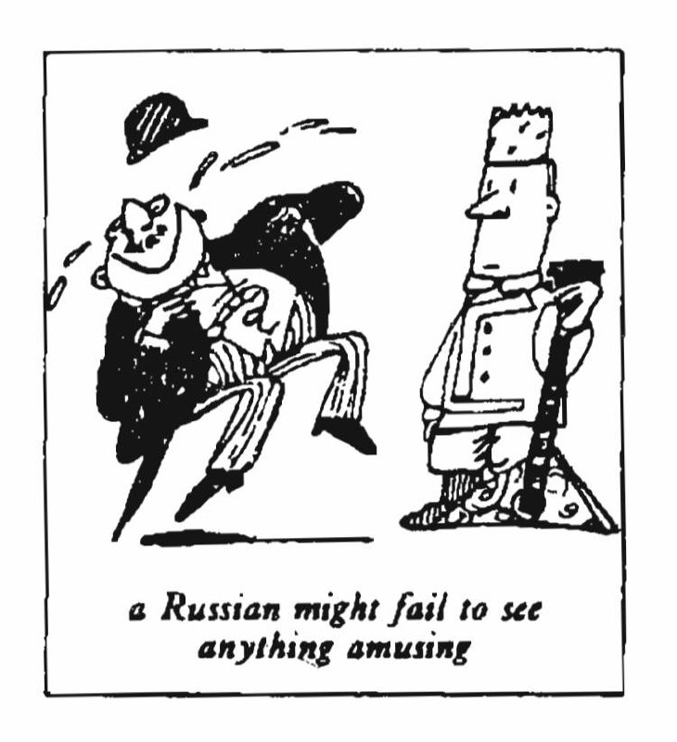
Funny or not?

Slide 3
Whether we find a joke funny or not largely depends on where we have been brought up. The sense of humor is mysteriously bound up with national characteristics. A Frenchman, for instance, might find it hard to laugh at a Russian joke. In the same way, a Russian might fail to see anything amusing in a joke which would make an Englishman laugh to tears. Most funny stories are based on comic situations. In spite of national differences, certain funny situations have a universal appeal. No matter where you live, you would find it difficult not to laugh at, say, Charlie Chaplin's early films. However, a new type of humor, which stems largely from America, has recently come into fashion. It is called 'sick humor. Comedians base their jokes on tragic situations like a violent death or serious accidents. Many people find this sort of joke distasteful. The following example of 'sick humor' will enable you to judge for yourself.

Slide 4
A man who had broken his right leg was taken to hospital a few weeks before Christmas. From the moment he arrived there, he kept on pestering his doctor to tell him when he would be able to go home. He dreaded having to spend Christmas in the hospital. Though the doctor did his best, the patient’s recovery was slow. On Christmas day, the man still had his right leg in plaster. He spent a miserable day in bed thinking of all the fun he was missing. The following day, however; the doctor consoled him by telling him that his chances of being able to leave the hospital in time for New Year celebrations were good. The man took hearts and, sure enough, on New Year’s Eve he was able to hobble along to a party. To compensate for his unpleasant experiences in the hospital, the man drank a little more than was good for him. In the process, he enjoyed himself thoroughly and kept telling everybody how much he hated hospitals. He was still mumbling something about hospitals at the end of the party when he slipped on a piece of ice and broke his left leg.

Slide 5
Precis:
The sense of humor is linked to national characteristics, which can affect whether someone finds a joke funny or not. Despite these differences, there are certain funny situations that have universal appeal. However, a newer type of humor called "sick humor" has emerged from America, which is based on tragic situations such as violent death or serious accidents. This type of humor can be controversial and not appreciated by everyone. The article provides an example of this type of humor in a joke about a man who breaks his leg and spends Christmas in the hospital. Despite being able to leave for New Year's Eve, he gets drunk and breaks his other leg, still talking about his hatred for hospitals.

Slide 6
Comprehension Questions:
Q1/ Answer the following using what you have learned from the paragraph:
1 What is the sense of humor bound up with?
The sense of humor bounds up with national characteristics.
2 Who is Charlie Chaplin?
Charlie Chaplin is an English comedian.
3 Where did the ‘sick humor' come from?
The sick humor mostly came from America.
4 Why was the man pestering the doctor?
He was pestering the doctor so he tells the man when he could go home.
5 What was the man thinking about when he spent a miserable day in bed?
The man was thinking about the fun he missed when he spent a miserable day in bed.

Slide 7
Q2/ Fill in the blanks with the proper answers:
1 In 'sick humor’, comedians base their jokes on ……………(tragic situation).
2 A man who had broken his ………….(right leg) was taken to a hospital a few weeks before Christmas.
3 While he was celebrating, the man told everyone that he …………... (hates hospitals).
4 At the end of the party, He slipped on ………………(a piece of ice) and broke his …………. (the left leg).

Slide 8
vocabulary
1)- recently = newly (adv.)
2)- distasteful = unpleasant (adj.)
3)- dread = scare (v.)
4)- miserable = unhappy (adj.)
5)- celebrations = party (n.)
6)- compensate = reward (v.)
7)- console = feel for him (v.)
8)- mumbling = stammer (n.)
9)- pester = annoy (v.)
10)- amuse = make laugh (v.)

Slide 9
Grammar
1. Write different sentences using the following:
(laugh, laugh at)
(amuse يسلي, enjoy يستمتع , entertain يرفه ).
She gave a loud, silly laugh (N.).
He might find it hard to laugh at (V.) the Arabian joke
He made faces to amuse her.
I really enjoyed watching the movie with you last night.
I am not here to entertain you.

Slide 10
Grammar
2. write different sentences using the following:
(keep off = to prevent, keep out = to stop, keep up with = to stay)
They lit a fire to keep off wild animals. (to prevent somebody/something from coming near)
Let’s keep out of her way while she is in such a bad mood. (to not go to a place, or to stop someone or something from going into a place)
The other runners struggled to keep up with the leader. (to do whatever is necessary to stay level equal with someone or something)

Slide 11
Grammar
3. Write different sentences using the following:
(could, was able to)
He could run faster than anyone else.
I was able to answer their questions.

