Slide 1
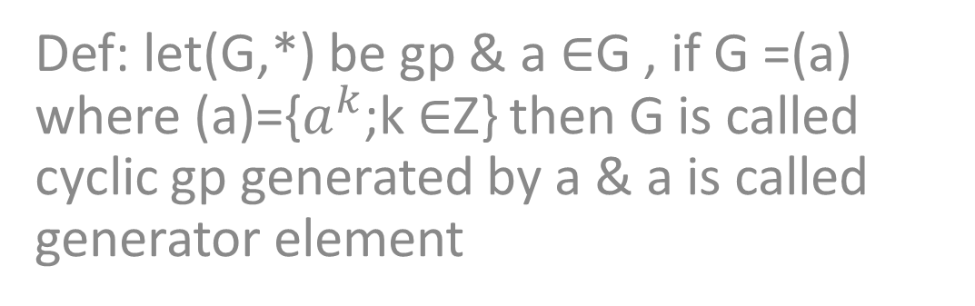
Cyclic group
Def: let(G,*) be gp & a $∈$G , if G =(a) where (a)={$a^{k}$;k $∈$Z} then G is called cyclic gp generated by a & a is called generator element

Slide 2
example
1- in (Z,+) ,{-1 , 1} are generator element
2- in( {1,-1,I,-i}.),{i, -i} are generator element
So (Z,+) & {1,-1,I,-i}are cyclic group

Slide 3
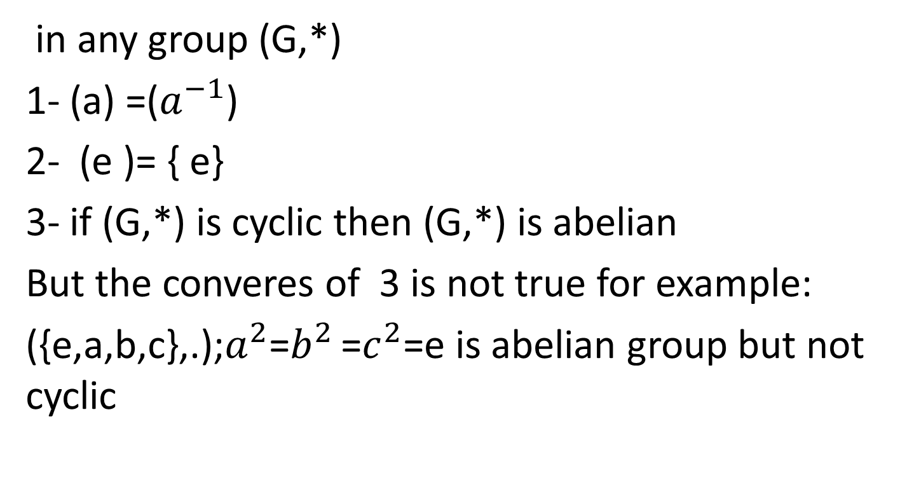
theoremes
in any group (G,*)
1- (a) =($a^{−1}$)
2- (e )= { e}
3- if (G,*) is cyclic then (G,*) is abelian
But the converes of 3 is not true for example:
({e,a,b,c},.);$a^{2}$=$b^{2 }$=$c^{2}$=e is abelian group but not cyclic

Slide 4

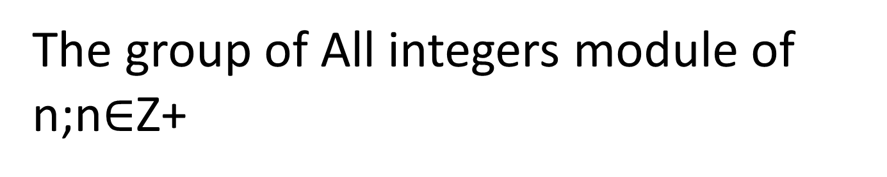
The group of All integers module of n;n$∈$Z+
Def: let n$∈$Z+ & a,b $∈$ Z,a is said to be congurent to b modul of n iff a-b=kn ,for some k$∈$Z and denoted by a$≅$b (mod n) .
example: 47 $≅($-1) (mod 12) since 47-(-1)=48

Slide 5
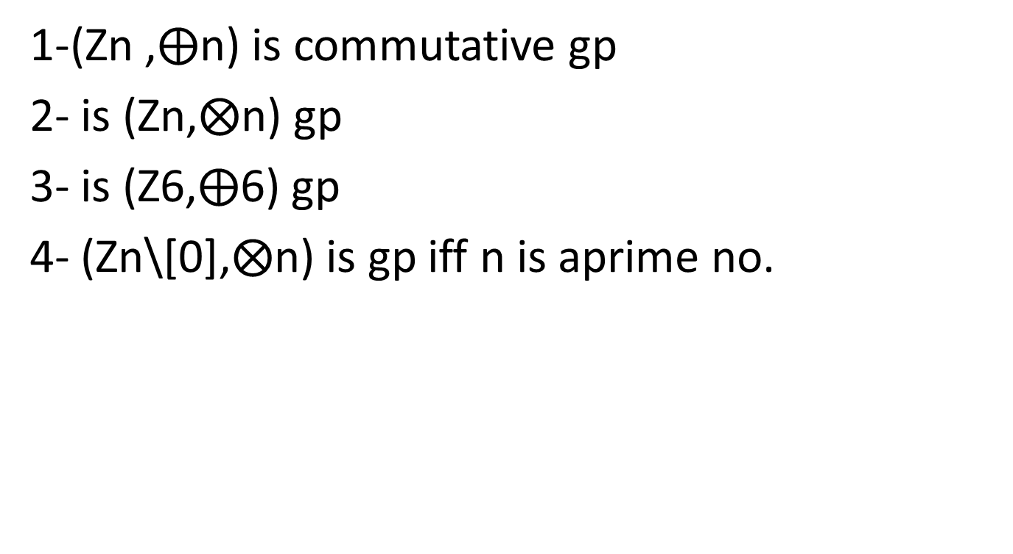
exercies
1-(Zn ,$⨁$n) is commutative gp
2- is (Zn,$⨂$n) gp
3- is (Z6,$⨁$6) gp
4- (Zn\[0],$⨂$n) is gp iff n is aprime no.

