Slide 1
Group
Definition of identity element: amathematical system is said to have an identity element e if a*e=e*a =a for each a in G

Slide 2
Invertable element
Definition: let(G,*)be M.Swith identity element if a*a^-1=a^-1*a=e then a^-1 is called inverse element

Slide 3
Definition of group
Let G be anon empty set and * be binary operation on G then (G,*)is group if satisfied the following codition
1-the binary operation * is associative
2- there is an element e inG s.t e*x=x*e=x
3-for each a in G,there is an element ( a)^-1 in G s.t a*a^-1=a^-1*a=e

Slide 4
example
1-(Z,x) is semi-gp but not gp
2-(Q/{0},X) IS GP

Slide 5
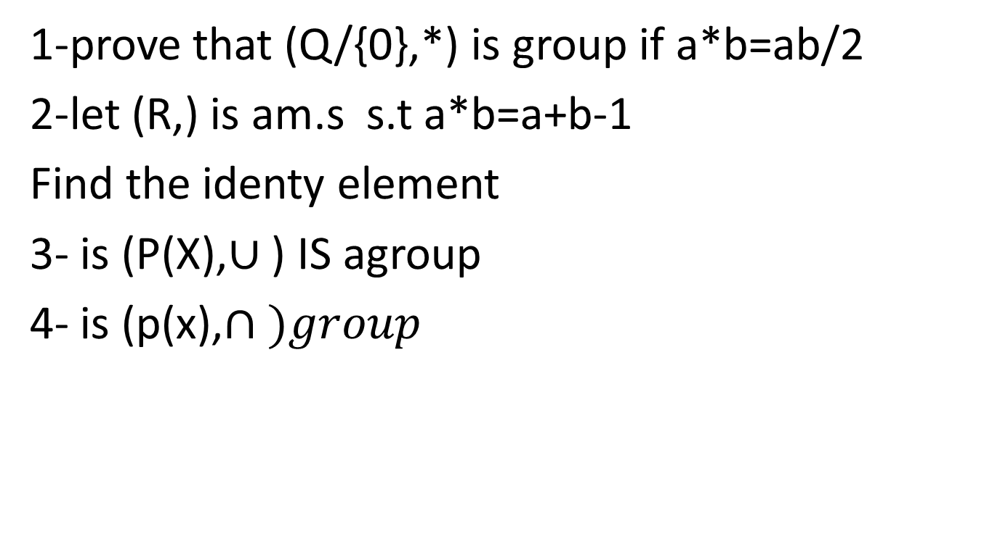
Exersies
1-prove that (Q/{0},*) is group if a*b=ab/2
2-let (R,) is am.s s.t a*b=a+b-1
Find the identy element
3- is (P(X),$∪$ ) IS agroup
4- is (p(x),$∩ )group$

