Slide 1
المحاضرة التاسعة
اذا كان فضاء العينة مستمر

Slide 2
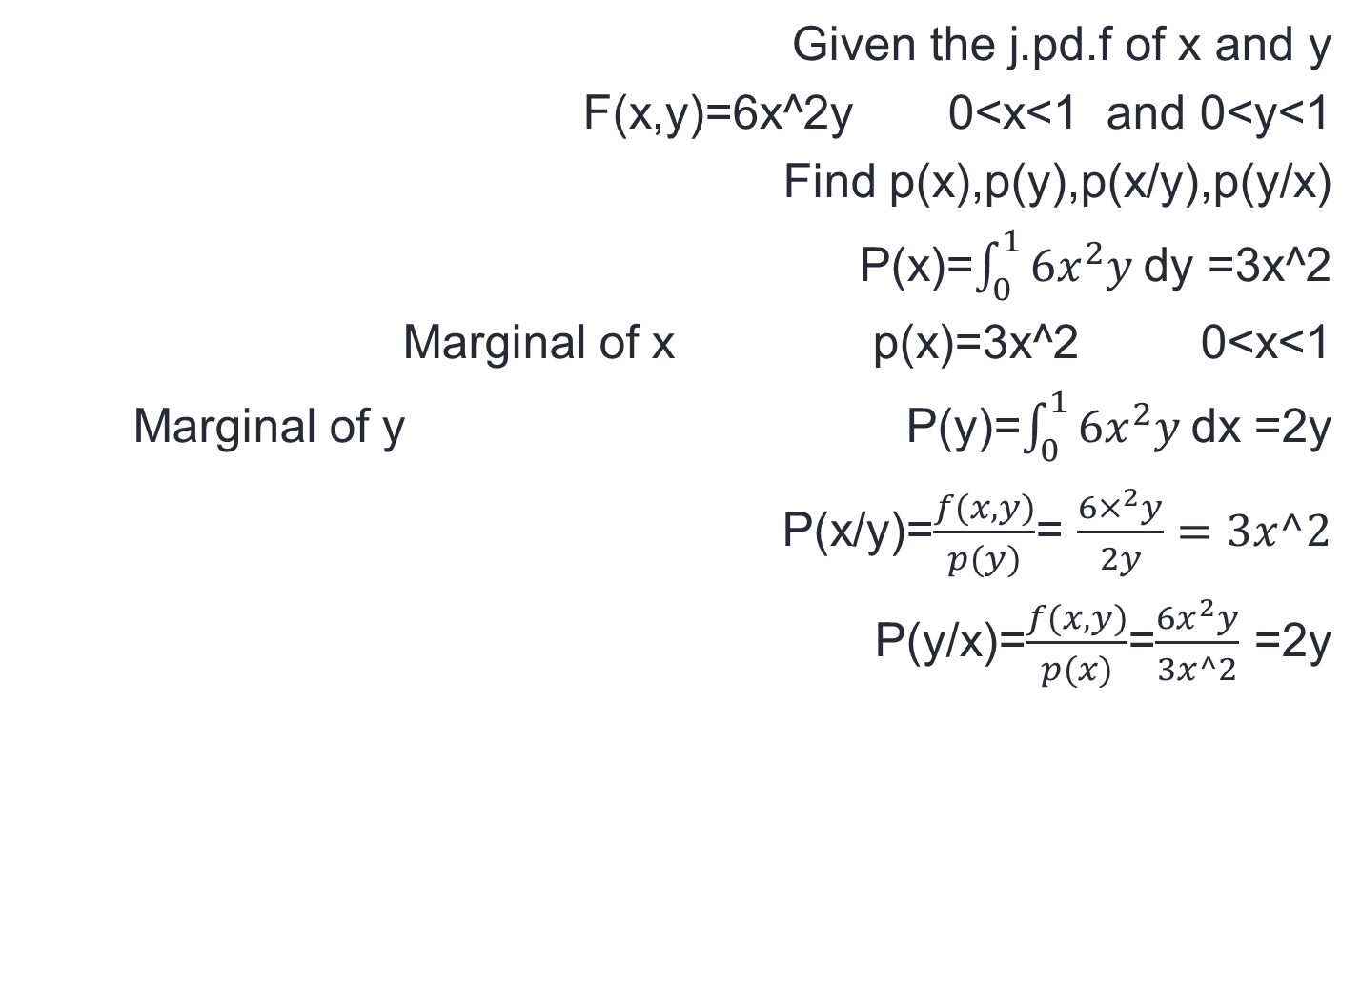
Given the j.pd.f of x and y
F(x,y)=6x^2y 0<x<1 and 0<y<1
Find p(x),p(y),p(x/y),p(y/x)
P(x)=$\int_{0}^{1}{6x^{2}y }$dy =3x^2
Marginal of x p(x)=3x^2 0<x<1
P(y)=$\int_{0}^{1}{6x^{2}y }$dx =2y Marginal of y
P(x/y)=$\frac{f(x,y)}{p(y)}$= $\frac{6×^{2}y}{2y}=3x^2$
P(y/x)=$\frac{f(x,y)}{p(x)}$=$\frac{6x^{2}y}{3x^2}$ =2y

Slide 3
indepent
X,y are indepent iff Exy=ExEY
Or
Cov(x,y)=0 iff x,y are indepent
Or
P(x,y)=p(x)p(y) iff x,y are indepent

