Slide 1
المحاضرة السابعة
اذا كان فضاء العينة مستمر

Slide 2
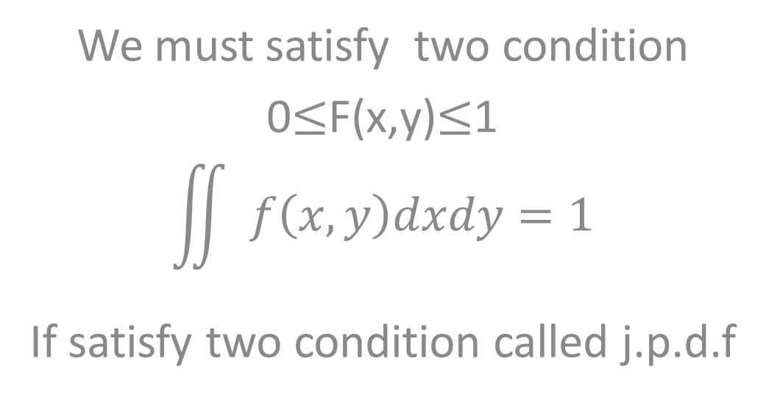
if f( x,y) are continuous
We must satisfy two condition
0$≤$F(x,y)$≤$1
$$\iint{ f\left(x,y\right)dxdy=1}$$
If satisfy two condition called j.p.d.f

Slide 3
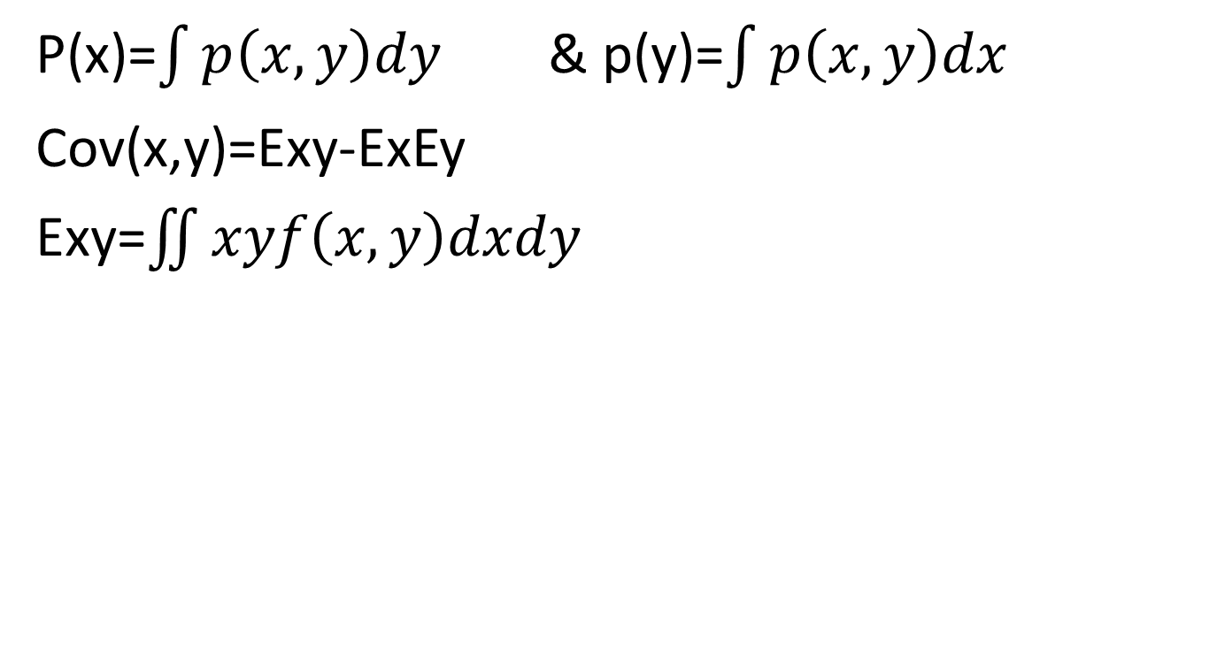
بعض القوانين المهمة في هذا الفصل
P(x)=$\int{p\left(x,y\right)dy}$ & p(y)=$\int{p\left(x,y\right)dx}$
Cov(x,y)=Exy-ExEy
Exy=$\iint{xyf\left(x,y\right)dxdy}$

Slide 4
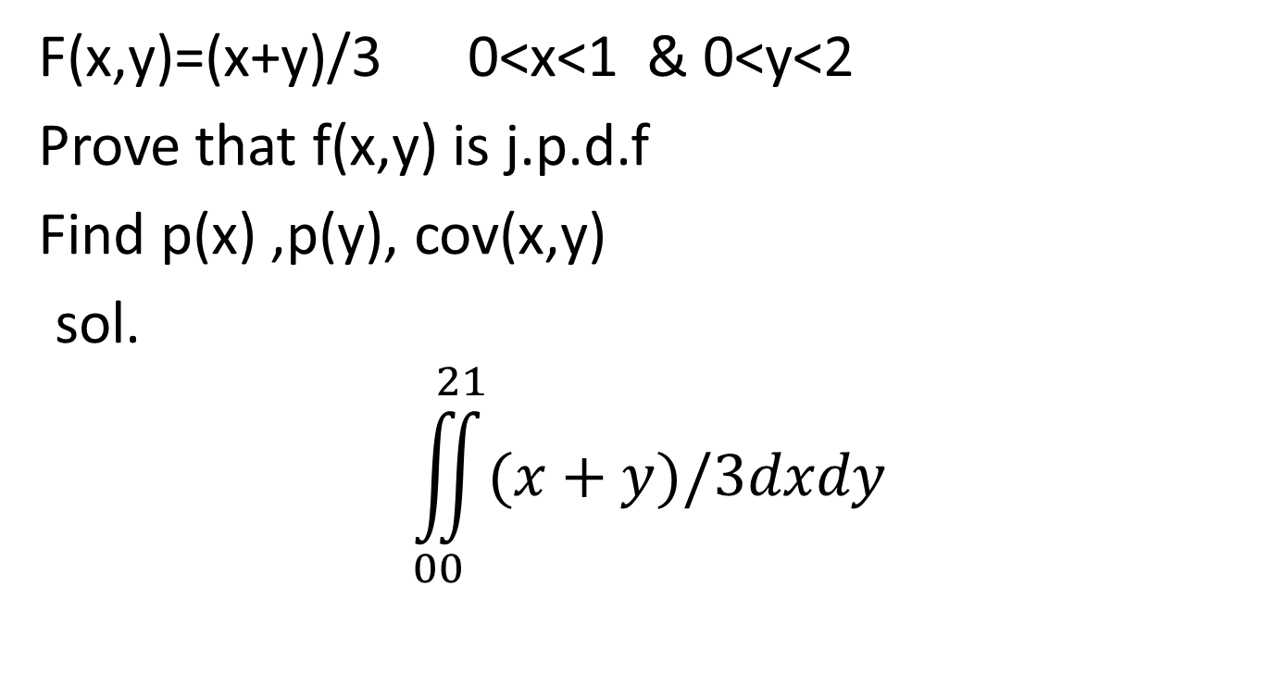
example
F(x,y)=(x+y)/3 0<x<1 & 0<y<2
Prove that f(x,y) is j.p.d.f
Find p(x) ,p(y), cov(x,y)
sol.
$$\iint_{00}^{21}{(x+y)/3dxdy}$$

Slide 5
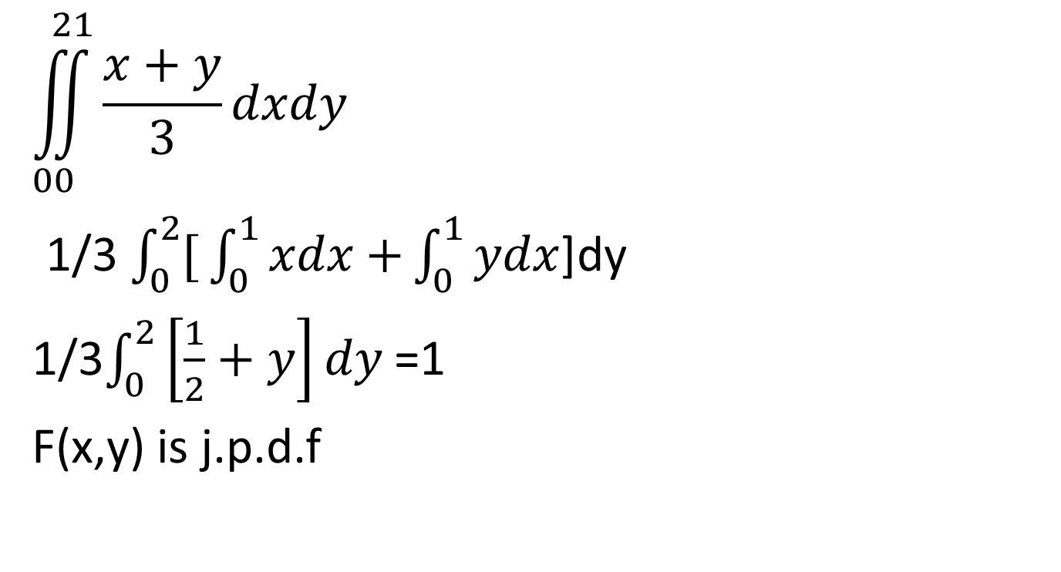
$$\iint_{00}^{21}{\frac{x+y}{3}dxdy}$$
1/3 $\int_{0}^{2}{[}\int_{0}^{1}{xdx+}\int_{0}^{1}{ydx}$]dy
1/3$\int_{0}^{2}{\left[\frac{1}{2}+y\right]dy}$ =1
F(x,y) is j.p.d.f

Slide 6
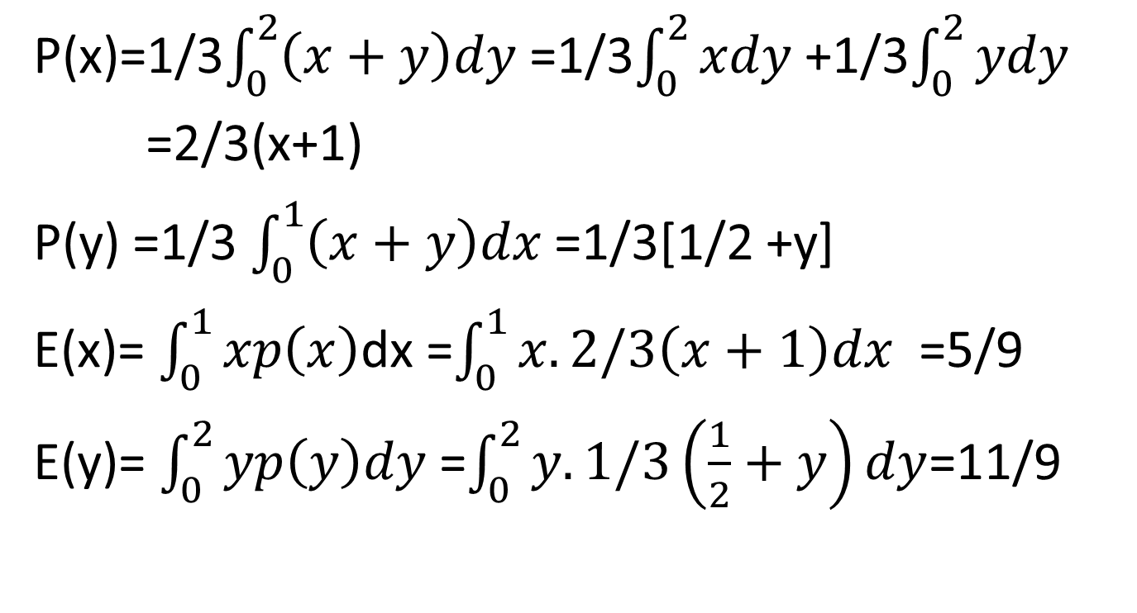
P(x)=1/3$\int_{0}^{2}{\left(x+y\right)dy }$=1/3$\int_{0}^{2}{xdy}$ +1/3$\int_{0}^{2}{ydy}$
=2/3(x+1)
P(y) =1/3 $\int_{0}^{1}{\left(x+y\right)dx }$=1/3[1/2 +y]
E(x)= $\int_{0}^{1}{xp\left(x\right)}$dx =$\int_{0}^{1}{x.2/3\left(x+1\right)dx}$ =5/9
E(y)= $\int_{0}^{2}{yp\left(y\right)dy}$ =$\int_{0}^{2}{y.1/3\left(\frac{1}{2}+y\right)dy}$=11/9

Slide 7
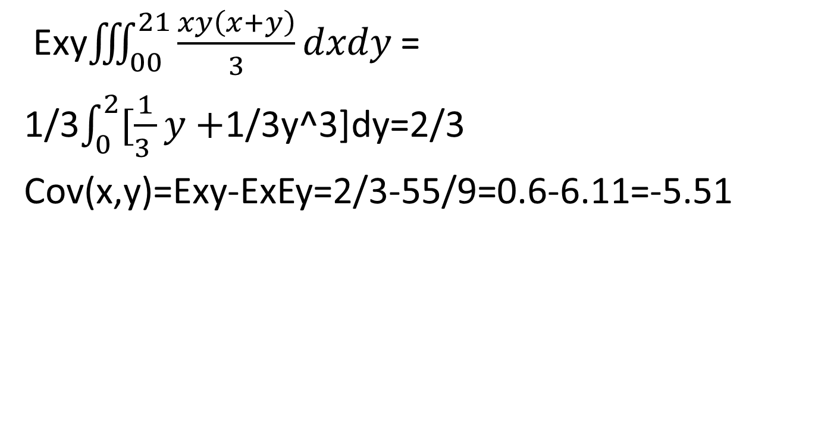
Exy$\iiint_{00}^{21}{\frac{xy\left(x+y\right)}{3}dxdy }$=
1/3$\int_{0}^{2}{[\frac{1}{3 }y+}$1/3y^3]dy=2/3
Cov(x,y)=Exy-ExEy=2/3-55/9=0.6-6.11=-5.51

Slide 8
قانون معامل الارتباط
rx,y=(cov(x,y)/(var(x).var(y))^1/2
بالنسبة للمثال السابق
rx,y=-5.51/(var(x).var(y)^1/2

