Slide 1
المحاضرة السادسة احتمالات متقدمة
محاضرات بوربوينت

Slide 2
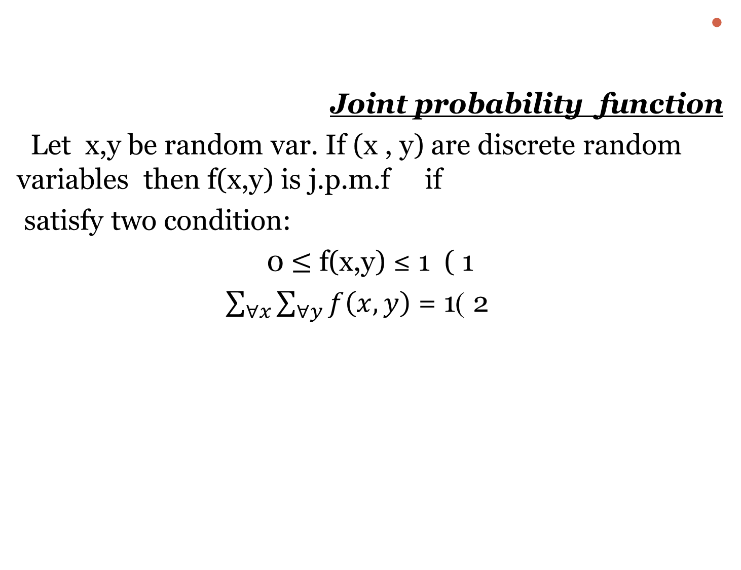
Joint probability function
Let x,y be random var. If (x , y) are discrete random variables then f(x,y) is j.p.m.f if
satisfy two condition:
1 ( 1 0 $≤$ f(x,y) ≤
2 ) $\sum_{∀x}{\sum_{∀y}{f\left(x,y\right)}}$ = 1

Slide 3
Ex : let f(x,y)= (x+y)/15 x=1,2 y=0,1,2
Find p(x=2,y=1) =3/15
P(x≤ 2,y=2) =px=2,y=2+
4/15 +3/15 =7/15
x/y | 0 | 1 | 2 | P(x)
1 | 1/15 | 2/15 | 3/15 | 6/15
2 | 2/15 | 3/15 | 4/15 | 9/15
P(y) | 3/15 | 5/15 | 7/15 | 1

Slide 4

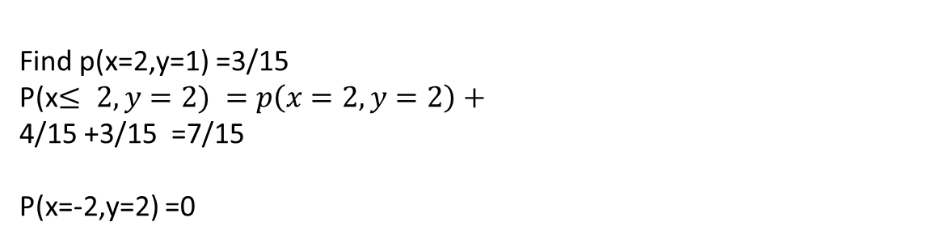
Find p(x=2,y=1) =3/15
P(x$≤ 2,y=2) =p\left(x=2,y=2\right)+$
4/15 +3/15 =7/15
P(x=-2,y=2) =0

