Slide 1
المحاضرة الثالثة احتمالات متقدمة
محاضرات بوربوينت

Slide 2
Ex: let x be arandom variable with the probability function
x 1 2 3
P(x) 1/4 1/4 1/2
-pr0ve that p(x) is p.m.f
-draw fiqure
-find p(x=1), p(x>1) p(x≥1)
-find E(x) ,E(x+4),E(2x-8)
- find variance of x

Slide 4
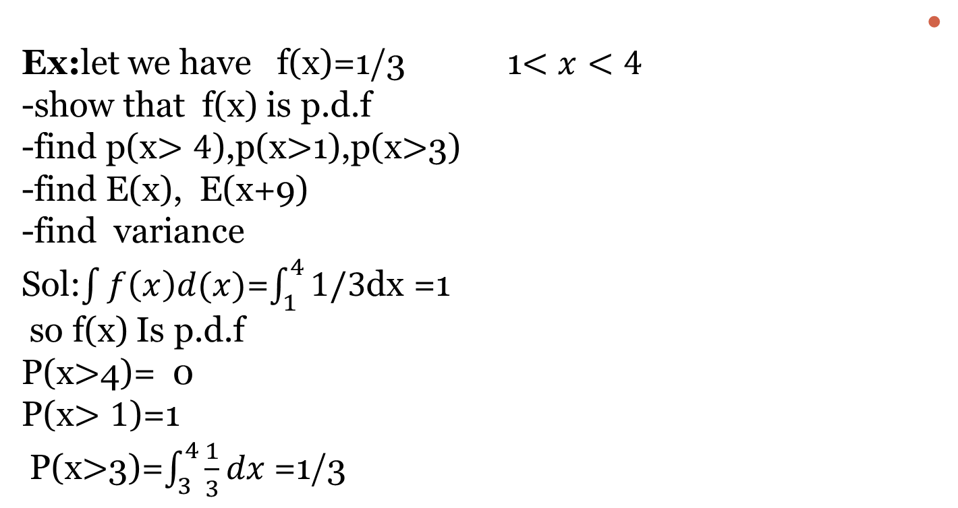
Ex:let we have f(x)=1/3 1$<x<4$
-show that f(x) is p.d.f
-find p(x$>4$),p(x$>$1),p(x$>$3)
-find E(x), E(x+9)
-find variance
Sol:$\int{f\left(x\right)d(x)}$=$\int_{1}^{4}{1/3}$dx =1
so f(x) Is p.d.f
P(x$>$4)= 0
P(x$>1$)=1
P(x$>$3)=$\int_{3}^{4}{\frac{1}{3}dx}$ =1/3

