Slide 1

م.رواء ابراهيم عيسى

Slide 2
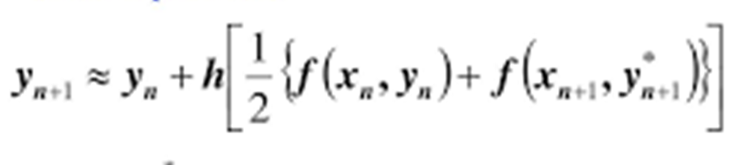


Modified Euler method
In order to get more accurate results than for Euler method ,we define the Modified Euler method ,which has the following general formula:-

Slide 3
The first equ. depends on the second equ. And this way called (Estimation –Correction),becouse from euler equ. We estimate value for y*(x) ,and then in the equ.we get acorrection for this value.

Slide 4
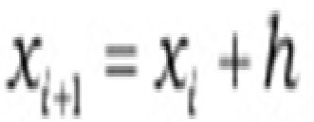
Example1:-
Use modified euler method =x²+y ,y(0)=1,h=0.02 Find y(0.02)?
Solution:
X₀=0, y₀=1 ,h=0.02 , f(x,y)=x²+y
X₁=X₀ + h =0+0.02=0.02
y*= y₀ +hf(X₀, y₀)
= y₀ +h(X²₀ +y₀)
=1+0.02(0²+1)=1+0.02=1.02
₁
₁
y₁= y₀ +h/2[f(X₀, y₀)+f(X₁, y*)]
= y₀ +h/2[(X² +y₀)+ (X² +y*)]
=1+0.02/2[(0²+1)+((0.02)²+1.02)] =1+0.0202=1.0202
₁
₀
₁
₁

Slide 5
Example2:-
Use modified euler method =-xy ,y(0)=0.5,h=0.1 Find y(0.2)?
Solution:
X₀=0, y₀=0.5 ,h=0.1 , f(x,y)=-xy
X₁=X₀ + h
=0+0.1=0.1
X₂=X₁ + h=0.1+0.1=0.2

Slide 6
y*= y₀ +hf(X₀, y₀)
= y₀ +h(-X₀ y₀)
=0.5+0.1(-0×0.5)
=0.5
₁
₁
= y₀ +h/2[f(X₀, y₀)+f(X₁, y*)]
= y₀ +h/2[(-X₀ y₀)+(- X₁ y*)]
=0.5+0.1/2 [(-0×0.5)+(-0.1×0.5)]
=0.5+0.05[-0.05]
=0.4975
₁
₁

Slide 7
y*= y₁ +hf(X₁, y₁)
= y₁ +h(-X₁ y₁)
=0.4975+0.1(-0.1×0.4975)
=0.4925
₂
= y₁ +h/2[f(X₁, y₁)+f(X₂, y*)]
= y₁ +h/2[(-X₁ y₁)+(- X₂ y*)]
=0.4975+0.1/2 [(-0.1×0.4975)+(-0.2×0.4925)]
=0.5+0.05[-0.05]
=0.4901
₂
₂

