Slide 1
حل اسئلة امتحان الشهر الأول
التحليل العددي

Slide 3
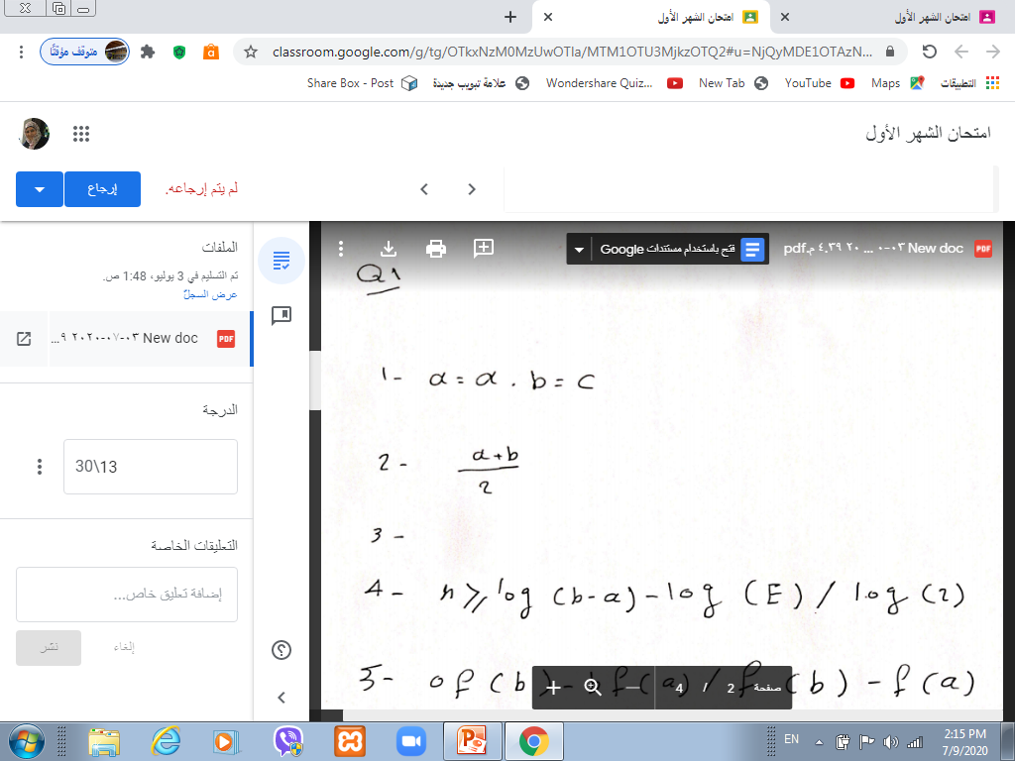

Slide 4
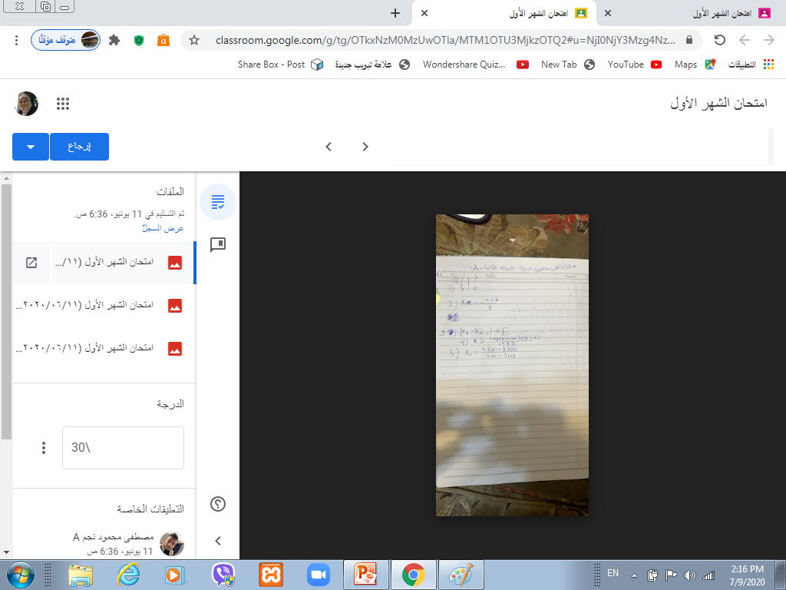

Slide 6
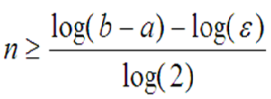
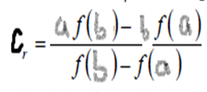
Q1:-- Fill in the blanks:-
1(If ƒ(c) ƒ(a) < 0,then the root belongs to---------
2) In bisection method ,we generate x by------------
3)the cessation clouse to generate the points is-------------
4) the no of iteration in bisection method satisfy the equ.--------
5)In false position method to generate the points x=---------
[a,c]
a+b/2
ǀ x_{n}-x_{n-1} ǀ<ϵ

Slide 7
Q2:-- Write correct or incorrect with discussion:-
1) Bisection method can’t find the approximate root of ƒ(x) =1+e^{-x} ,on [0,1], Є=0.01.
1)Correct
Ƒ(a)= 1+e⁻⁰=2
Ƒ(b)= 1+e⁻¹=1.3678
since Ƒ(a)* Ƒ(b)>0 then bisection can not find the root

Slide 8
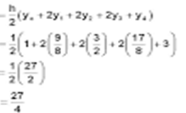
2) Trapizume role $\int_{0}^{4}{\frac{1}{8}x^{2}+1}$ dx ≈10.75, where n=4
First, h = = (b-a)/n =(4 - 0)/4 = 1,
X_{i}=a+ih i=0,1,2,..,n
X₀=0+0*1=0 X₀=a
X₁=0+1*1=1
X₂=0+2*1=2
X₃=0+3*1=3
X₄=0+4*1=4 X_{n}=b
$\int_{0}^{4}{\frac{1}{8}x^{2}+1}$=
=6.75

Slide 9
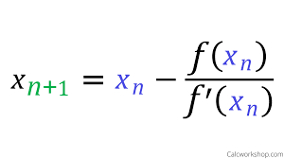
Q3:- Write three iteration using Newton- Raphson metod where
ϵ=0.00001
Ƒ(x)=2-e^{x}
Ƒʹ(x)=-e^{x}

