Slide 2
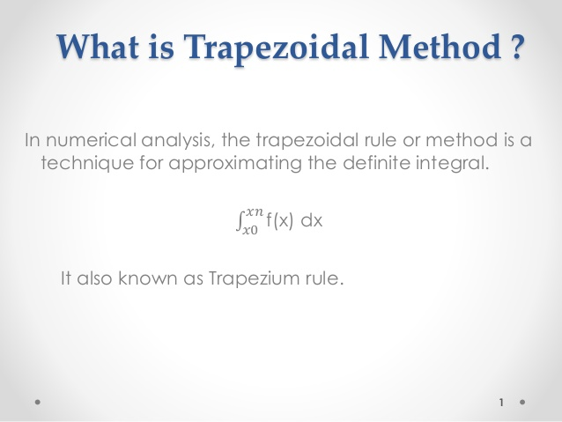

Slide 3
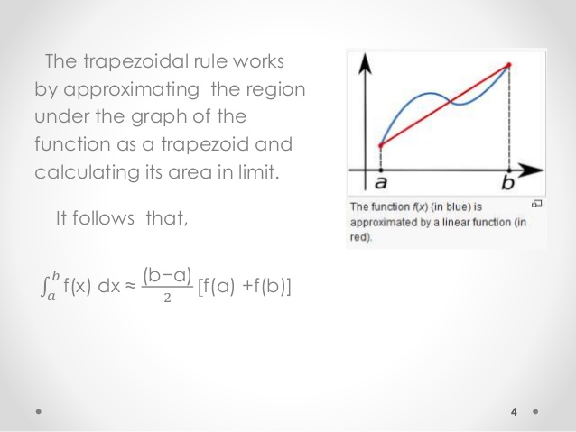

Slide 4
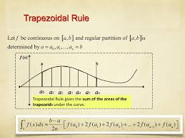

Slide 5
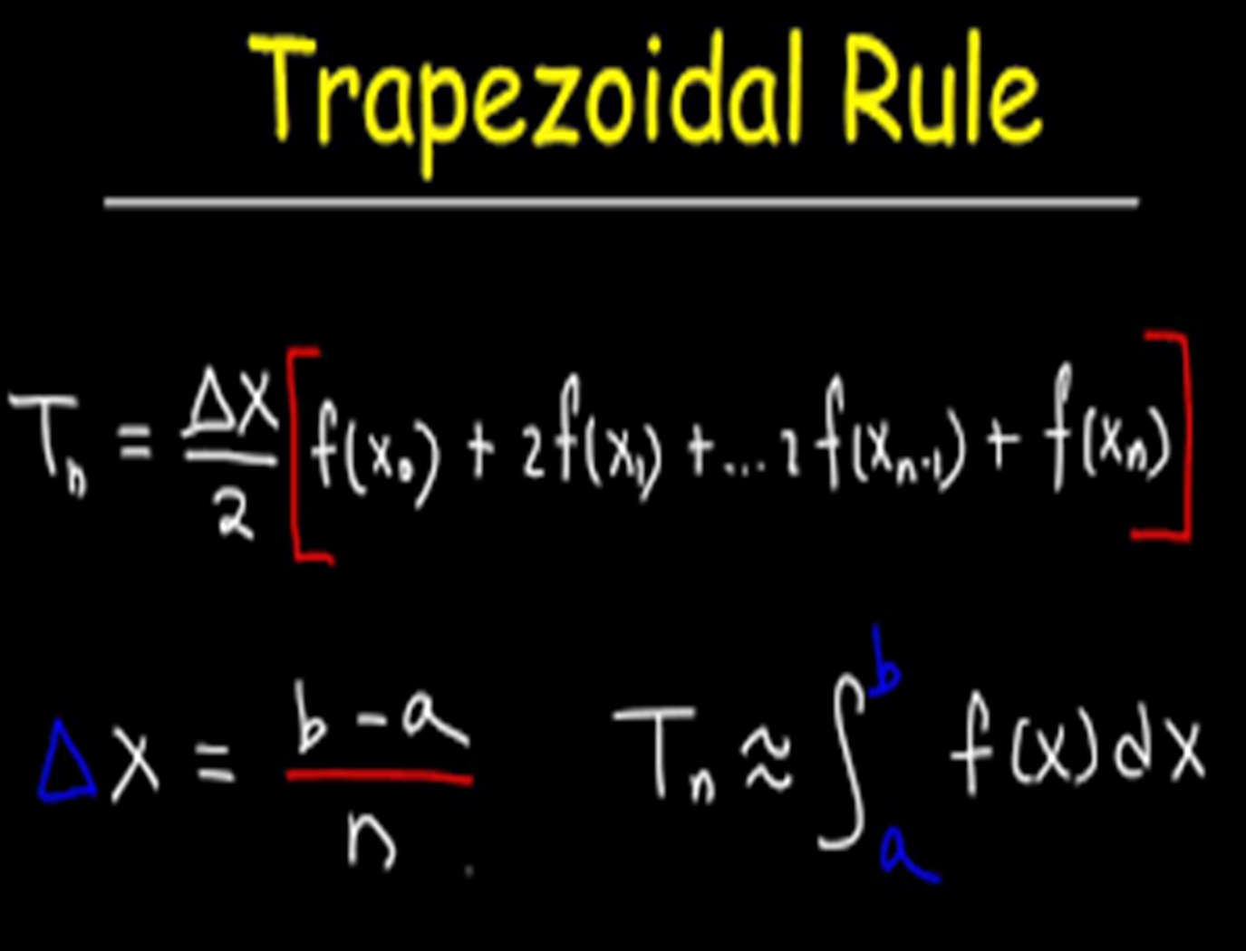

Slide 6
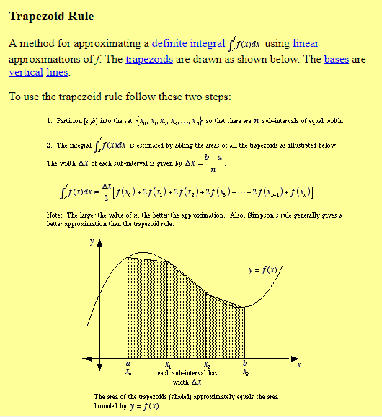

Slide 7
Example 1.
Approximate the integral of f(x) = x³ on the interval [1, 2] with four subintervals. n=4
Solution:-
First, h = = (b-a)/n =(2 - 1)/4 = 0.25, and thus we calculate:
X_{i}=a+i i=0,1,2,..,n
X₀=1+0*0.25=1 X₀=a
X₁=1+1*0.25=1.25
X₂=1+2*0.25=1.5
X₃=1+3*0.25=1.75
X₄=1+4*0.25=2 X_{n}=b

Slide 8

X₀=1 f(X₀) = f(1)=1³=1
X₁=1.25 f(X₁) = f(1.25)= (1.25)³=1.9531
X₂=1. 5 f(X₂) = f(1.5)= (1.5)³=3.375
X₃=1.75 f(X₃) = f(1.75)= (1.75)³=5.3593
X₄=2 f(X₄) = f(2)= (2)³=8
= 0.25/2 *(f(1) + 2⋅(f(1.25) + f(1.5) + f(1.75)) +f(2))⋅
= 0.25/2 *(1³ + 2⋅(1.25³ + 1.5³ + 1.75³) + 2³)

Slide 9
0.25
= *[1+2(1.9531)+2(3.375)+2(5.3593)+8)
= 3.796875
2

Slide 10
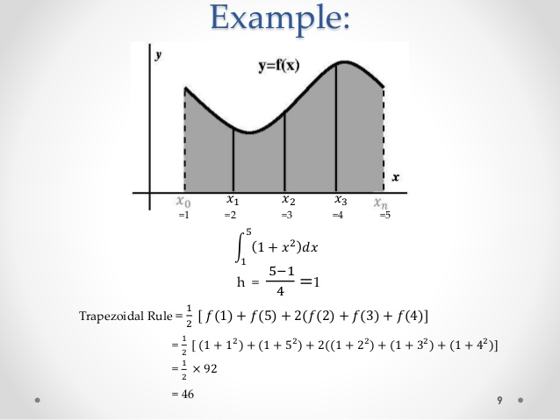

Slide 11
