Slide 1
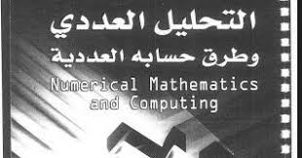


Slide 2
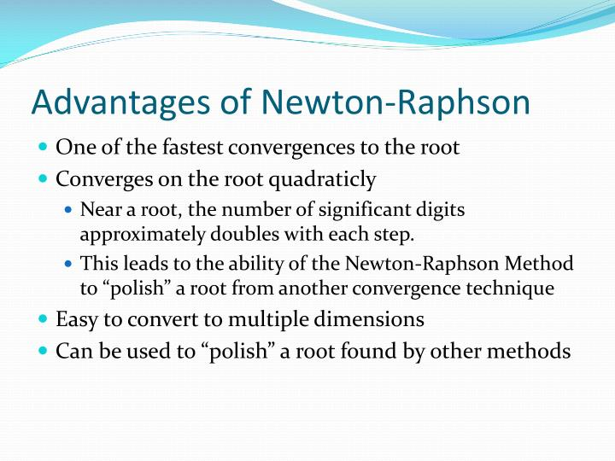

Slide 3
في التحليل العددي، طريقة نيوتن (بالإنجليزية: Newton's method)‏ أو طريقة نيوتن-رافسون (بالإنجليزية: Newton–Raphson method)‏ هي خوارزمية فعالة لإيجاد جذور تابع حقيقي
طريقة نيوتن هو واحدة من الطرق المستعملة من أجل حساب الجذر التربيعي
Newton's method. It is based on a very simple idea, one that is fundamental and repeated time and again in the derivation of numerical methods

Slide 4
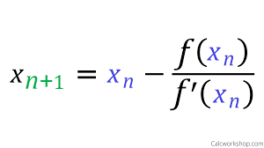
The Newton–Raphson method in one variable is implemented as follows:
The method starts with a function f defined over the real numbers x, the function's derivative f ′, and an initial guess x₀ for a root of the function f. If the function satisfies the assumptions made in the derivation of the formula and the initial guess is close, then a better approximation x_{n} is

Slide 5
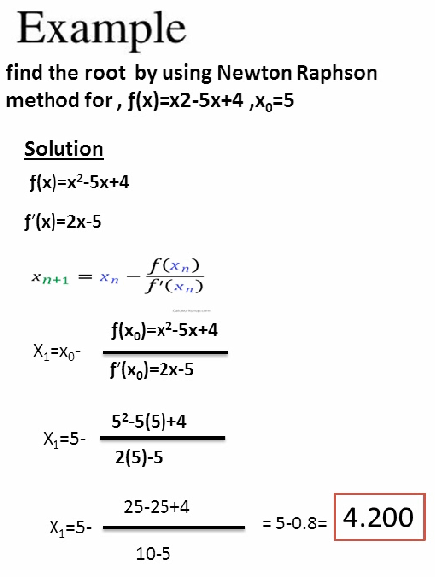

Slide 6
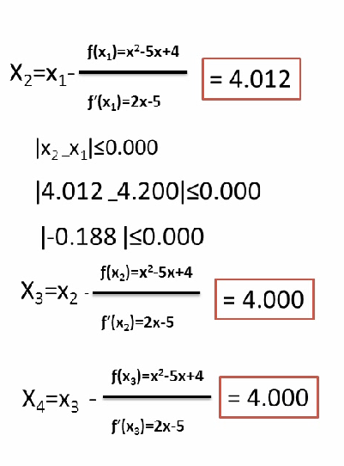

Slide 7
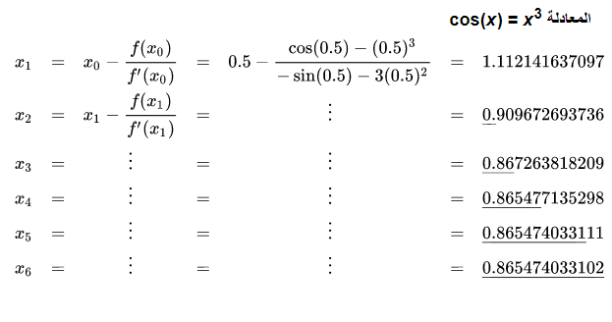
Example :- find the root by using Newton Raphson method for x₀=0.5
cos(x) = x³ , ϵ=10^{-11 ,}

