Slide 1
Passive Voice
By
Asst. Prof. Estabraq R. (PhD.)
English Classes
College of Basic Education
Al-Mustansiriyah Universty

Slide 2
Definition of Passive Voice
A passive voice is a type of a clause or sentence in which an action (through verb), or an object of a sentence, is emphasized rather than its subject.
Simply, the subject receives the action of the verb. The emphasis or focus is on the action, while the subject is not known or is less important.

Slide 3
What Is Passive Voice?
Passive voice is a quality of a verb that describes when the subject of a sentence is acted upon by the verb. For example:
The sheriff was shot.
(This is an example of the passive voice. The action is done to the subject.)
When the opposite is true (i.e., the subject of the sentence is acting out the verb), it is said to be in active voice. For example:
I shot the sheriff.
(This is an example of the active voice. The subject does the action.)
In other words, a verb is said to be in the passive voice when its subject does not perform the action of the verb but has the action of the verb performed on it.

Slide 4
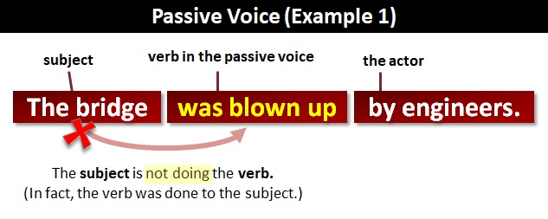
More Examples of the Passive Voice
Look at this example of the passive voice

Slide 5
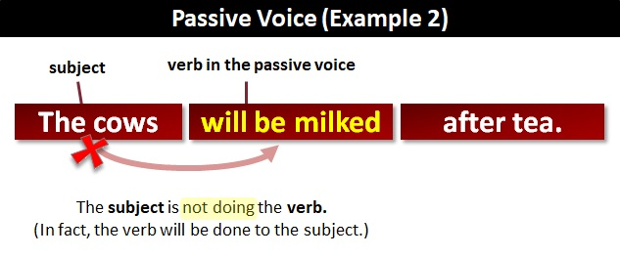
Another Example

Slide 6
Examples of Verbs in the Passive Voice
Remember that if a verb is in the passive voice, its subject has the action of the verb done to it. Here are some more example sentences featuring passive verbs (shaded):
Everyone was startled by the power outage.
A scream was heard coming from across the house.
The candles were extinguished as we rushed to the scream.
The crime was illuminated shortly by flashes of lightning.
She had been murdered.
A trap was devised to catch the killer.
Lieutenant Lavender was caught by the brilliant detective Educator Emerald.

Slide 7


