Slide 1
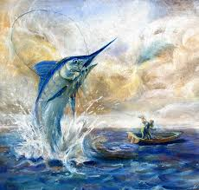
Themes & Symbolism in Earnest Hemingway's The Old Man and the Sea
Prof. Dr. Eman Fathi
Asst. Prof. Aseel Hatif Jassam

Slide 2
HEMINGWAY’S Themes & symbols
Earnest Hemingway, a prolific literary writer of his time infuses a multitude of symbolic elements into one of his most well-known stories, The Old Man and the Sea, which helps in developing many themes throughout the story. Hemmingway has constructed the struggle between Santiago and the marlin, his antagonist to symbolize overall themes of strength, perseverance, valor, and defeat. Moreover, his use of such symbols advances the plot toward the eventual defeat of Santiago.

Slide 3
Manhood & Masculinity
The Old Man and the Sea shows Hemingway’s philosophy of life as exemplified by manhood, and Santiago’s (and the marlin’s) willingness to struggle against an undefeatable opponent.
Santiago proves his manhood by refusing to be defeated, notwithstanding the incredible odds against him. From the beginning of the novella, we learn of Santiago’s hopeless struggle.
He has gone fishless for 84 days, but he doesn’t give up on life? Santiago keeps fighting. He has been abandoned by all, even by Manolin, his young friend, although this abandonment is forced by Manolin’s father. Santiago is left in isolation, and according to Hemingway, it is not until a man is isolated that he can prove himself honorable and worthy.

Slide 4
Santiago’s Resistance of defeat
Manhood in The Old Man and the Sea, as demonstrated by Santiago, is done in isolation, far out beyond other fishermen, where the big fish dwells.
Even after Santiago catches the marlin, the struggle remains hopeless as sharks attack his catch. Santiago still fights. Injured and beaten, but never defeated, Santiago resists inevitable defeat.
When looking at prominent themes in The Old Man and the Sea, it is important to remember Hemingway’s philosophy on struggle and death. According to Hemingway, it is the inevitability of death and struggle that allow humans to prove their worth.

Slide 5
Santiago’s pride and its influence on his behavior
Santiago acknowledges he had gone too far out. He resembles other literary over-reachers, those who attempt to do more than they are capable and pay a heavy price–Prometheus, Victor Frankenstein, Odysseus, Dr. Faustus, and Lucifer for example. His prideful error causes him to lose his prize catch. Hemingway, however, does not condemn Santiago.
Many people would overlook the sharks when thinking about the symbols in The Old Man and the Sea. The sharks first come to attack the marlin that the old man caught because it was bleeding and they could smell the blood. Santiago figures that the sharks would be coming at some point, so he tries to prepare for them. When the sharks first come and starts attacking the marlin, Santiago uses all of his might to try to kill them.

Slide 6
Santiago’s Pride
As more and more sharks come up to the boat, the old man starts to get tired. He is running out of supplies and ways to kill the sharks. Some of the sharks are harder to kill because of their position near the boat. The sharks in the story represent struggle and obstacles of life. The old man works very hard to catch the marlin and when the sharks attack it, he feels devastated. He gets mostly devastated because he has worked so hard to catch the marlin in the first place and bring it into the dock.

Slide 7
The sharks represent obstacles in the life that the old man has to face. Even though sharks are dangerous and are very hungry, the old man puts all of his effort and all of his strength into killing the sharks.
Santiago greatly wishes he could make it back to land and the sharks would not continue to follow. Every time a shark attacks, the fish bleeds more, which attracts more sharks. The old man overcomes the sharks.
The sharks can represent evil. Santiago considers the sharks base predators, not worthy of glory. They represent destructive forces in life that serve no purpose. The old man builds up an inner strength and defeats them in the end, just like we can defeat obstacles in life.

Slide 8
The fight with the marlin is a symbol for Santiago's fight for pride in his village. The sharks can also represent the villagers in Santiago's town. Santiago talks in the beginning of the novella about how the villagers used to think lowly of him.
They believe that he is unlucky, and Santiago starts to believe it too. They do not believe he can catch anything anymore. When the sharks come, they threaten to crush Santiago's dream, just like the villagers used to do. They also threaten the fish's dream of escape. So, the sharks could basically symbolize the people in life who try to bring him down.

Slide 9
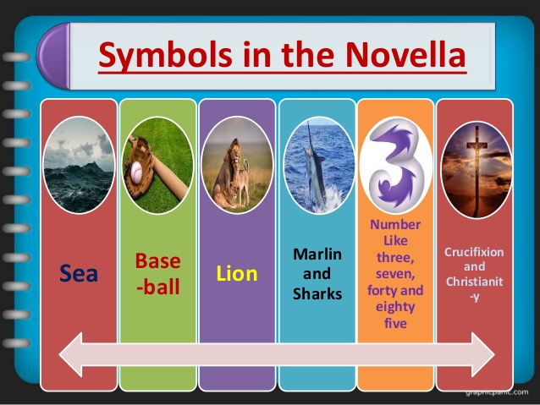

Slide 10
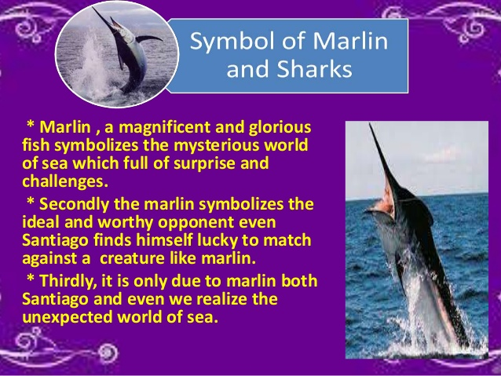
The Symbol of the SEA

Slide 11
The marlin
The marlin represents the ultimate opponent, one that brings out the best in Santiago. It is a giant, 18-foot fish that battles with Santiago in the middle of the ocean for three days and three nights. Although Santiago hooks the marlin on his first afternoon at sea, the marlin refuses to come to the surface and instead pulls Santiago farther and farther from land. Santiago admires the marlin's beauty and endurance, and considers it a "noble" adversary, telling the fish repeatedly that though he loves it, he must kill it. Ultimately, the marlin is presented as Santiago's worthy opponent. Struggling against such an opponent brings out the best in an individual—courage, endurance, and love.

Slide 12
The Marline as Santiago’s other self
At the same time, because Santiago comes to see the marlin as an alter-ego—he identifies the marlin as male and imagines the fish is old—the marlin comes to represent Santiago himself as well. In other words, Santiago's struggle with the marlin is in fact a struggle with himself. It is not a struggle of strength but rather of endurance, and a refusal to accept defeat. Santiago's struggle with the marlin is a struggle to face and overcome his own weaknesses as much as it is a struggle to subdue the great fish. In the process, by refusing to give in to the fish or the weakness of his mind and body, Santiago transcends those weaknesses.

Slide 13
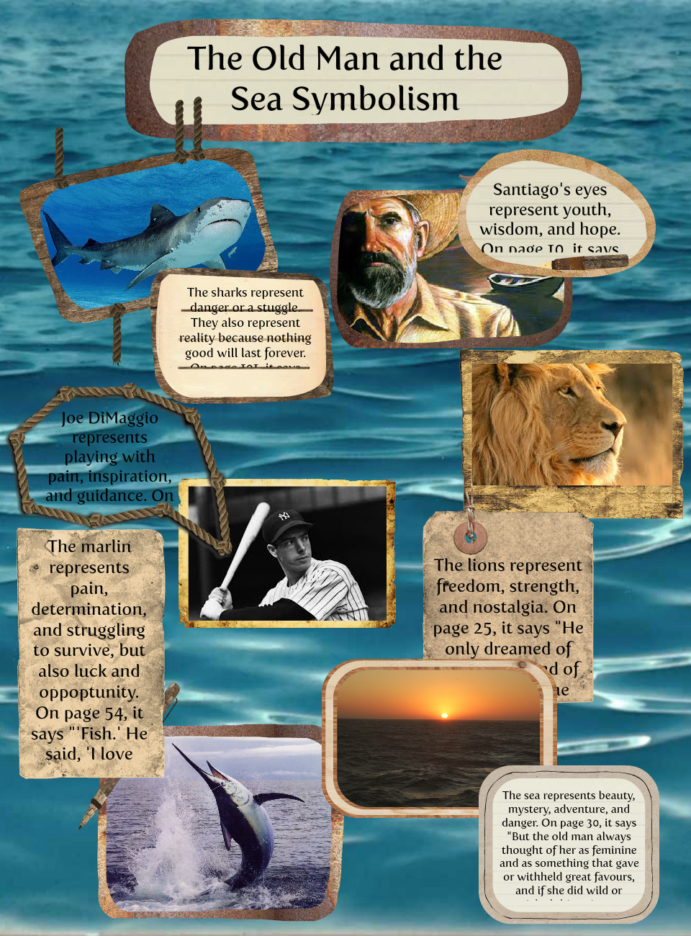
Symbols and their meanings

Slide 14
Santiago considers Joe Dimaggio unbeatable. He symbolizes the indomitable will of the human spirit. Dimaggio, at the time the novella was written, suffered from a bone spur, mentioned in the novella. Despite the bone spur, DiMaggio overcame his opponents, much in the same way Santiago overcomes his, despite injuries.
Santiago dreams of Lions on the beach in Africa three times. They represent virility and youth. The imagery of the Lion at the end of the novella represents hope of eternal life.
The mast is an obvious allusion to the cross of Jesus. It is on his skiff, where stands the mast, that Santiago suffers. Santiago suffers at sea for three days with painful injuries to the palms of his hands and his back.

Slide 15
Manoline: Santiago’s young friend represents hope. Although Manolin’s father prohibits him from fishing with Santiago, who is believed to be cursed, Manolin never abandons him emotionally. It can be argued, however, that as Santiago fishes, he is without hope. The 84-day fishless streak attests to it.
The Lost harpoon: Santiago loses the harpoon as he fends off sharks, symbolic of individuals who lose their faith as life’s woes attack. Much like Santiago without a harpoon, those without faith are defenseless.

Slide 16
Religious Symbolism in Ernest Hemingway ‘s The Old Man and The Sea
Many times, stories by Ernest Hemingway have much religious influence and symbolism. In The Old Man and the Sea, numerous occurrences in the life of Santiago the fisherman are similar to the incidents recorded in the life of Jesus of Nazareth. The names of the characters translated from Spanish to English are just examples of those many similarities.
The characters in The Old Man and the Sea are in actuality, major figures in the New Testament. Santiago is an old man, yet he has young eyes. No matter how defeated he is, he will never show it and he will look on the brighter side of things. These traits make Santiago a god-like figure. Manolin, which translates into Messiah, is Jesus (Stoltzfus qtd in CLC 13:280). Santiago is the "father" who teaches his symbolic son and disciple, Manolin. After catching the largest marlin, Manolin will leave his parents in order to follow the teachings of Santiago, his master, just as Jesus did (Stoltzfus qtd in CLC 13:280).

Slide 17
Pedrico is actually Saint Peter, Jesus' closest apostle and a great fisherman (Wilson 50). Peter helped Jesus fish for souls as Pedrico helps Manolin fish for food. Santiago gives Pedrico the head of the mutilated marlin which symbolizes Saint Peter as head of the Christian church and the first Pope (Stoltzfus CLC 280)
In the story, there are many references to the crucifixion of Jesus. Santiago's badly injured hands evoke the hands of the crucified Jesus and three other situations reinforce this theory. First, Santiago's marlin is approached by a pair of shovel nosed sharks. "Ay', he said out loud." (Hemingway, The Old Man and the Sea) There is no meaning of "Ay", but perhaps it is the sound a man makes as his hands are nailed to wood (Brenner, The Old Man and the Sea, Story of a Common Man )

Slide 18
Next, once back on shore, Santiago climbs the hill to his shack, with the mast on his shoulder, falling several times (Hemingway, The Old Man and the Sea 121). This is an obvious reference to Christ's struggle to carry the cross up the hill Cavalry (Crossan, The Historical Jesus 163).
Finally, Santiago has hooked a fish. It is a Friday, symbolic of Good Friday, the day Jesus was crucified. The hook goes into and through the mouth of the fish, just as the nail went through the hand of Jesus. On the second day, the old man anxiously awaited the rising of the fish to the top of the water.

Slide 19
Santiago says ten Hail Marys and ten Our Fathers. On the second day after the death of Jesus, his followers awaited his resurrection and prayed. On the third day, the fish rose and the old man has killed it. This day refers to Easter Sunday when Jesus rose from the dead, and then ascended to heaven.
Therefore, the incidents that occurred in the life of Santiago are very similar to the occurrences in the life of Jesus of Nazareth. Ernest Hemingway decides to construct his story to reflect upon the life of Jesus but does not make this too obvious to the reader. There are many references to the crucifixion of Jesus. This shows that the old man and Jesus suffered in many of the same ways. They were both fishermen. The old man is the fisherman of fish and Jesus was the fisherman of souls.

Slide 20
Biblical Numerology
The old man stats fishing with the boy for forty days and then he alone fishes for forty-four days, struggling with the marline for three days, and landing it on the seventh attempt, killing sharks and resting seven times.
Santiago’s return in three days from the death-like sea parallels resurrection. The religious symbols employed by Hemingway are biblical echoes voicing the author’s faith and acting as symbolic devices. The Christological elements like love, forgiveness, and compassion can be seen in the marline and Santiago locked in a moral combat.
The number 3 is a symbol of divine perfection.It is also the numerical signature of God.As well as the representing personal completeness, it is the number of the Godhead, and stands for Trinity.

Slide 21
The Symbolic Significance of BASEBALL
Ernest Hemingway's The Old Man and the Sea takes place in and around Cuba. The love of baseball began to grow in Cuba during the late 1800s, and by the time of the action in The Old Man and the Sea, baseball had become a national sport and pastime, much like, say, hockey in Canada or soccer (football) in Brazil.
So an old Cuban fisherman who talks about baseball is realistic in Hemingway's setting. Santiago's continual references to Joe DiMaggio, though, go much further than just establishing a realistic setting. To Santiago, Joe DiMaggio — who was and still is considered the greatest baseball player in history — represents what a man should be. Santiago idolizes DiMaggio in part because he (DiMaggio) suffered through the pain of a bone spur to make a great comeback.

Slide 22
This idea of struggling and persevering in order to ultimately redeem one's individual existence through one's life's work is central to the conflict of The Old Man and the Sea. As Santiago struggles with the marlin, he equates his struggle with the pain of DiMaggio's bone spur and tries to live up to DiMaggio's example by not giving up on the marlin.
Ernest Hemingway's use of baseball and mention of Joe DiMaggio in ''The Old Man and the Sea'' come to represent an ideal to the fisherman Santiago, one that he continues to compare himself against to measure his success and worth.

Slide 23
In Cuba, the setting of Hemingway's novel The Old Man and the Sea, the game of baseball is a national sport and pastime. It holds a special place in everyone's heart.
Santiago also discusses baseball with himself. It is a way for him to stay focused and not become delusional. When he is on the sea holding onto the big fish he has hooked, he recognizes that he is ''tired inside.'' Santiago realizes that all he has left to think about is the fish. ''That and baseball.'' These thoughts help him stay determined and focused despite his exhaustion

