Slide 1
Network Layer
The network layer is responsible for carrying data from one host to another. It provides means to allocate logical addresses to hosts, and identify them uniquely using the same. Network layer takes data units from Transport Layer and cuts them in to smaller unit called Data Packet. Network layer defines the data path, the packets should follow to reach the destination.

Slide 2
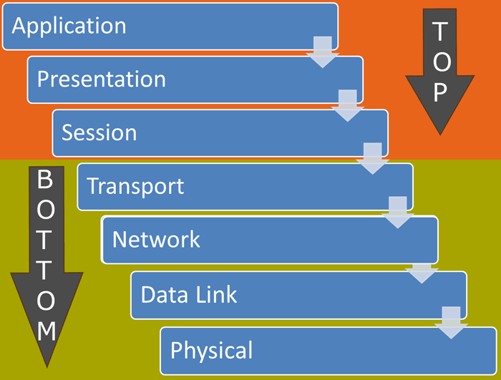
OSI Model:-
OSI stands for Open Systems Interconnection. It has been developed by ISO – ‘International Organization of Standardization‘, in the year 1974.

Slide 3
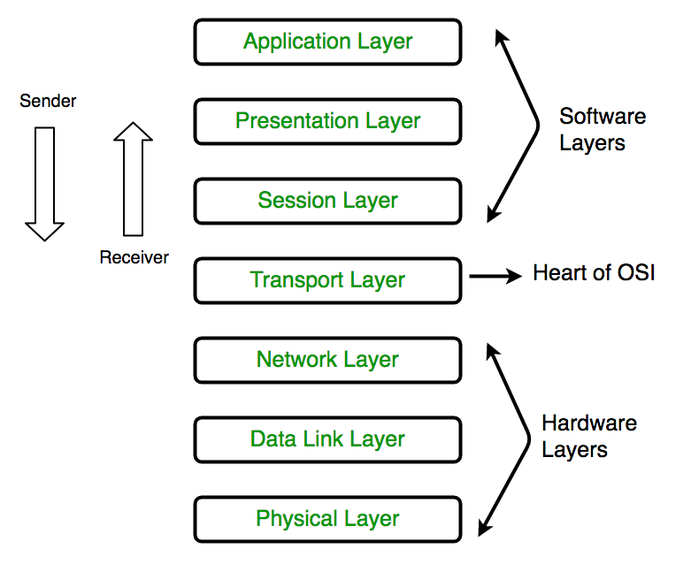

Slide 4
Group | Layer Number | Layer Name | Description
Top Layers | 7 | Application | Provide user interface to send and receive the data
 | 6 | Presentation | Encrypt, format and compress the data for transmission
 | 5 | Session | Initiate and terminate session with remote system
Bottom Layers | 4 | Transport | Break data stream in smaller segments and provide reliable and unreliable data delivery
 | 3 | Network | Provide logical addressing
 | 2 | Data Link | Prepare data for transmission
 | 1 | Physical | Move data between devices

