Slide 1
1.11 Network Topology
The topology defines how the devices (computers, printers..etc) are connected and how the data flows from one device to another. There are two conventions while representing the topologies. The physical topology defines how the devices are physically wired. The logical topology defines how the data flows from one device to another.

Slide 2
1. Bus topology:

Slide 3
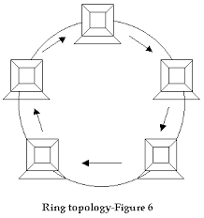
2. Ring Topology

Slide 4
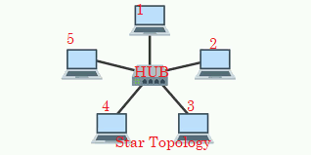
3. Star topology

Slide 5
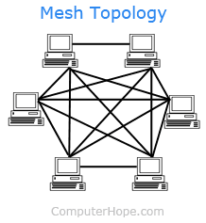
4. Mesh topology

Slide 6
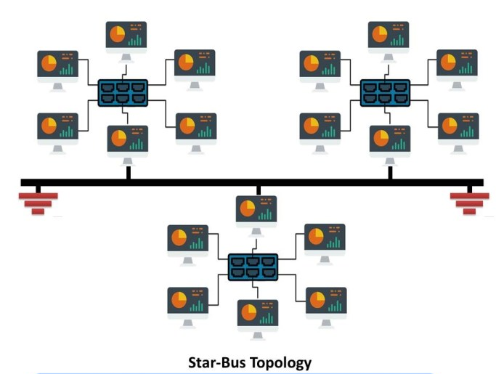
5. Tree topology

Slide 7
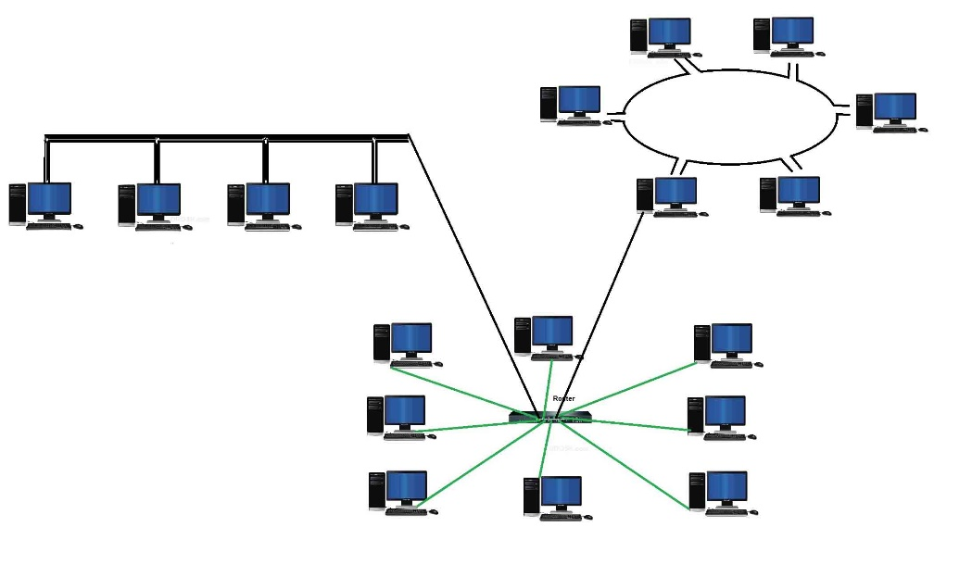
6. Hybrid topology

