Slide 1
1.7 PROTOCOL
1.7.1 Elements of a Protocol
Syntax:
B. Semantics :
C. Timing :

Slide 2
1.8 Multipoint Link:-
Transmission Media: - وسائط النقل
Guided Transmission Media: -
Unguided Transmission Media:-

Slide 3
Types of Guided Transmission Media:-
1- Twisted Pair Cable:- كيبل الزوج الملتوي
Usage of Twisted Pair Cable:-

Slide 4

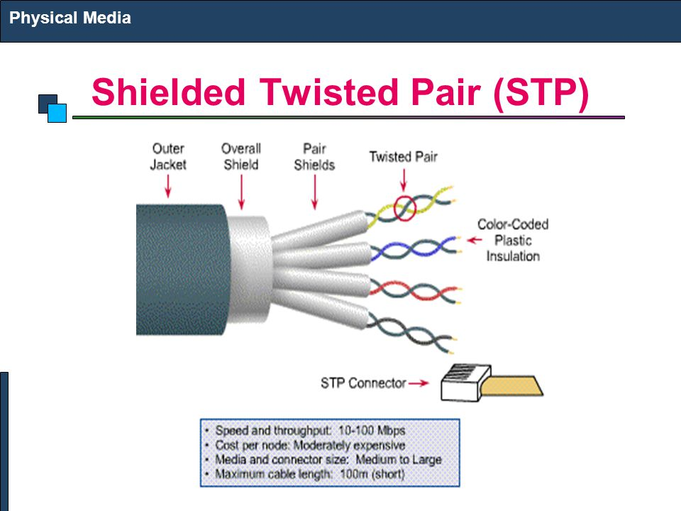
There are two types of twisted pair cables.
Unshielded Twisted Pair (UTP) Cable: -
2. Shielded Twisted Pair (STP) Cable: -

Slide 5
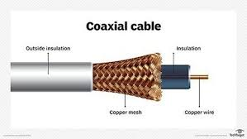
2- Coaxial Cable:-
Types of Coaxial Cable:-
1- Flexible coaxial cable. الكابلات المحورية المرنة
2-Rigid coaxial cable. الكابلات المحورية الصلبة

Slide 6
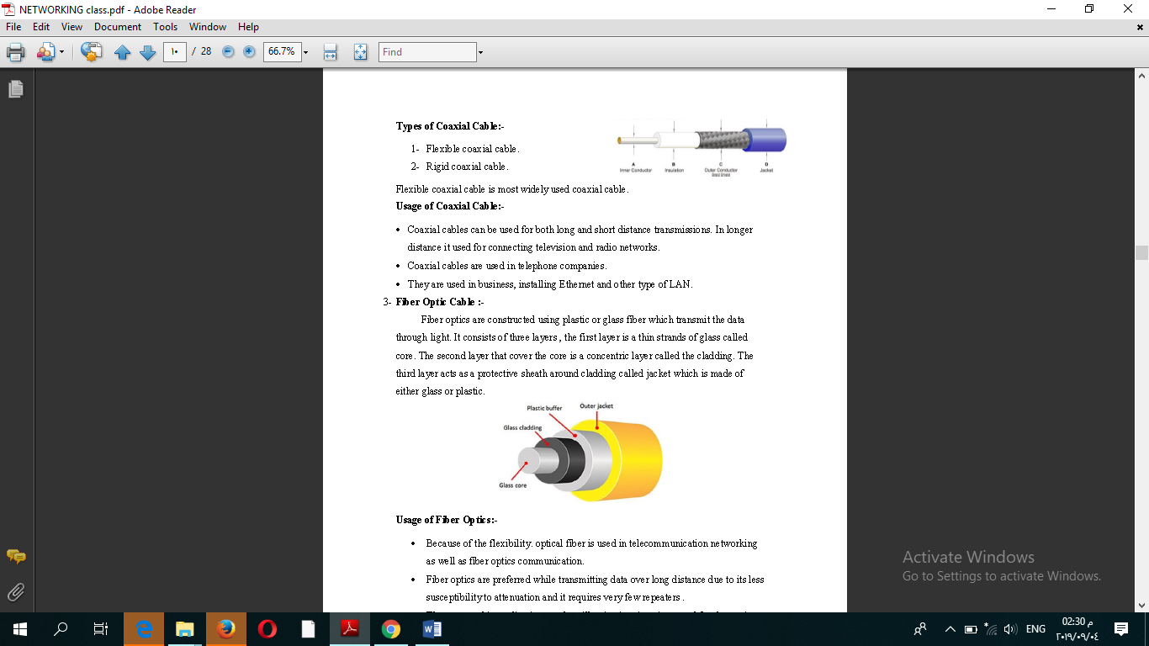
3- Fiber Optic Cable:-
Usage of Fiber Optics:-

Slide 7
Types of Unguided Transmission Media:-
1- Satellite Microwave Transmission:-
2- Radio wave transmission:-
3- Terrestrial microwave transmission:-
4- Infrared wave transmission: -

