Slide 1
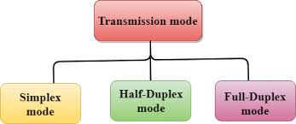
1.5 DATA FLOW تدفق البيانات

Slide 2
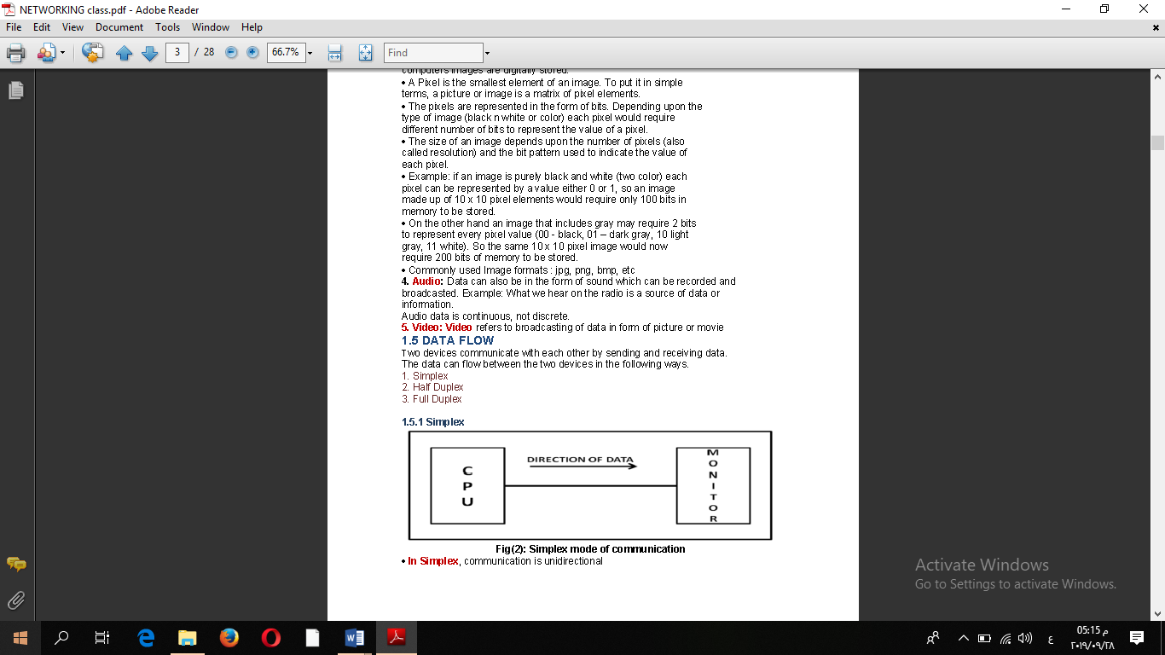
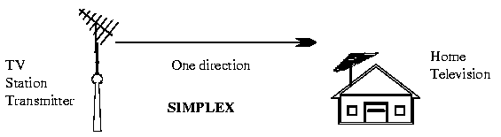
1. Simplex

Slide 3
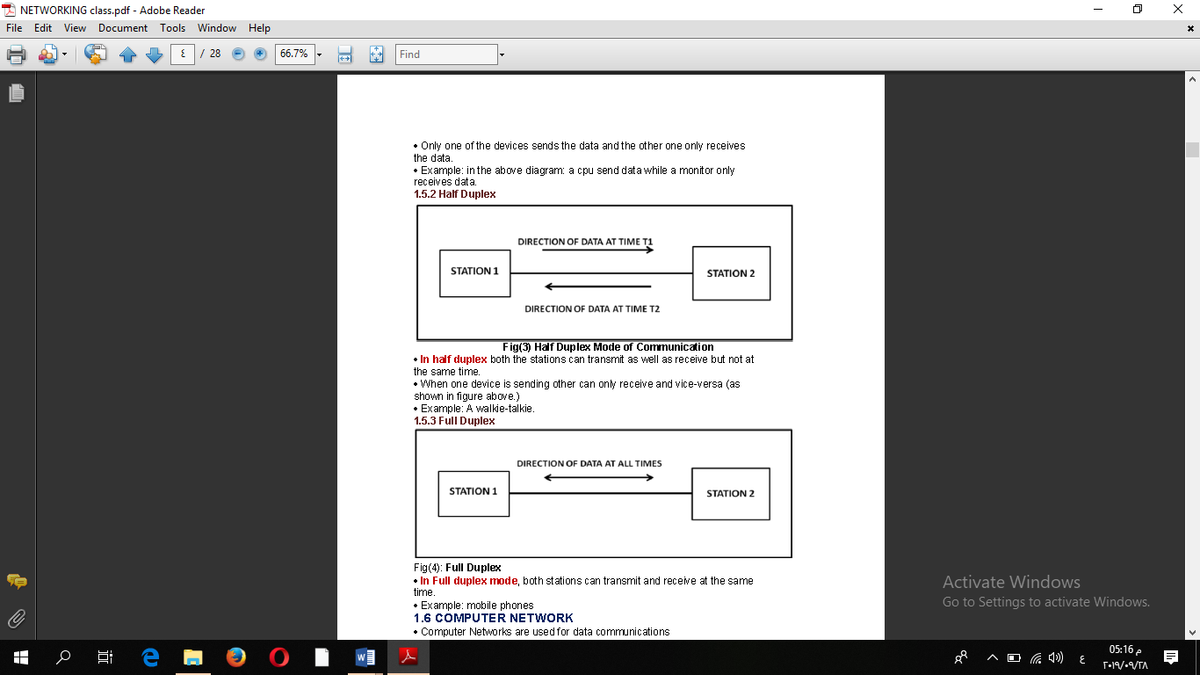
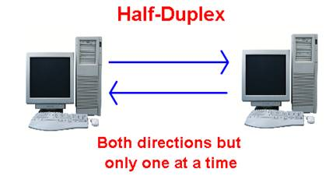
2. Half Duplex

Slide 4
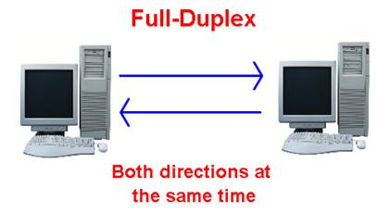
3. Full Duplex

Slide 5
1.6 COMPUTER NETWORK
Definition: A computer network can be defined as a collection of nodes. A
node can be any device capable of transmitting or receiving data. The communicating nodes have to be connected by communication links.
A Compute network should ensure:
Reliability
Security
Performance

Slide 6
1.6.1 Categories of Network
Networks are categorized on the basis of their size. The three basic categories of
computer networks are:

Slide 7
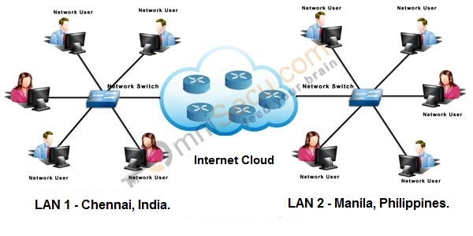
A. Local Area Networks (LAN)

Slide 8
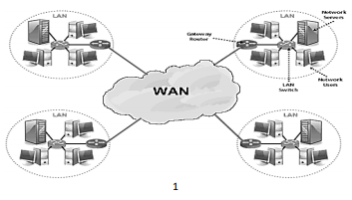
B. Wide Area Network (WAN)

Slide 9
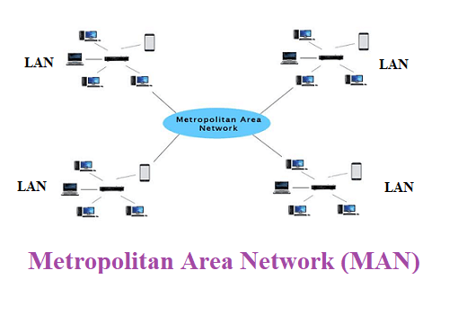
C. Metropolitan Area Network (MAN)

