Slide 1
Derevatives
المشتقة
اعداد
م.رواء ابراهيم عيسى

Slide 2

Definition
The derivative f'(x) of the function f(x) is the slope of the tangent at the point (x, f(x)).

Slide 3
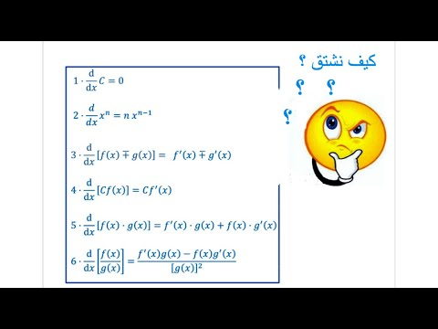

Slide 4
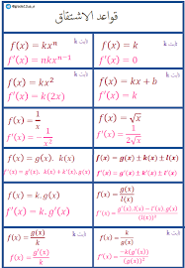

Slide 5
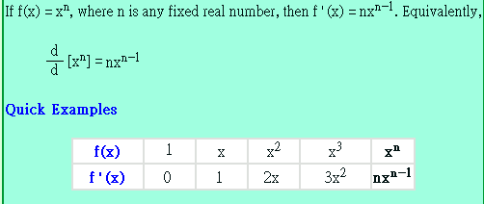
Power Rule

Slide 6
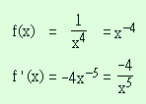

Negative Exponents
Since the power rule works for negative
exponents, we have, for

Slide 7
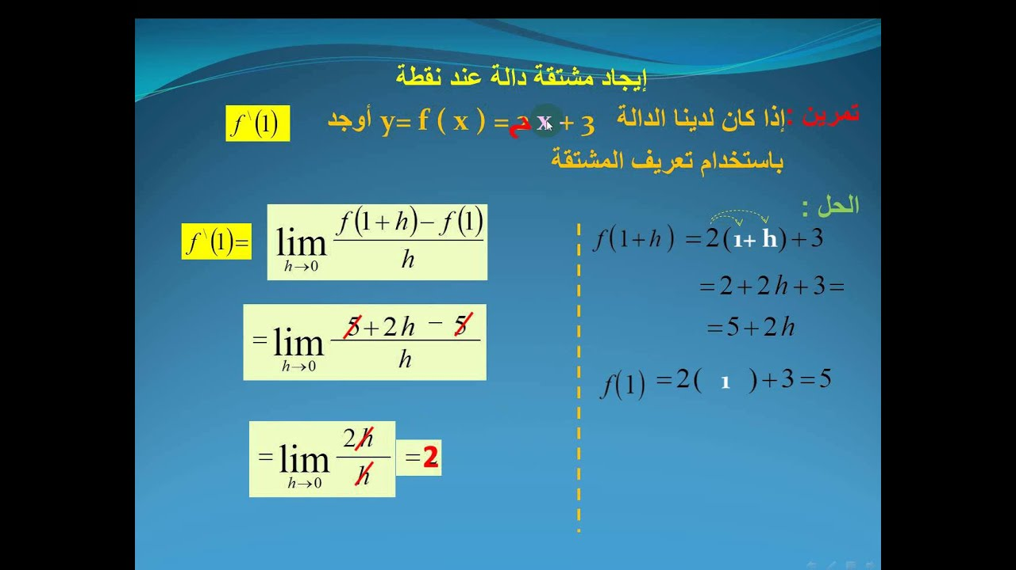

Slide 8
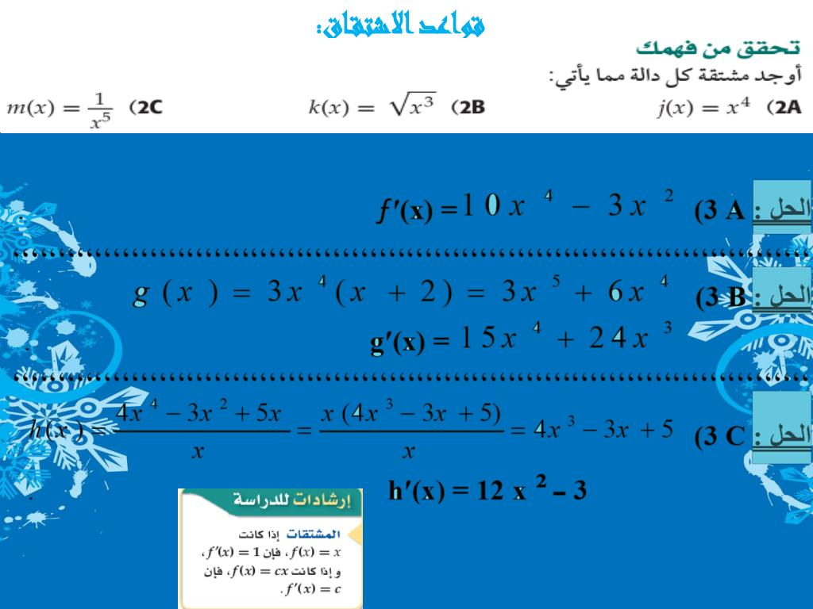

Slide 9
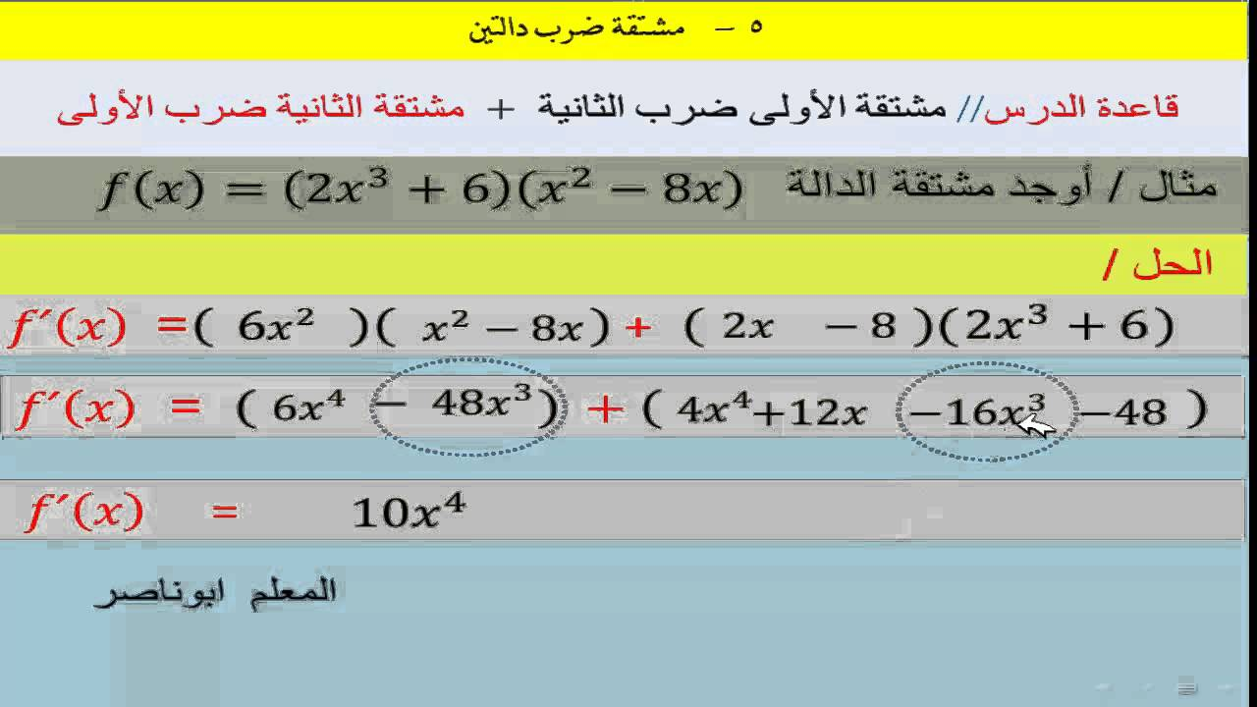

Slide 10
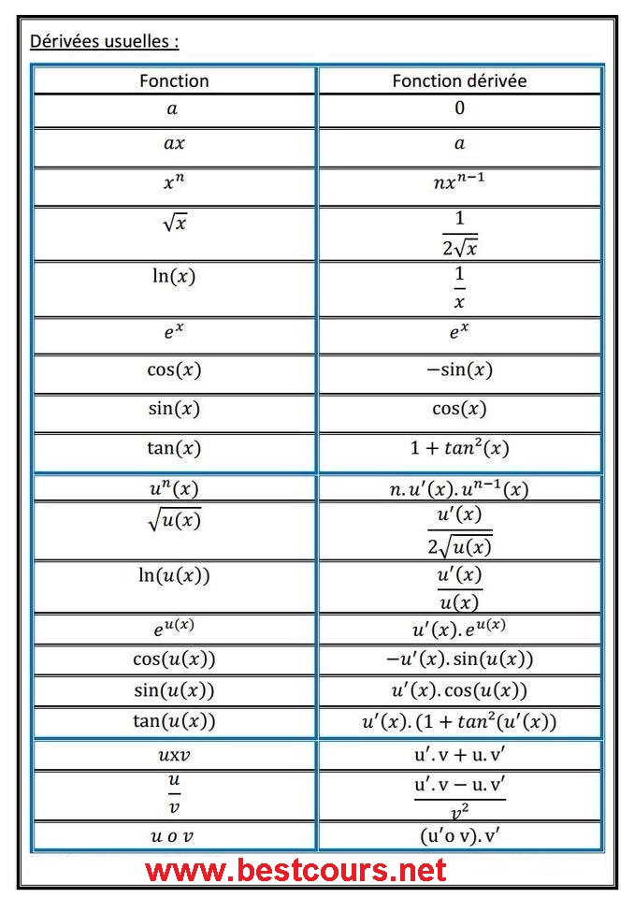

Slide 11
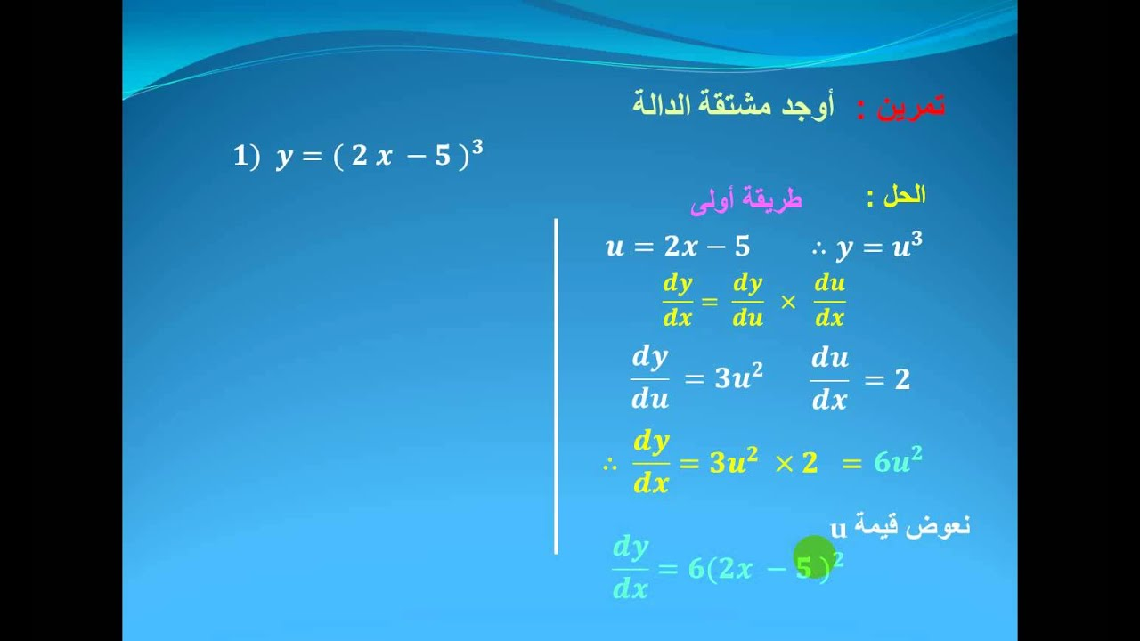

Slide 12
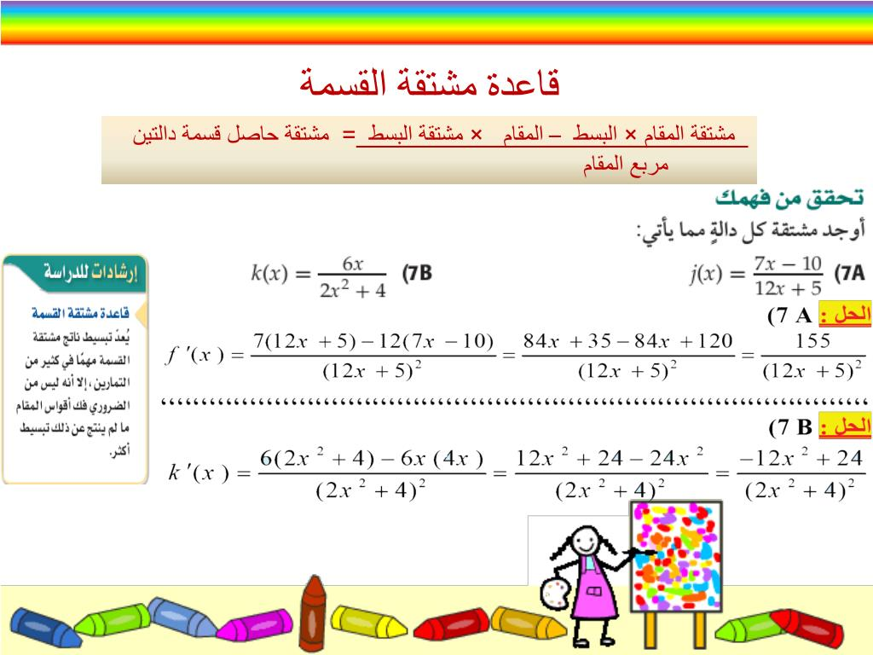

Slide 13
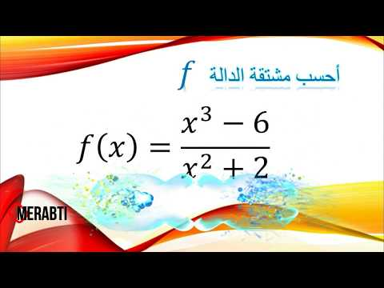
h.W

