Slide 1
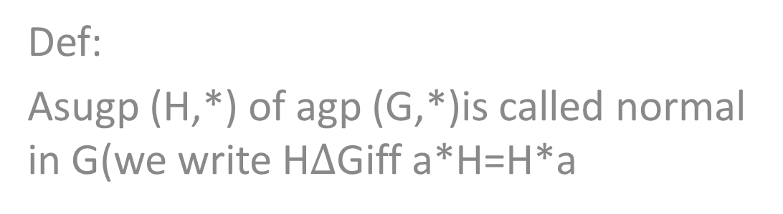
Normal subgp
Def:
Asugp (H,*) of agp (G,*)is called normal in G(we write H$∆$Giff a*H=H*a

Slide 2
Examples
(Z,+) is normal subgp of (R,+)
2-in (Z4,+4),H={[0],[2]} so 0*H=H,1+H=H+1,2+H=H+2,3+H=H+3 so
(H,+4) is normal subgroup of (Z4,+4)

Slide 3
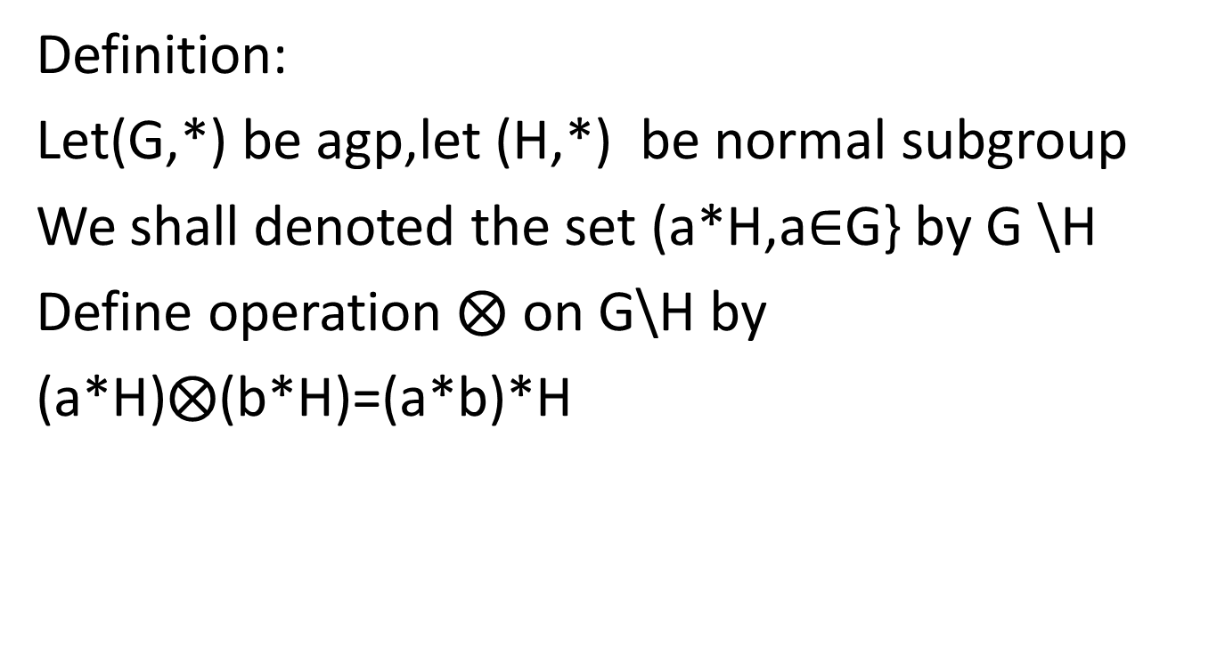
Quation gp
Definition:
Let(G,*) be agp,let (H,*) be normal subgroup
We shall denoted the set (a*H,a$∈$G} by G \H
Define operation $⨂$ on G\H by
(a*H)$⨂$(b*H)=(a*b)*H

Slide 4
theorem
1-let (G,*) be agroup,(H,*) be normal subgroup of (G,*) then(G\H) is gp

Slide 5

Remark and example
1- let(Z,+) BE GP,H={3m;m$∈$Z},then Z\H =Z3

