Slide 1
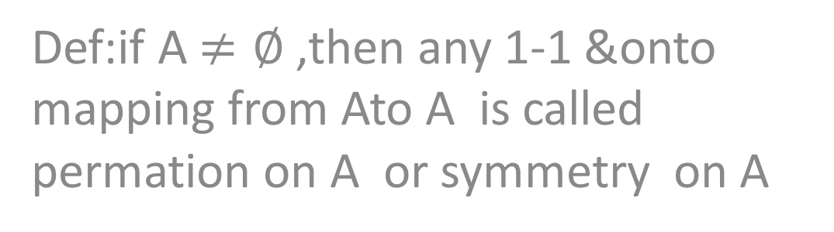
Apermutation or symmetric gp
Def:if A $≠∅$ ,then any 1-1 &onto mapping from Ato A is called permation on A or symmetry on A

Slide 2
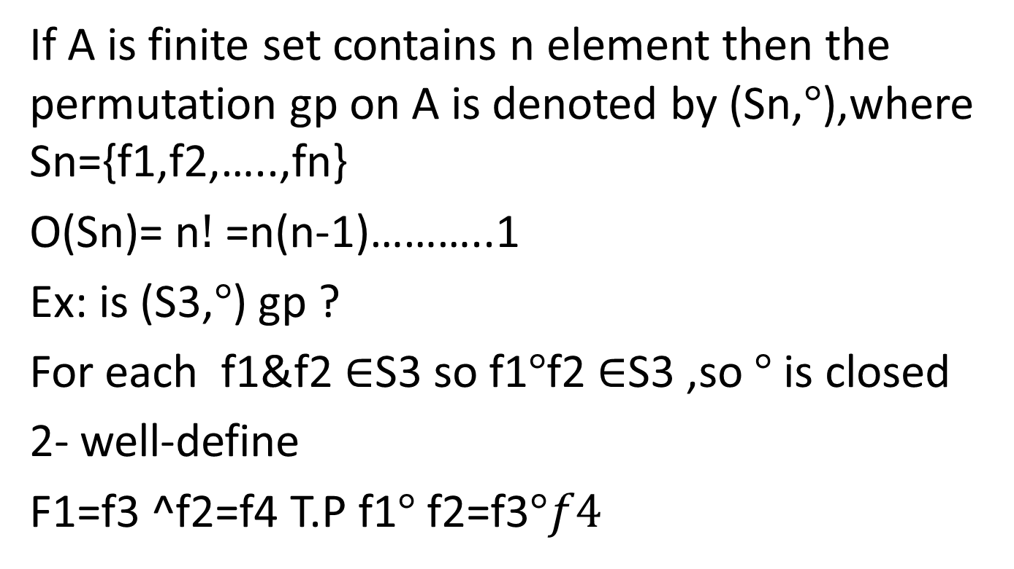
Remark
If A is finite set contains n element then the permutation gp on A is denoted by (Sn,$°$),where Sn={f1,f2,…..,fn}
O(Sn)= n$!$ =n(n-1)………..1
Ex: is (S3,$°$) gp ?
For each f1&f2 $∈$S3 so f1$°$f2 $∈$S3 ,so $°$ is closed
2- well-define
F1=f3 ^f2=f4 T.P f1$°$ f2=f3$°f4$

Slide 3
3- asso.
Identity: is f1
Inverse: f1^-1 =f1 , f2^-1=f3 ,f3^ -1=f2^-1=f3,f4^-1=f4 ,f5^-1=f5 ,f6^-1=f6

Slide 4

NORMAL SUBGROUP
Def: let (G,*) be gp & H $⊆$G,let a$∈$G,the left(right) coset ofH inG determines by a is denoted by a*H(H*A)and define as
A*H={a*H:h$∈$H}

Slide 5
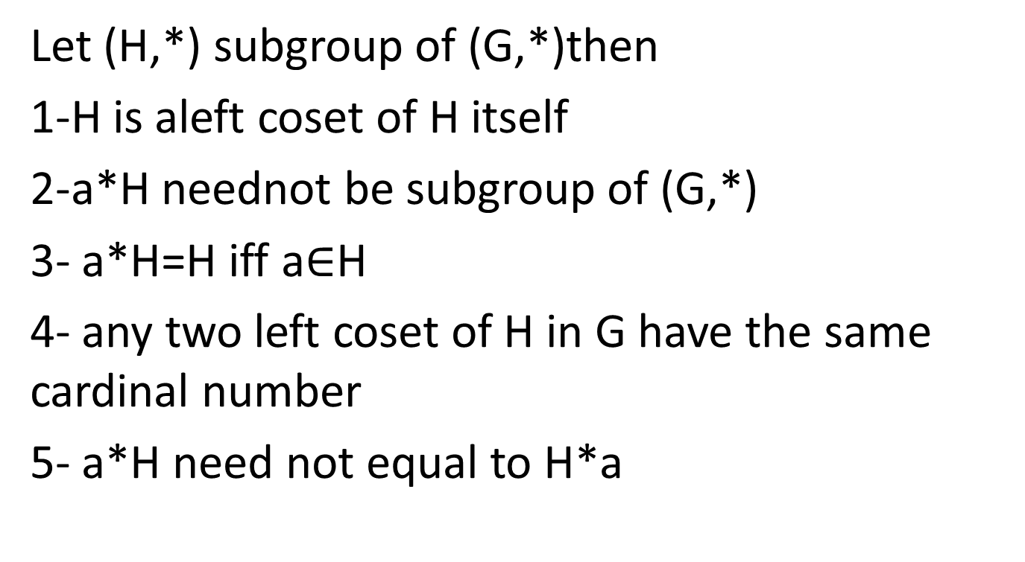
Remark
Let (H,*) subgroup of (G,*)then
1-H is aleft coset of H itself
2-a*H neednot be subgroup of (G,*)
3- a*H=H iff a$∈$H
4- any two left coset of H in G have the same cardinal number
5- a*H need not equal to H*a

Slide 6
Examples
1- let (Z6,+6)is gp& H={[0],[2],[4]}
[1]+6 H={[1],[3],[5]} is not subgp of Z6
2- fined all left coset of (ZE,+) in(Z,+)
3-(ZE,+) is subgp of(Z,+) but (ZO,+) is not subgp of (Z,+)

