Slide 1
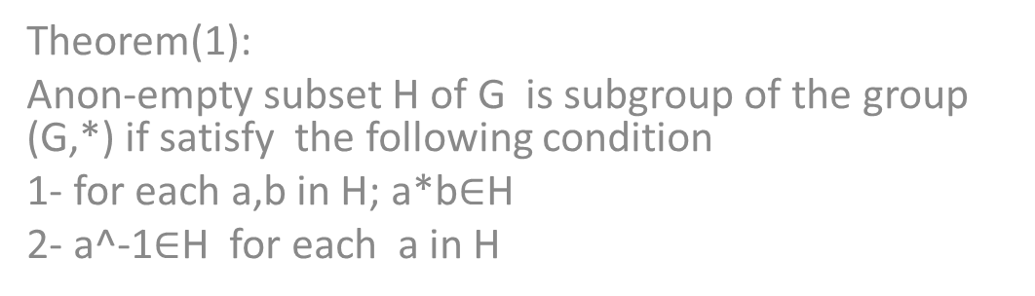
theorem
Theorem(1):
Anon-empty subset H of G is subgroup of the group (G,*) if satisfy the following condition
1- for each a,b in H; a*b$∈$H
2- a^-1$∈$H for each a in H

Slide 2

Theorem (2)
Let (G,*)be agroup & $φ≠$H$⊆$G then (H,*) is subgroup of (G,*) iff a*(b)^-1 $∈$H for each a,b in H

Slide 3
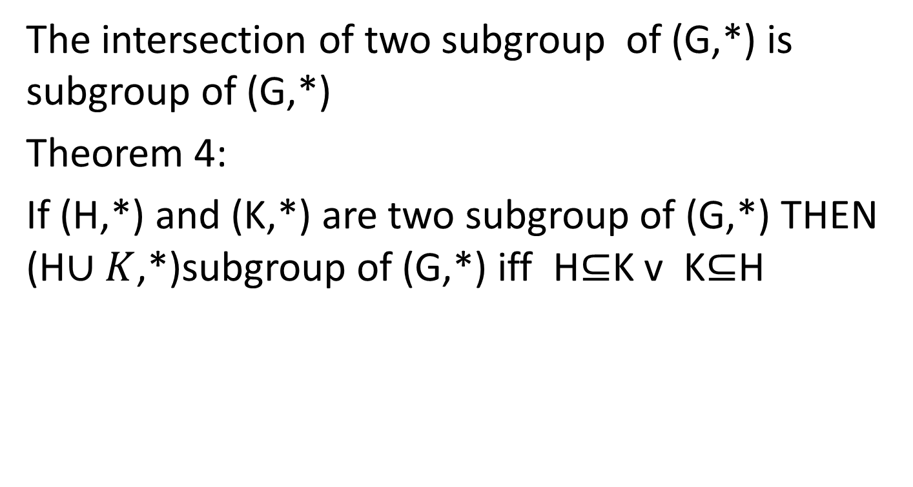
Theorem 3
The intersection of two subgroup of (G,*) is subgroup of (G,*)
Theorem 4:
If (H,*) and (K,*) are two subgroup of (G,*) THEN (H$∪K$,*)subgroup of (G,*) iff H$⊆$K v K$⊆$H

Slide 4
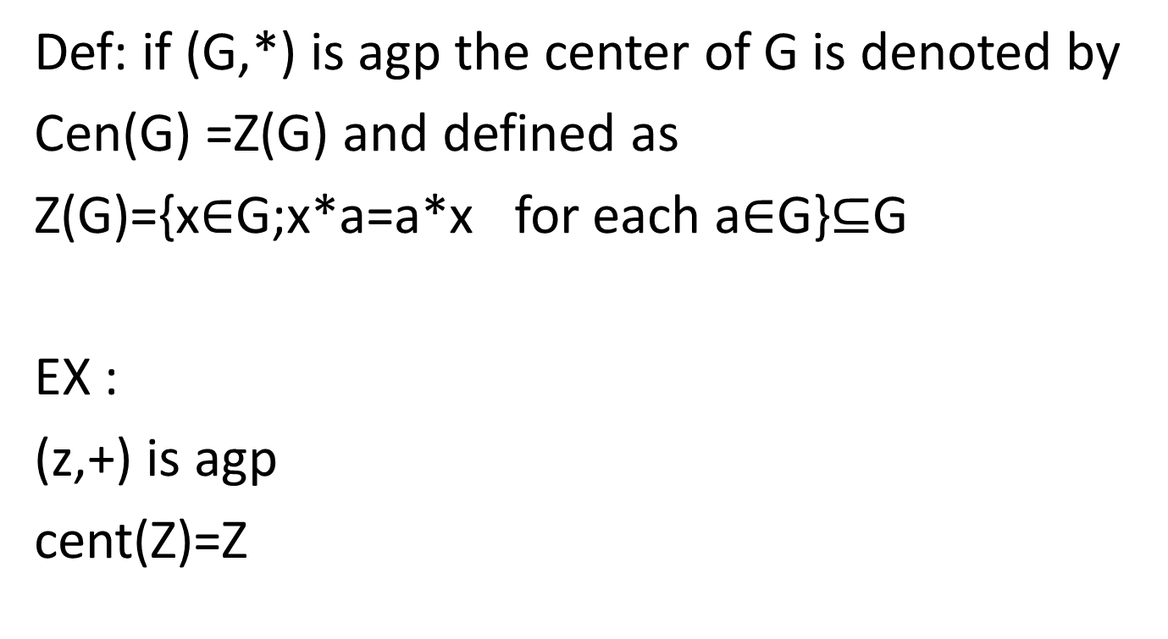
Center of group
Def: if (G,*) is agp the center of G is denoted by
Cen(G) =Z(G) and defined as
Z(G)={x$∈$G;x*a=a*x for each a$∈$G}$⊆$G
EX :
(z,+) is agp
cent(Z)=Z

Slide 5
theorem
Agrup (G,*) is abelain iff cent(G)=G
theorem 2)
for any gp (G,*) (Z(G),*) Issubgroub of (G,*)

