Slide 1
انواع الزمر
1- finite group:
Agroup (G,*) is called afinite gp if G is afinite set
Order of G :
Is the nember of element of G and is denoted by O(G)
Def:infinite gp
(G,*) is called infinite gp if G is infinite set and we say that G is infinite order

Slide 2
example
1-(Z,+) is infinit gp
2- let G={1,-1},then(G,X) is gp ,what the order of group?
O(G)=2
3-let( G={1,-1,i,-i},x) be abelain gp ,whatO(G)?
O(G)=4

Slide 3
exercise
1-which of the following math.system are group?abelain group?
2-let( G=RXR/(0,0),*) ,where (a,b)*(c,d)=(ac-bd,ad+bc)
3-(G,X) whereG={a^k:k in Z},a inR/{0,1}

Slide 4
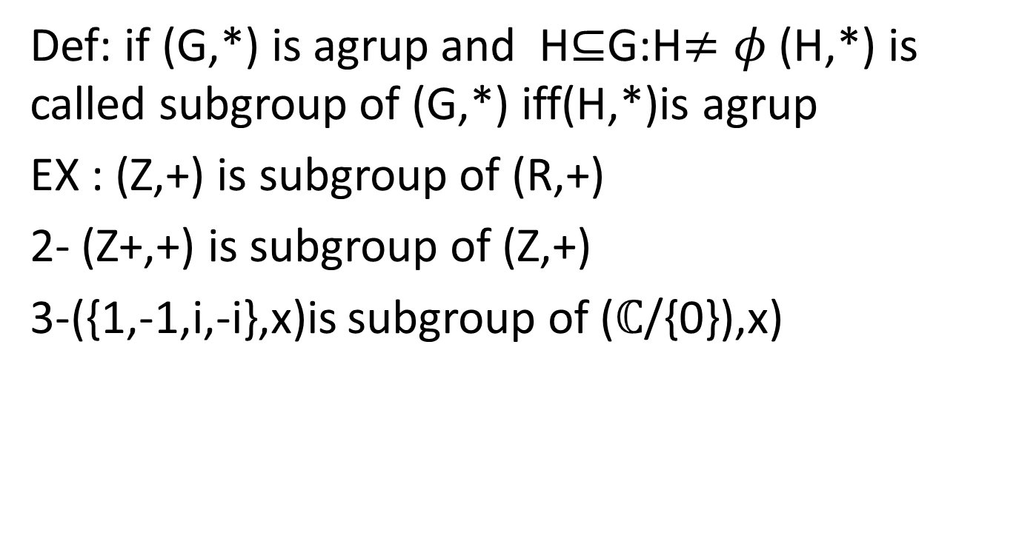
subgroup
Def: if (G,*) is agrup and H$⊆$G:H$≠φ$ (H,*) is called subgroup of (G,*) iff(H,*)is agrup
EX : (Z,+) is subgroup of (R,+)
2- (Z+,+) is subgroup of (Z,+)
3-({1,-1,i,-i},x)is subgroup of ($ℂ$/{0}),x)

