Slide 1
Group
Let G be non empty set and * be binary operatio on G ,THEN (G,*) iS group if satisfy the following condition

Slide 2
Group
1- the binary operation * is associative
2-there is an element e in G S.t e*x=x*e=x for all x in G
3- for each a in G there is an element a^-1 in Gs.t a*a^-1=a^-1*a=e

Slide 3
Examples
1-(Z,+) is group
2- (Z+,+) is not group sincr for each a in Z+ there is not a^-1 ;a+a^-1=0
3-(Q,x)is not group since 0 in Q but 1\0 is not in Q

Slide 4
Remark
1- let (G,*)be gp with identity ,a in G then
1-(a)^n=a*a*a*…….*a if a in G&(G,*)IS gp,n in N
2-(a)^0=e
3-(a)^-k=(a^-1)^k;k in Z

Slide 5
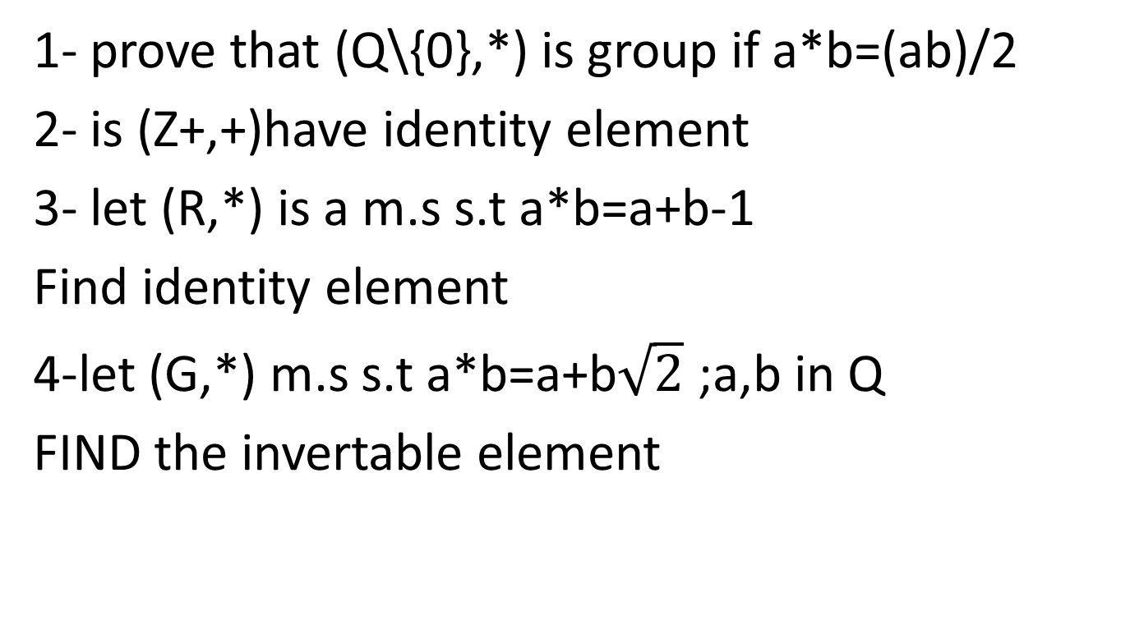
Exersies
1- prove that (Q\{0},*) is group if a*b=(ab)/2
2- is (Z+,+)have identity element
3- let (R,*) is a m.s s.t a*b=a+b-1
Find identity element
4-let (G,*) m.s s.t a*b=a+b$\sqrt{2}$ ;a,b in Q
FIND the invertable element

