Slide 1
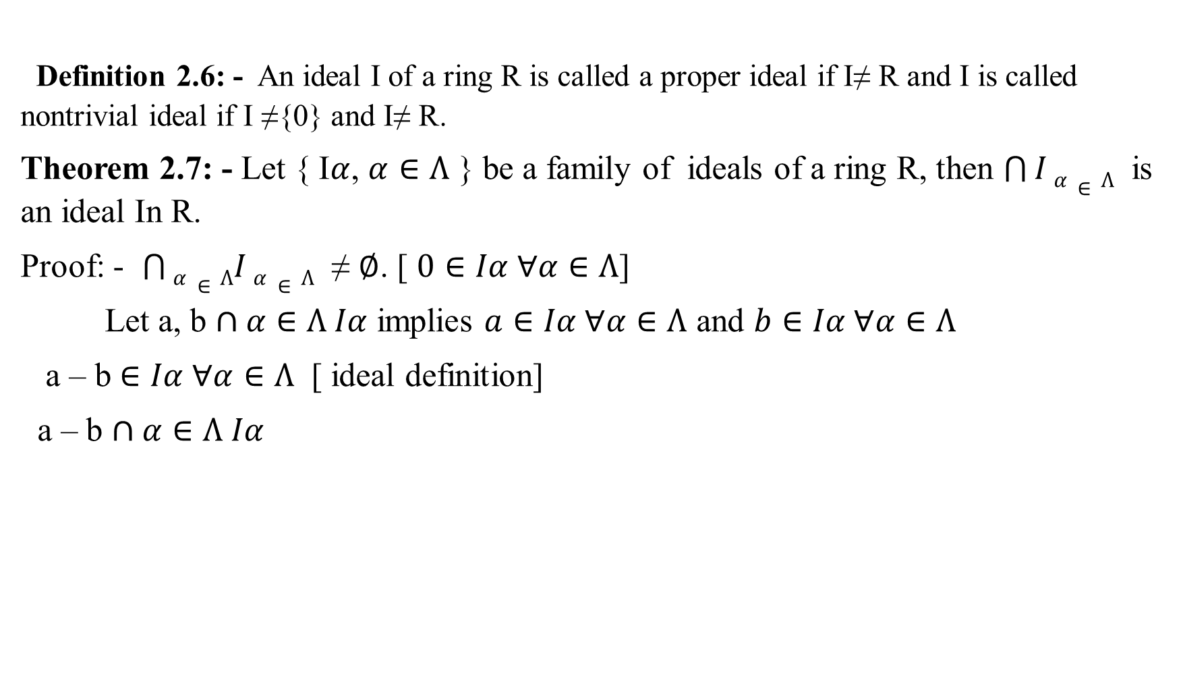
Definition 2.6: - An ideal I of a ring R is called a proper ideal if I≠ R and I is called nontrivial ideal if I ≠{0} and I≠ R.
Theorem 2.7: - Let { I$α$, $α∈Λ$ } be a family of ideals of a ring R, then $\bigcap{I}α∈Λ$ is an ideal In R.
Proof: - $\bigcap{α∈ΛI}α∈Λ$ ≠ $∅$. [ $0∈Iα ∀α∈Λ$]
Let a, b $∩α∈Λ Iα$ implies $a∈Iα ∀α∈Λ$ and $b∈Iα ∀α∈Λ$
a – b $∈Iα ∀α∈Λ$ [ ideal definition]
a – b $∩α∈Λ Iα$

Slide 2

Let $a∈∩α∈Λ Iα$ , $r∈R$
$a∈Iα ∀α∈Λ$ implies that $ra∈Iα ∀α$
$ra∈\bigcap{I}α, α∈Λ$
$\bigcap{I}α, α∈Λ$ is ideal.
But the union is not ideal for example:
2Z is ideal , 3Z is ideal, $2∈2Z , 3∈3Z$
If $2Z∪3Z is ideal$
$2 , 3 ∈2Z∪3Z , 3−2 ∈2Z∪3Z c!$
$1∉2Z∪3Z$
$2Z∪3Z is not ideal$

