Slide 1
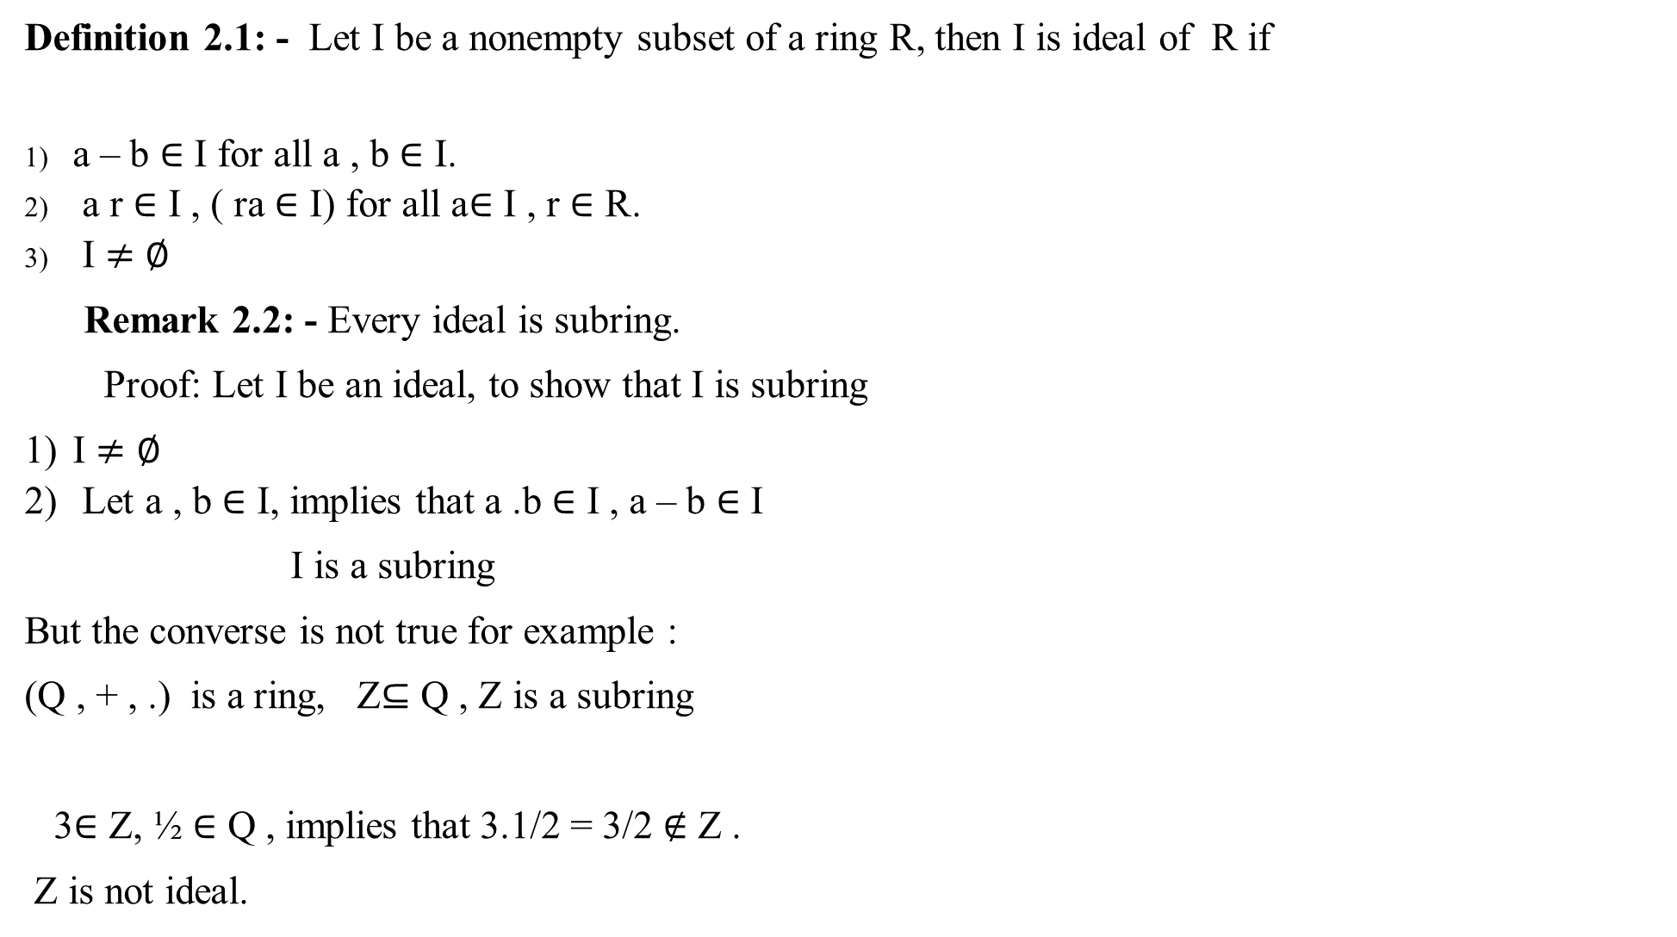
Definition 2.1: - Let I be a nonempty subset of a ring R, then I is ideal of R if
a – b $∈$ I for all a , b $∈$ I.
a r $∈$ I , ( ra $∈$ I) for all a$∈$ I , r $∈$ R.
I $≠∅$
Remark 2.2: - Every ideal is subring.
Proof: Let I be an ideal, to show that I is subring
I $≠∅$
Let a , b $∈$ I, implies that a .b $∈$ I , a – b $∈$ I
I is a subring
But the converse is not true for example :
(Q , + , .) is a ring, Z$⊆$ Q , Z is a subring
3$∈$ Z, ½ $∈$ Q , implies that 3.1/2 = 3/2 $∉$ Z .
Z is not ideal.

Slide 2

Example 2.3 : -
2Z is subring and ideal.
5Z , 3Z are ideals.
In general nZ is an ideal for all n.
Remark 2.4 : -
Let I be an ideal of a ring R with 1. If 1 $∈$ I , then I = R.
Proof :- I $⊆$ R, let r $∈$ R, 1 $∈$ I, but I is an ideal
اذن 1.r $∈$ I implies that r $∈$ I implies that R $⊆$ I. Thus I = R.

Slide 3

Remark 2. 5:-
Let I be an ideal of a ring R with 1and I contains an invertible element, then
I = R.
Proof: - a $∈$ I, but a is invertible, then there exist b $∈$ R such that a.b $∈$ I implies 1 $∈$ I
اذن I=R, by remark ( 2.4).

