Slide 1
Homomorphism
Definition 1.19:- Let R and R* be a ring, f: R→R*, then f is homomorphism if
f(a+b) = f(a) + f(b)
f(a.b) = f(a) f(b).
Example 1.20 :-
Let Ø : R→ R* s.t Ø( r )=0 for all r in R is a ring homomorphism is called zero homomorphism.
I : R → R* s . t I( r) = r for all r in R is a ring homo. is called identity homo.

Slide 2
Definition 1. 21 :-
Let f: R→R*be a ring homomorphism.
If f is one to one, then f is monomorphism.
If f is onto, then f is epimorphism.
If f is (1 – 1) and onto, then f is isomorphism.
Definition 1.22:-
If f: R→R* and f is isomorphism, then we say that R is isomorphic to R*, and R$≈$R*
Remark 1.23:-
If f: R→R*be a ring homomorphism, then
f(0_{R}) = 0_{R}
f(-a) = -f(a) for all a in R.
F(1_{R}) = 1_{R}, when R and R* are rings with identity.

Slide 3
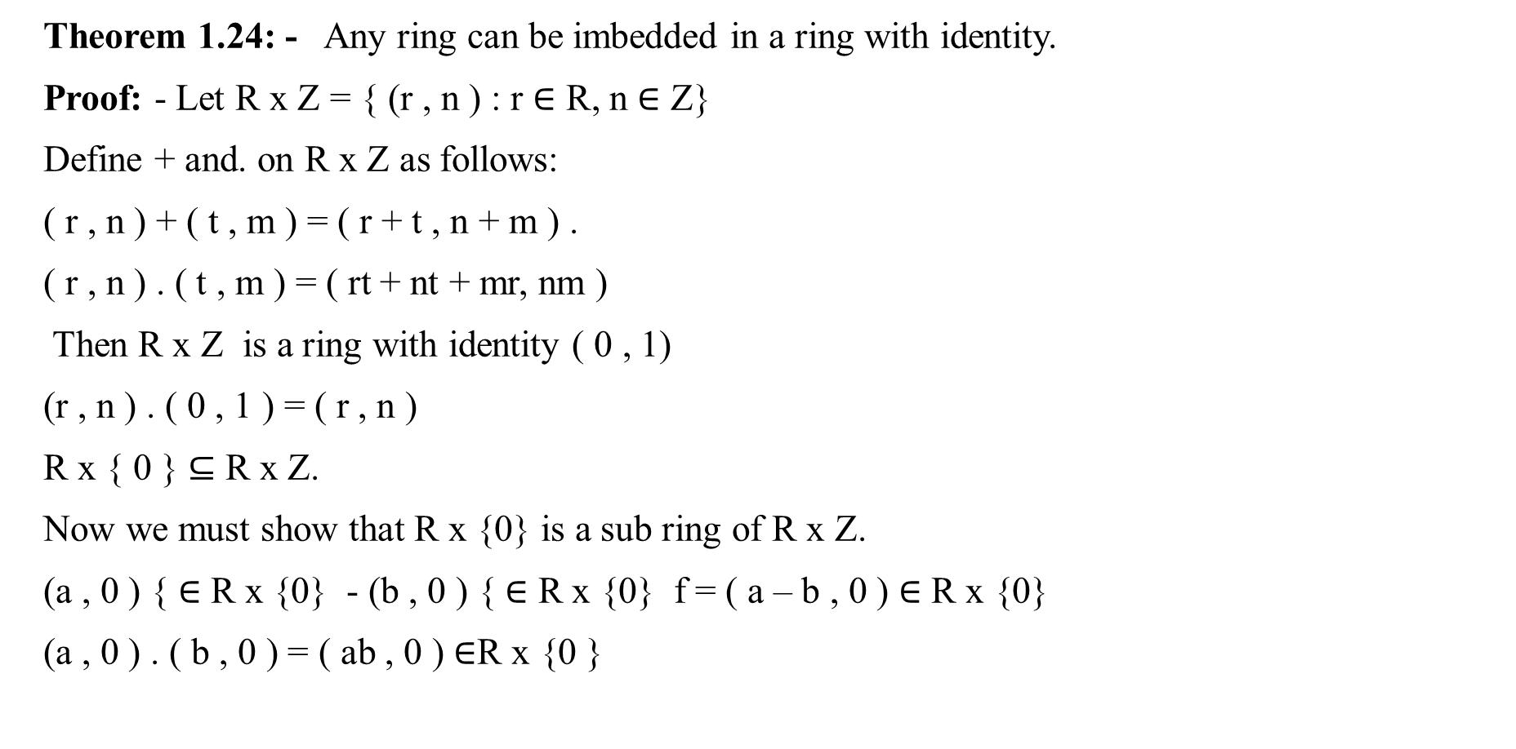
Theorem 1.24: - Any ring can be imbedded in a ring with identity.
Proof: - Let R x Z = { (r , n ) : r $∈$ R, n $∈$ Z}
Define + and. on R x Z as follows:
( r , n ) + ( t , m ) = ( r + t , n + m ) .
( r , n ) . ( t , m ) = ( rt + nt + mr, nm )
Then R x Z is a ring with identity ( 0 , 1)
(r , n ) . ( 0 , 1 ) = ( r , n )
R x { 0 } $⊆$ R x Z.
Now we must show that R x {0} is a sub ring of R x Z.
(a , 0 ) { $∈$ R x {0} - (b , 0 ) { $∈$ R x {0} f = ( a – b , 0 ) $∈$ R x {0}
(a , 0 ) . ( b , 0 ) = ( ab , 0 ) $∈$R x {0 }

Slide 4
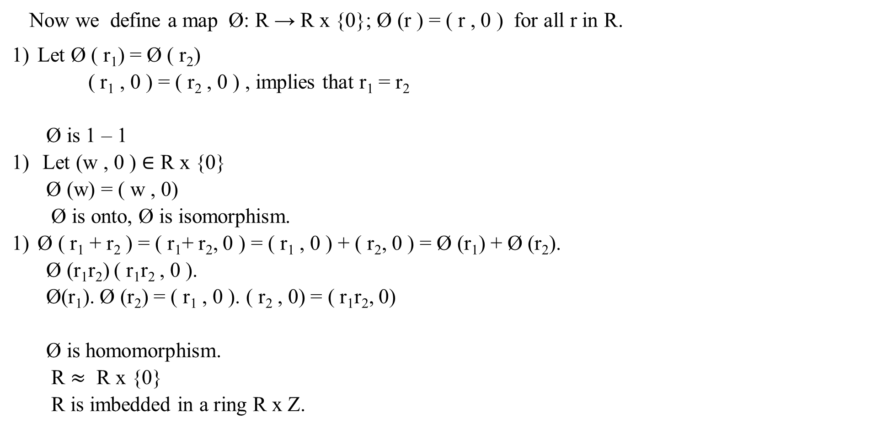
Now we define a map Ø: R → R x {0}; Ø (r ) = ( r , 0 ) for all r in R.
Let Ø ( r₁) = Ø ( r₂)
( r₁ , 0 ) = ( r₂ , 0 ) , implies that r₁ = r₂
Ø is 1 – 1
Let (w , 0 ) $∈$ R x {0}
Ø (w) = ( w , 0)
Ø is onto, Ø is isomorphism.
Ø ( r₁ + r₂ ) = ( r₁+ r₂, 0 ) = ( r₁ , 0 ) + ( r₂, 0 ) = Ø (r₁) + Ø (r₂).
Ø (r₁r₂) ( r₁r₂ , 0 ).
Ø(r₁). Ø (r₂) = ( r₁ , 0 ). ( r₂ , 0) = ( r₁r₂, 0)
Ø is homomorphism.
R $≈$ R x {0}
R is imbedded in a ring R x Z.

