Slide 1
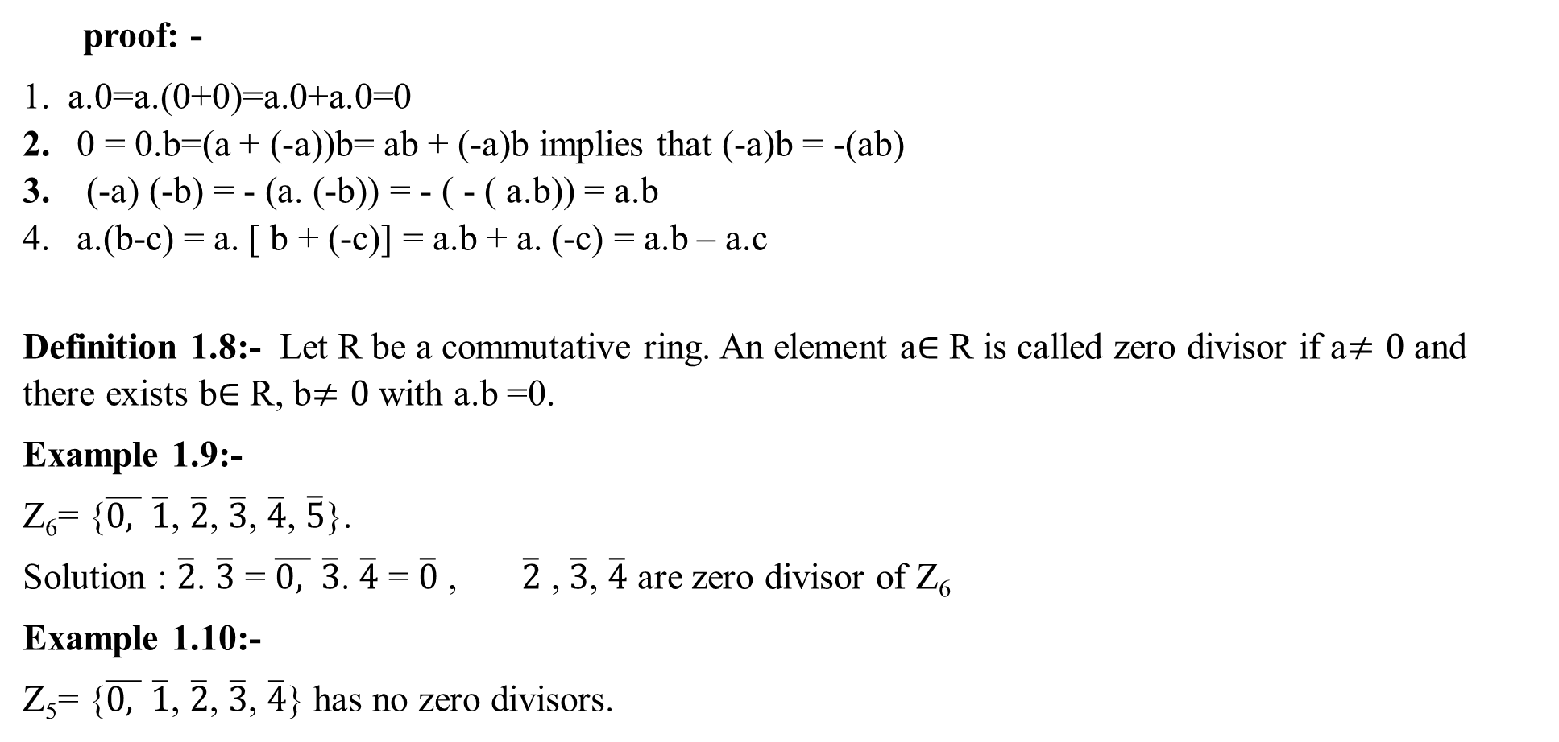
proof: -
a.0=a.(0+0)=a.0+a.0=0
0 = 0.b=(a + (-a))b= ab + (-a)b implies that (-a)b = -(ab)
(-a) (-b) = - (a. (-b)) = - ( - ( a.b)) = a.b
a.(b-c) = a. [ b + (-c)] = a.b + a. (-c) = a.b – a.c
Definition 1.8:- Let R be a commutative ring. An element a$∈$ R is called zero divisor if a$≠0$ and there exists b$∈$ R, b$≠0$ with a.b =0.
Example 1.9:-
Z₆= {$\overline{0, }$ $\overline{1}$, $\overline{2}$, $\overline{3}$, $\overline{4}$, $\overline{5}$}.
Solution : $\overline{2}$. $\overline{3}$ = $\overline{0, }$ $\overline{3}$. $\overline{4}$ = $\overline{0}$ , $\overline{2}$ , $\overline{3}$, $\overline{4}$ are zero divisor of Z₆
Example 1.10:-
Z₅= {$\overline{0, }$ $\overline{1}$, $\overline{2}$, $\overline{3}$, $\overline{4}$} has no zero divisors.

Slide 2
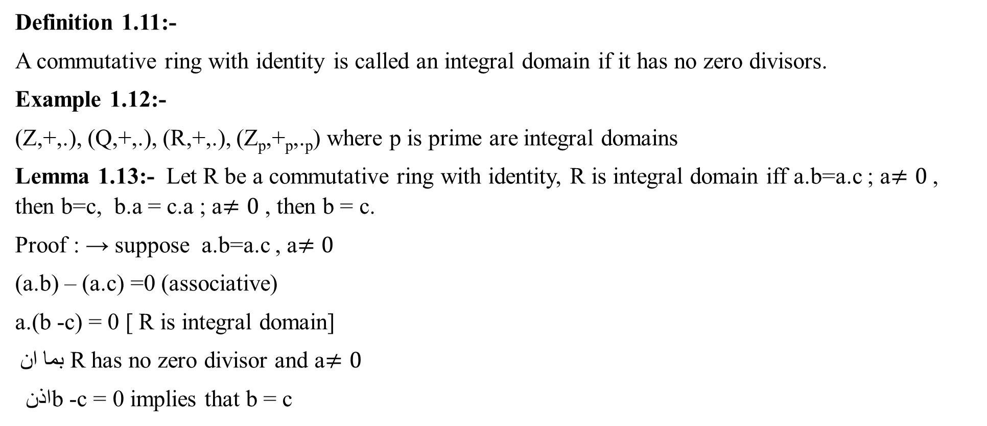
Definition 1.11:-
A commutative ring with identity is called an integral domain if it has no zero divisors.
Example 1.12:-
(Z,+,.), (Q,+,.), (R,+,.), (Z_{p},+_{p},._{p}) where p is prime are integral domains
Lemma 1.13:- Let R be a commutative ring with identity, R is integral domain iff a.b=a.c ; a$≠0$ , then b=c, b.a = c.a ; a$≠0$ , then b = c.
Proof : → suppose a.b=a.c , a$≠0$
(a.b) – (a.c) =0 (associative)
a.(b -c) = 0 [ R is integral domain]
بما ان R has no zero divisor and a$≠0$
اذن b -c = 0 implies that b = c

Slide 3
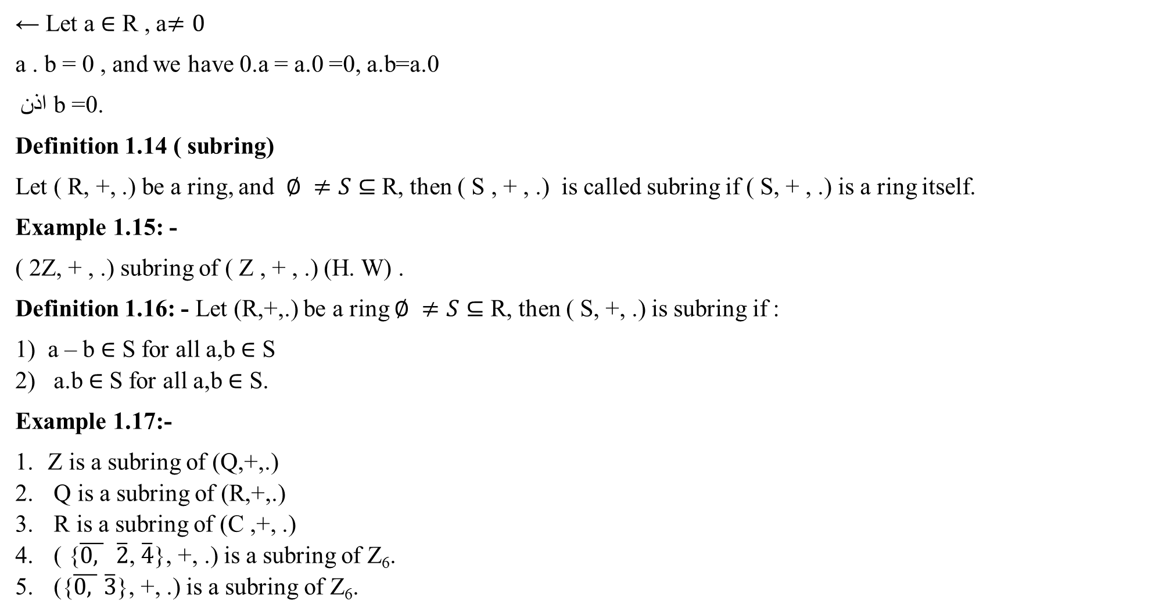
← Let a $∈$ R , a$≠0$
a . b = 0 , and we have 0.a = a.0 =0, a.b=a.0
اذن b =0.
Definition 1.14 ( subring)
Let ( R, +, .) be a ring, and $∅ ≠S⊆$ R, then ( S , + , .) is called subring if ( S, + , .) is a ring itself.
Example 1.15: -
( 2Z, + , .) subring of ( Z , + , .) (H. W) .
Definition 1.16: - Let (R,+,.) be a ring $∅ ≠S⊆$ R, then ( S, +, .) is subring if :
a – b $∈$ S for all a,b $∈$ S
a.b$∈$ S for all a,b $∈$ S.
Example 1.17:-
Z is a subring of (Q,+,.)
Q is a subring of (R,+,.)
R is a subring of (C ,+, .)
( {$\overline{0, }$ $\overline{2}$, $\overline{4}$}, +, .) is a subring of Z₆.
({$\overline{0, }$ $\overline{3}$}, +, .) is a subring of Z₆.

Slide 4
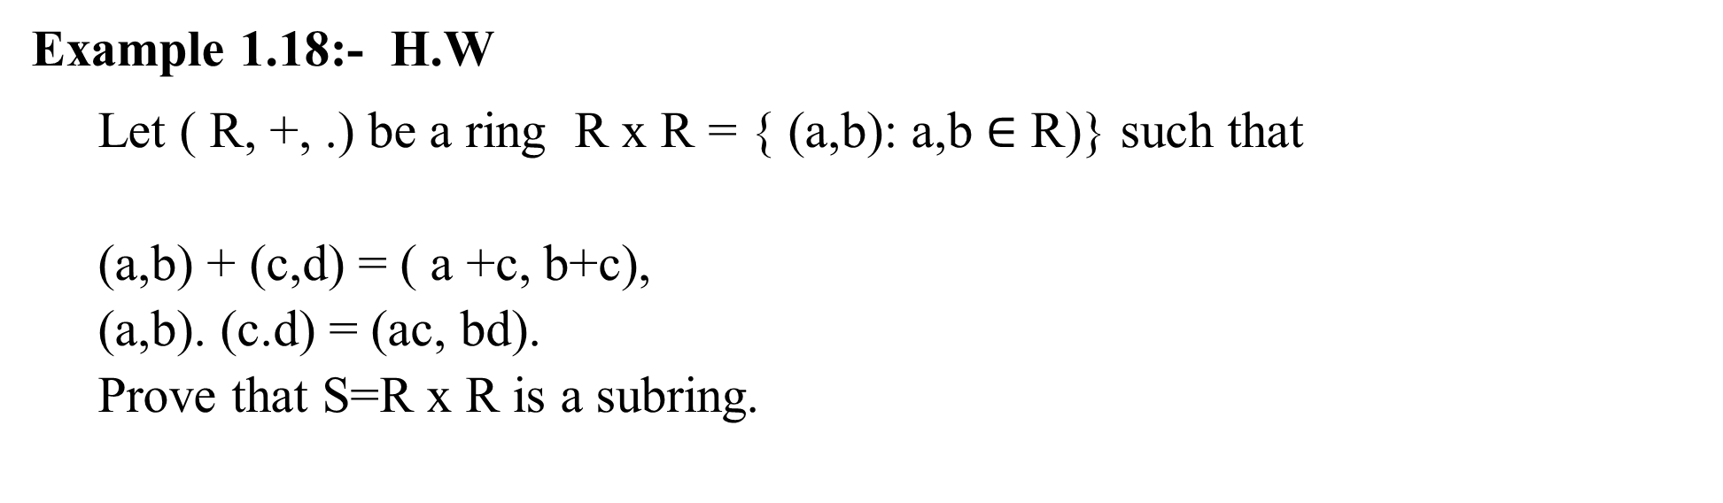
Example 1.18:- H.W
Let ( R, +, .) be a ring R x R = { (a,b): a,b $∈$ R)} such that
(a,b) + (c,d) = ( a +c, b+c),
(a,b). (c.d) = (ac, bd).
Prove that S=R x R is a subring.

