Slide 1
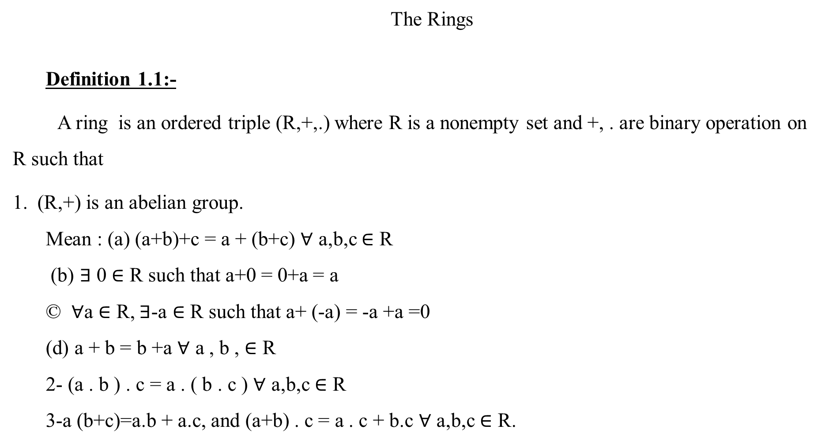
The Rings
Definition 1.1:-
A ring is an ordered triple (R,+,.) where R is a nonempty set and +, . are binary operation on R such that
(R,+) is an abelian group.
Mean : (a) (a+b)+c = a + (b+c) $∀$ a,b,c $∈$ R
(b) $∃$ 0 $∈$ R such that a+0 = 0+a = a
© $∀$a $∈$ R, $∃$-a $∈$ R such that a+ (-a) = -a +a =0
(d) a + b = b +a $∀$ a , b , $∈$ R
2- (a . b ) . c = a . ( b . c ) $∀$ a,b,c $∈$ R
3-a (b+c)=a.b + a.c, and (a+b) . c = a . c + b.c $∀$ a,b,c $∈$ R.

Slide 2
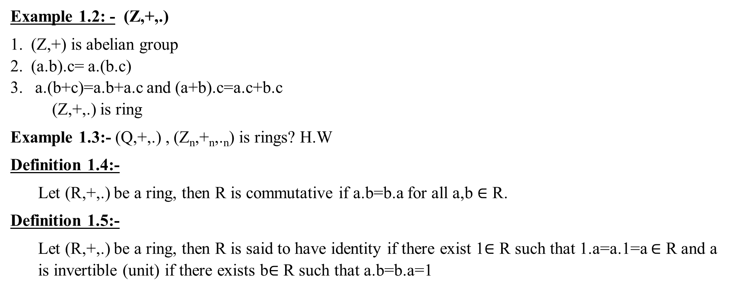
Example 1.2: - (Z,+,.)
(Z,+) is abelian group
(a.b).c= a.(b.c)
a.(b+c)=a.b+a.c and (a+b).c=a.c+b.c
(Z,+,.) is ring
Example 1.3:- (Q,+,.) , (Z_{n},+_{n},._{n}) is rings? H.W
Definition 1.4:-
Let (R,+,.) be a ring, then R is commutative if a.b=b.a for all a,b $∈$ R.
Definition 1.5:-
Let (R,+,.) be a ring, then R is said to have identity if there exist 1$∈$ R such that 1.a=a.1=a $∈$ R and a is invertible (unit) if there exists b$∈$ R such that a.b=b.a=1

Slide 3
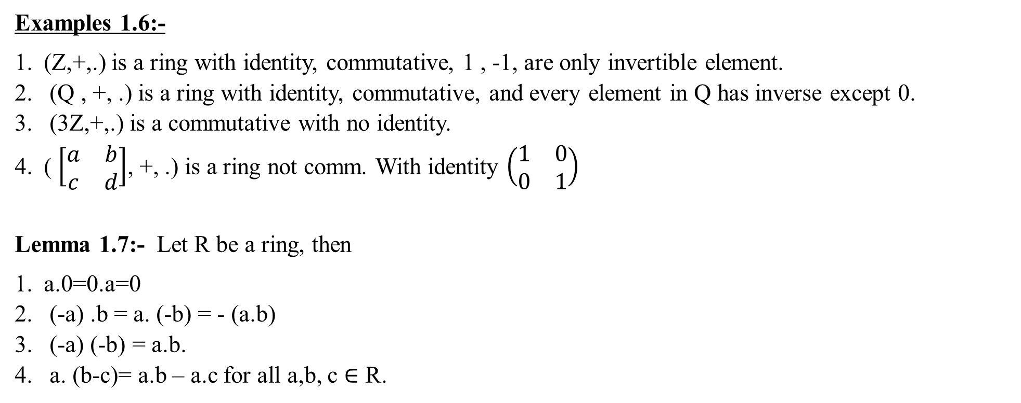
Examples 1.6:-
(Z,+,.) is a ring with identity, commutative, 1 , -1, are only invertible element.
(Q , +, .) is a ring with identity, commutative, and every element in Q has inverse except 0.
(3Z,+,.) is a commutative with no identity.
( $\left[\begin{matrix}a & b \\ c & d\end{matrix}\right]$, +, .) is a ring not comm. With identity $\left(\begin{matrix}1 & 0 \\ 0 & 1\end{matrix}\right)$
Lemma 1.7:- Let R be a ring, then
a.0=0.a=0
(-a) .b = a. (-b) = - (a.b)
(-a) (-b) = a.b.
a. (b-c)= a.b – a.c for all a,b, c $∈$ R.

