Slide 1
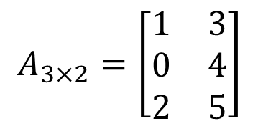
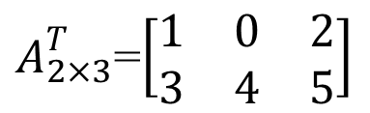
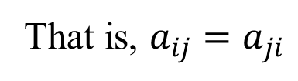
Matrices - Operations
TRANSPOSE OF A MATRIX
If :
Then the transpose of A, denoted by A^{T} is :
for all i and j

Slide 2
Matrices - Operations
To transpose a matrix A :
Interchange rows and columns of A.
The dimensions of A^{T} are the reverse of the dimension of A
If the dimension of A is (mxn) then the dimension of A^{T} is (nxm).

Slide 3
Matrices - Operations
Properties of transposed matrices:
(A+B)^{T} = A^{T} + B^{T}
(AB)^{T} = B^{T} A^{T}
(kA)^{T} = kA^{T}
(A^{T})^{T} = A

Slide 4
Matrices - Operations
(A+B)^{T} = A^{T} + B^{T}

Slide 5
Matrices - Operations
(AB)^{T} = B^{T} A^{T}

