Slide 1
Matrices
Introduction

Slide 2
Matrices - Introduction
Matrix algebra has at least two advantages:
Reduces complicated systems of equations to simple expressions
Adaptable to systematic method of mathematical treatment and well suited to computers
Definition:
A matrix is a set or group of numbers arranged in a square or rectangular array enclosed by two brackets

Slide 3
Matrices - Introduction
Properties:
A specified number of rows and a specified number of columns
Two numbers (rows x columns) describe the dimensions or size of the matrix.
Examples:
3x3 matrix
2x4 matrix
1x2 matrix

Slide 4
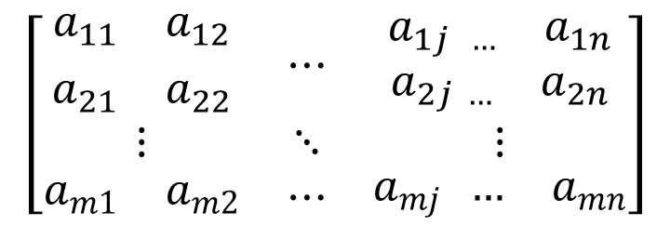
Matrices - Introduction
A matrix is denoted by a bold capital letter and the elements within the matrix are denoted by lower case letters
e.g. matrix [A] with elements a_{ij}
A_{mxn}=
i goes from 1 to m
j goes from 1 to n

Slide 5
Matrices - Introduction
TYPES OF MATRICES
Column matrix or vector:
The number of rows may be any integer but the number of columns is always 1

Slide 6
Matrices - Introduction
TYPES OF MATRICES
2. Row matrix or vector
Any number of columns but only one row

Slide 7
Matrices - Introduction
TYPES OF MATRICES
3. Rectangular matrix
Contains more than one element and number of rows is not equal to the number of columns

Slide 8
Matrices - Introduction
TYPES OF MATRICES
4. Square matrix
The number of rows is equal to the number of columns
(a square matrix A has an order of m)
m x m
The principal or main diagonal of a square matrix is composed of all elements a_{ij} for which i=j

Slide 9
Matrices - Introduction
TYPES OF MATRICES
5. Diagonal matrix
A square matrix where all the elements are zero except those on the main diagonal
i.e. a_{ij} =0 for all i = j
a_{ij} = 0 for some or all i = j

Slide 10
Matrices - Introduction
TYPES OF MATRICES
6. Unit or Identity matrix - I
A diagonal matrix with ones on the main diagonal
i.e. a_{ij} =0 for all i = j
a_{ij} = 1 for all i = j

Slide 11
Matrices - Introduction
TYPES OF MATRICES
7. Null (zero) matrix - 0
All elements in the matrix are zero
For all i,j

Slide 12
Matrices - Introduction
TYPES OF MATRICES
8. Triangular matrix
A square matrix whose elements above or below the main diagonal are all zero

Slide 13
Matrices - Introduction
TYPES OF MATRICES
8a. Upper triangular matrix
A square matrix whose elements below the main diagonal are all zero, i.e. a_{ij} = 0 for all i > j

Slide 14
Matrices - Introduction
TYPES OF MATRICES
8b. Lower triangular matrix
A square matrix whose elements above the main diagonal are all zero, i.e. a_{ij} = 0 for all i < j

Slide 15
Matrices – Introduction
TYPES OF MATRICES
9. Scalar matrix
A diagonal matrix whose main diagonal elements are equal to the same scalar, i.e. a_{ij} = 0 for all i = j, and a_{ij} = c for all i = j
A scalar is defined as a single number or constant.

