Slide 1
المحاضرة الخامسة احتمالات متقدمة
محاضرات بوربوينت

Slide 2
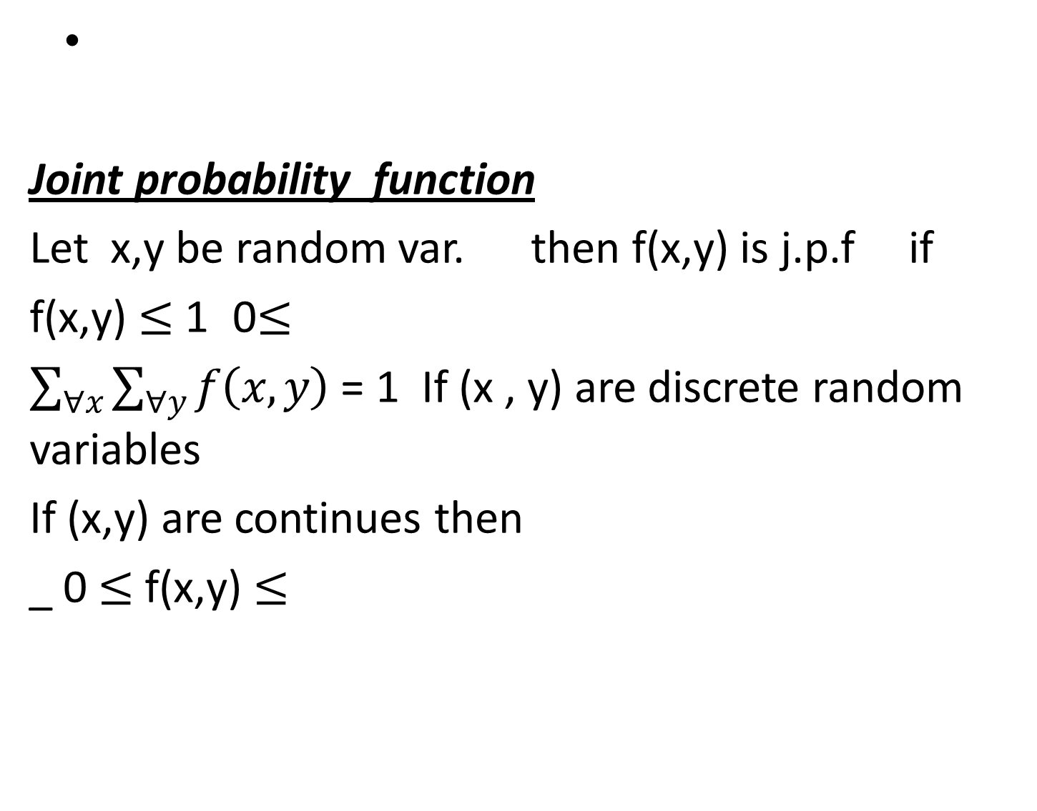
Joint probability function
Let x,y be random var. then f(x,y) is j.p.f if
0$≤$ f(x,y) $≤$ 1
$\sum_{∀x}{\sum_{∀y}{f\left(x,y\right)}}$ = 1 If (x , y) are discrete random variables
If (x,y) are continues then
_ 0 $≤$ f(x,y) $≤$

Slide 3
Ex : let f(x,y)= (x+y)/15 x=1,2 y=0,1,2
Find p(x=2,y=1) =3/15
P(x≤ 2,y=2) =px=2,y=2+
4/15 +3/15 =7/15
x/y | 0 | 1 | 2 | P(x)
1 | 1/15 | 2/15 | 3/15 | 6/15
2 | 2/15 | 3/15 | 4/15 | 9/15
P(y) | 3/15 | 5/15 | 7/15 | 1

Slide 4

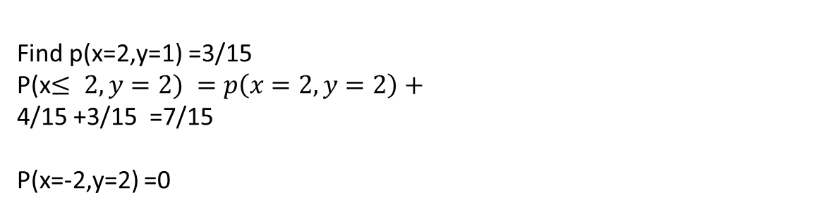
Find p(x=2,y=1) =3/15
P(x$≤ 2,y=2) =p\left(x=2,y=2\right)+$
4/15 +3/15 =7/15
P(x=-2,y=2) =0

