Slide 1
المحاضرة الرابعة احتمالات متقدمة
محاضرة بوربوينت

Slide 2
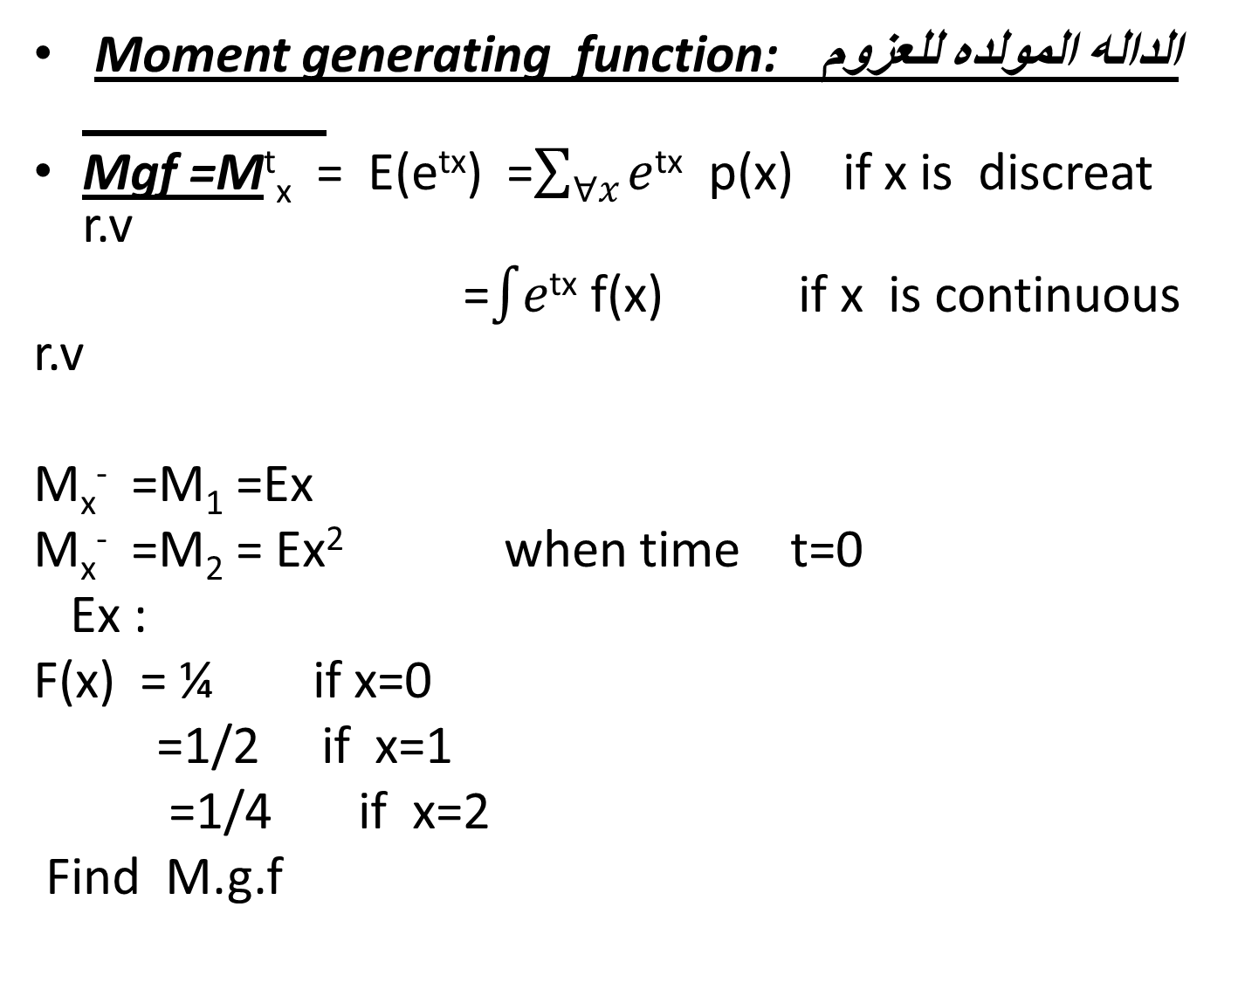
Moment generating function:الداله المولده للعزوم
Mgf =M^{t}_{x} = E(e^{tx}) =$\sum_{∀x}{e}$^{tx} p(x) if x is discreat r.v
=$\int{e}$^{tx} f(x) if x is continuous r.v
M_{x}⁻ =M₁ =Ex
M_{x}⁻ =M₂ = Ex² when time t=0
Ex :
F(x) = ¼ if x=0
=1/2 if x=1
=1/4 if x=2
Find M.g.f

Slide 3

-find mean ,vairince by M.g.f
Sol :
M_{x}^{t}= E (e^{tx}) =$\sum{e}$ ^{tx} p(x)
=1/4 e^{0t} + ½ e^{t} +1/4 e^{2t}
E(x)=M⁻ =1/2 e^{t} +1/4 e^{2t} =1 when t=0
E x² = M⁻⁻ =1/2 e^{t} +2/2 e^{2t} =1

Slide 4

Ex :
P(x) = ¼ 1$<x<5$
Find mean and var.
E(x) =$\int_{1}^{5}{xp(x)}$ =3
E(x²) =$\int_{1}^{5}{x}$² ¼ dx = 31/3
Var (x) =Ex² -(Ex)
=31/3 -3² =4/3
M^{t} =E e^{tx} =$\int_{1}^{5}{e}$^{tx} p(x) dx =$\int_{1}^{5}{e}$^{tx} ¼ dx

