Slide 1
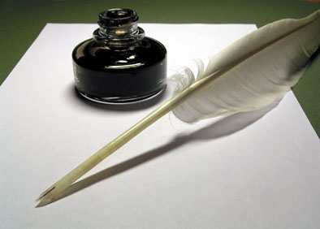
WRITING SKILLS

Slide 2
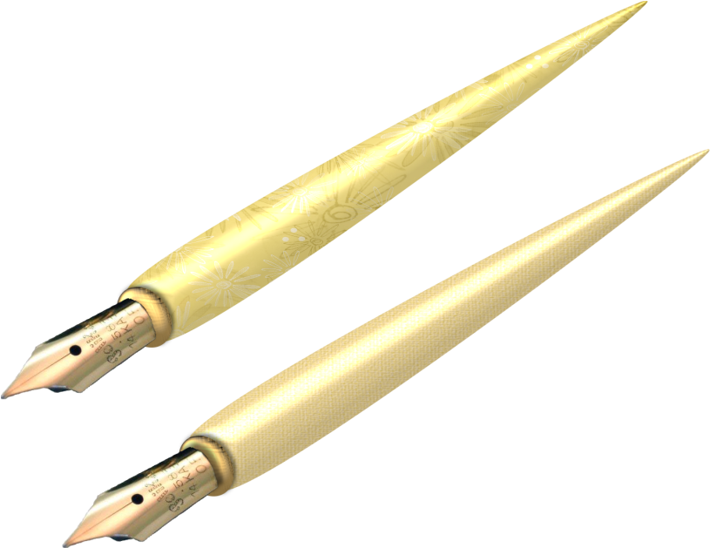
FORMAL AND INFORMAL Styles
FORMAL STYLE IS APPROPRIATE
INFORMAL STYLE IS APPRPOPRIATE
A composition
A report
A letter to somebody you do not know personally
A story
A letter to your friend
An article for your school magazine
Direct speech in a story

Slide 3
INFORMAL WRITING EXAMPLES
Contractions
There’something else I’ve got to tell you
Informal set phrases
Thank you for your letter
Informal greetings in letters
Dear Sam
Incomplete sentences
Great news about your brother
Phrasal verbs
‘go on’ instead of continue’
Informal connecting words
Well, I think that’s all I wanted to say

Slide 4
FORMAL WRITING EXAMPLES
No contractions
I do not think there is an excuse for the treatment I received
Formal set phrases
I look forward to hearing from you
Formal greetings
Dear Sir, Madam, Dear Mr/Mrs
Complete sentences
We should consider redoing the shop window display
Use of passive voice
The local sport centers were opened in the last ten years
Formal connecting words
In addition to this, many people feel that the police are underfunded

Slide 5

USEFUL PHRASE REFERENCE
INFORMAL LETTER
Greetings Dear + first name
Asking about them Hi! How are things? How’s it going?
Referring to the news Great news about… Glad to hear that…
Giving news Listen, did I tell you… You’ll never believe
what…
Making suggestions Why don’t you..? Maybe you could…
Closing expressions Well, got to go now. See you soon.
Signing off Love, Lots of love, Yours,
Name your first name

Slide 6
USEFUL PHRASE REFERENCE
FORMAL LETTER
Greeting name unknown: Dear Sir/Madam
name known: Dear Mr../Dear Mrs…/Dear Ms…
Reason for writing I am writing to.. I am writing with regards to…
Asking questions I would be grateful if.. I wonder if you could…
Referring to their letter As you started in your letter..
Regarding/Concerning..
Closing expressions I look forward to hearing from you.
Signing off If Dear + name :Yours sincerely, if Dear Sir/Madam:
Yours faithfully, Dear+name: Yours
Name your first name + surname

Slide 7
USEFUL PHRASE REFERENCES
LETTER OF APPLICATION
Greeting name unknown: Dear Sir/Madam
name known: Dear Mr../Dear Mrs../Dear Ms +name
Reason for writing I am writing to apply for the post/position of
I am writing with reference to your advertisement,
which I saw…
Your experience I gained some experience…My qualification include..
CV Please find attached my CV…
Closing expressions I look forward to hearing from you. Please do not hesitate to contact me if…
Signing off if Dear=name: Your sincerely, if Dear Sir/Madam:
Yours faithfully, Dear+=name:Yours
Name your first name + surname

Slide 8
A LETTER
Dear Rudik,
Thanks for your letter. Cambridge sounds great! I’m really glad you’ve having a good time. We all miss you here.
Yeah, buying a computer sounds a very good idea. It’s a much better idea getting a laptop, as it’s so easy to carry around.
Also, if you’re going to be using it for essays, you’ll definitely need a word processor and printer. You’d have to pay extra for them.
Anyway, that’s what think. Let me know which one you decide to get. Happy shopping! So, take care, work hard (but not to hard) and see you soon.
Bye!
Emma

Slide 9
A LETTTER
Dear Ms Turner,
I am writing in response to your advertisement for tour guides, which I read in the ‘Reporter’ on 11th June. I would like to apply for one of the advertised positions.
I am very interested ib modern art and would welcome the opportunity to inform visitors to the gallery. I have previously worked in a local museum, as you can see from my attached CV.
I also believe I have the personal qualities and qualifications necessary for this position. I speak French as my first language and recently passed the Cambridge First Certificate in English examination with ‘A’ grade.
Should you require any further information, please do not hesitate to contact me. I am available for interview at your convenience.
Yours sincerely,
Paul Bishop

Slide 10
A FORMAL LETTER
Reservations Manager
Calton Hotel
78 Park Lane
Bristol
June 16
Dear Jack/Sir or Madam
I am writing/This is just a note to confirm a reservation that was made/I asked you for this morning by telephone. This reservation, for a couple of/two nights, is for me/myself, David Cook.
I want/would like a room with a bathroom. I will be attending/I’m going to pop into The Trade Fair that is being held/is going on in Bristol that week.
It is all right/Would it be possible for me to have a room at the back of the hotel?
Thank you/Thanks for sending me the brochure about/regarding your conference facilities. Unfortunately/I’m sorry I can’t give you/I am unable to provide you with any definite dates at the moment/now,as/because we have yet to finalize/sort out the details of our sales conference. But/However, I will contact/ I’ll drop a line as soon as I can/possible.
I look/I’m looking forward to meeting you on 12 July.
Best wishes/Yours faithfully,
David Cook.

Slide 11
CURRICULUM VITAE
A. PERSONAL DETAILS
Name_________________________
Address________________________
Telephone______________________
Date of birth____________________
Nationality_____________________
B. EDUCATION
Qualification____________________
Languages _____________________
C. WORK EXPERIENCE
________________________________
D. PERSONAL QUALITIES
________________________________

Slide 12
Part-time/weekend SALES ASSISTANT
for city gift shop
Must be trustworthy
and have a friendly
sociable personality.
Would suit a student.
Please apply in writing to:
Simon Willis, PO Box 234

Slide 13
HOW MANY BROTHER AND SISTERS YOU HAVE
PREVIOUS WORK EXPERIENCE
HOW MANY GCSe/OTHER QUALIFICACTION YOU HAVE
WHERE YOU SAW THE ADVERT
WHAT YOU LOOK LIKE
WHY YOU ARE INTERESTED IN THE JOB
WHAT PETS YOU HAVE
YOUR POSITIVE QUALUTUES
NEGATIVE THINGS ABOUT YOUR PERSONALITY
WHEN YOU ARE AVAILABLE FOR AN INTERVIEW
WHEN YOU COULD START WORK
WHAT LANGUAGES YOU SPEAK
YOUR AGE
WHAT YOU DO/WHAT ARE YOU STUDYING

Slide 14

A LETTER OF APPLICATION
28 Leahurst Rd
York
YK13 SNL
14th September
Dear Mr Willis,
I am writing to apply for the position of Part-Time Sales Assistant which I saw in the newspaper I bought while I was walking my dog , Pedro, yesterday.
I am 16 years old, I am tall and I have got long brown curly hair. I have got one sister, who I get on with very well.
Although I don’t have any experience of working in a shop, I want to work for you. I have had a regular baby-sitting job for a year now. I am trustworthy and reliable, but I can sometimes be a little impatient and moody.
I’m free to start from July. I finish my exams at the end of May so I can’t wait to hear from you.
Yours sincerely,
A.Leary
Andrea Leary

Slide 15
Write a letter of application (100-150 words) choosing the following adverts
WANTED :
Receptionist’s to work in doctor’s surgery at weekends. Would suit teenager who wishers to learn about medicine as a possible career.
Please apply in writing to
Dr BROWN, Harley Road.
WANTED :
ENERGETIC AND CONFIDENT
Summer WAITERS/WAITRESSES
June-August
Languages & experience working with people an advantage.
Send CV and letter of application to : Mr Brown, The Blue Whale Restaurant, 17 White Road, Dover

Slide 16

CHECKING YOUR WRITING
Always check that your writing is consistent with your purpose. In your letter of application, check that:
You have painted a good picture of yourself
Dates, qualifications, experience are consistent
There is no irrelevant information included
It is easy for the reader to follow
GOOD LUCK !!!

Slide 17
Составила учитель английского языка I категории лицея № 12 города Лениногорска РТ
Шашкова Елена Сергеевна (252-003-676)

