Slide 1

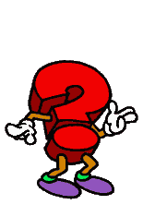
QUESTION WORDS

Slide 2
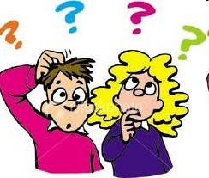
WHAT?
What’s your favourite drink?
What is she like?

Slide 3


WHO?
Who’s your English teacher?

Slide 4
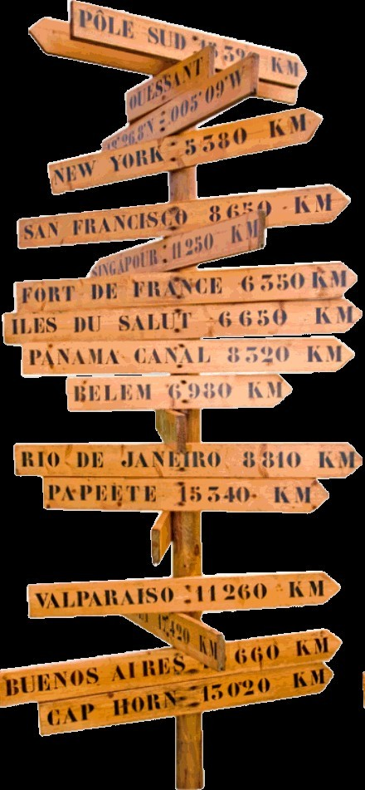
WHERE?
Where is the nearest bank?

Slide 5
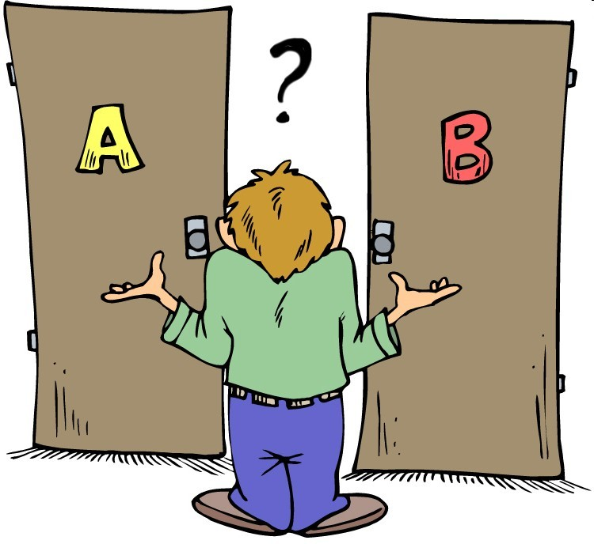
WHICH?
Which
door should I open?

Slide 6

WHEN?
When is your birthday?

Slide 7

HOW
MANY?
How many
balls are there?

Slide 8
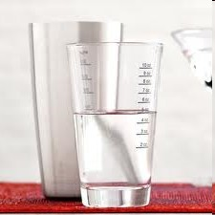
HOW MUCH?
How much water do you usually drink ?

Slide 9

HOW MUCH?
How much is that pair of jeans?

Slide 10

WHAT TIME?
What time does the football match begin?

Slide 11

WHY?
Why are you so happy?

Slide 12

HOW LONG?
How long have you been a sports fan?

Slide 13
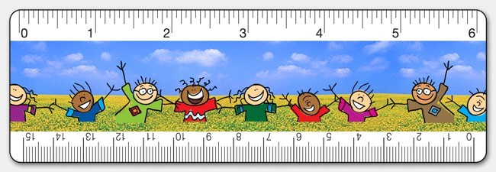
HOW LONG?
How long is your table?

Slide 14

Exercise
•
Complete with the correct question word.
1. ^{W}....^{H}....^{E}....^{R}...^{E}.......... are my keys?
..
2. ...W....H....A....T.. is the problem?
3. .^{W}....^{H}....^{O}....... is your favourite singer?
4. .W....H....E....R... are you
froEm?
5. ^{W}....^{H}....^{E}....^{N}.... is your
birthday?

Slide 15

6. .......^{H}....^{O}....^{W}........... do you eat
fast fOooFdT? EThNree times a week.
7. .....^{H}...^{O}....^{W}......... dogs have you got? 2
MANY
9. .W....H....O....... is your best
8.^{W}...^{H}....^{O}....^{S}...^{E}.. pen is this? It’s
friend?
Sally’s.
10. ..........^{H}....^{O}....^{W}........... is this book? £12.
MUCH
11. .........^{H}....^{O}....^{I}..^{W}......... sugar
is there?MUCH
13.^{W}...^{H}....^{A}....^{T}..... is your e-mail?
12.W....H....E...... is your
graduNation? Tomorrow.

Slide 16
14. ..^{W}....^{H}....^{Y}...... is she crying?
Because her cat died.
^{W}.....^{H}...^{A}.....^{T}... is your last name? Smith.
.^{W}....^{H}....^{O}....... is your favourite actor?
Leonardo
DiCaprio.
17.^{W}....^{H}....^{A}....^{T}.... is she like? She’s medium height and slim.
18. ....^{H}...^{O}....^{W}.......... have you been living here? For two years.
LONG
19. ..^{H}....^{O}....^{W}..... is your baby?
OLD
Two years old.

Slide 17
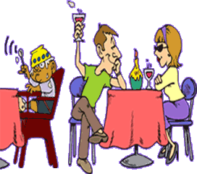
Questions - Practice
Ask your friend some more questions.
Ex: Who is your best friend at school?
How many school subjects do you have?

Slide 18

Good work!

