Slide 1
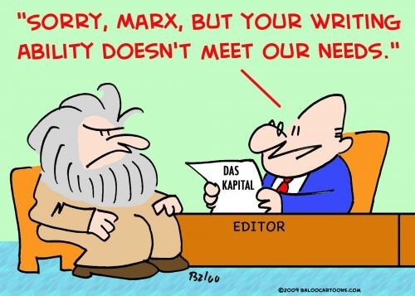
Writing a formal letter
Source: www.usingenglish.com/resources/letter-writing.html#layout

Slide 2
Rules for Writing Formal Letters in English
In English there are a number of conventions that should be used when writing a formal or business letter. Furthermore, you try to write as simply and as clearly as possible, and not to make the letter longer than necessary. Remember not to use informal language like contractions.
Addresses:
Your Address
The return address should be written in the top right-hand corner of the letter.
The Address of the person you are writing to
The inside address should be written on the left, starting below your address.
Date:
Different people put the date on different sides of the page. You can write this on the right or the left on the line after the address you are writing to. Write the month as a word.

Slide 3
Salutation or greeting:
Dear Sir or Madam,
If you do not know the name of the person you are writing to, use this. It is always advisable to try to find out a name.
Dear Mr Jenkins,
If you know the name, use the title (Mr, Mrs, Miss or Ms, Dr, etc.) and the surname only. If you are writing to a woman and do not know if she uses Mrs or Miss, you can use Ms, which is for married and single women.

Slide 4
Content of a Formal Letter
First paragraph
The first paragraph should be short and state the purpose of the letter- to make an enquiry, complain, request something, etc.
The paragraph or paragraphs in the middle of the letter should contain the relevant information behind the writing of the letter. Most letters in English are not very long, so keep the information to the essentials and concentrate on organising it in a clear and logical manner rather than expanding too much.
Last Paragraph
The last paragraph of a formal letter should state what action you expect the recipient to take- to refund, send you information, etc.

Slide 5
Ending a letter:
Yours faithfully
If you do not know the name of the person, end the letter this way.
Yours sincerely
If you know the name of the person, end the letter this way.
Your signature
Sign your name, then print it underneath the signature. If you think the person you are writing to might not know whether you are male of female, put you title in brackets after your name.

