Slide 1
BE GOING TO AND
WILL FUTURE

Slide 2
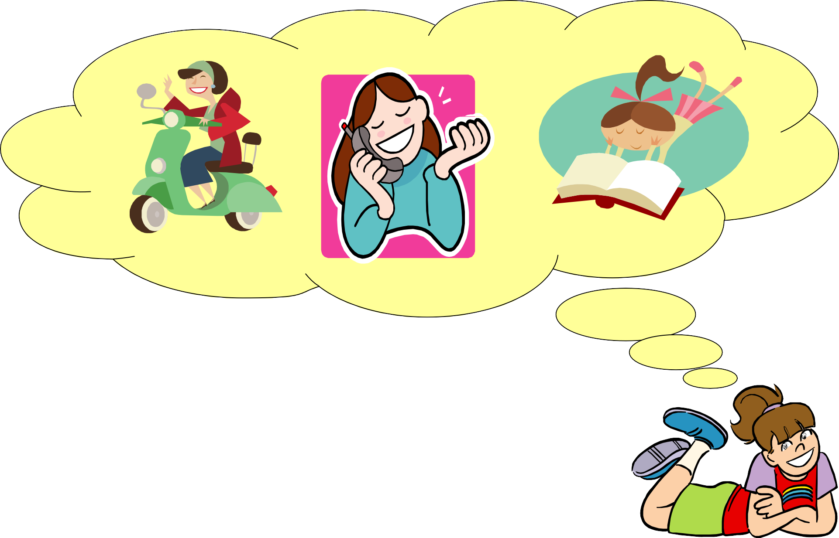
I AM GOING TO : I HAVE DECIDED TO DO STH.
Today, I am going to drive my new motorcycle, then I am going to phone my best friend and finally I am going to read my favourite novel.

Slide 3

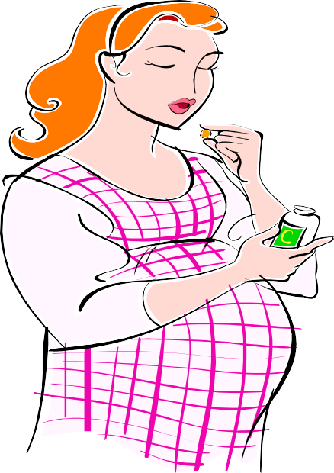
IS GOING TO HAPPEN: The situation now make us believe that.
Look at those black clouds! It’s going to rain.
She is pregnant.
She is going to have a baby.
PREDICTIONS WITH PRESENT EVIDENCE

Slide 4



WILL
I left the door open. I will close it right now.
(In the restaurant)
W :What would you like to drink?
  I will have a cup of coffee, please.
Did you call Sue? No, I forgot it.
I will call her tonight
Decisions at the time of speaking

Slide 5

I am little hungry.
I think I will have a sandwich.
I don’t think I will go out tonight. I am too tired.
Personal opinion

Slide 6
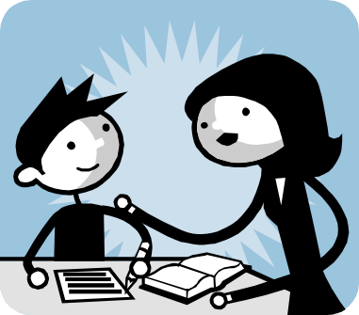
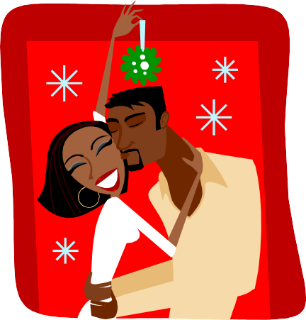


Don’t worry. I will help you with your homework.
I will love you forever.
Offers Promises Predictions
You will be rich

Slide 7
Exercises.- Choose the correct form of the verb.
1) Why are you working so hard these days? (buy)
- Because I’m going to buy a car , so I’m saving as much as I can
2) What are you going to buy Jill for her birthday? (buy)
A CD.
-mmm But She hasn’t got a CD player.
In that case, I will buy her a book.
3) Dad, can you mend this for me?
- I’m sorry. Ask Mum. _{She} will _{do it for you.}
4) Why have you got so many eggs?
-Because I
am going to make an omelette.
5) I haven’t got enough money to get home.
- I
will lend you some, if you like. How much do you need?

Slide 8






Slide 9
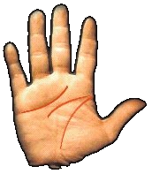
HEART LINE:
Marked line: Lucky in love!
Happy relationships.
Weak line: Unlucky in love/ Unloyalty
THE HEAD LINE
Curve – Marked line:
Brilliant memory/ creativity/ Unrealistic
Straigth- Weak line:
Bad Memory/ Poor concentration/ Realistic
THE LIFE LINE
Large and marked line: Good health / Energy /Power Weak line:
A lot of illness/ weak

Slide 10
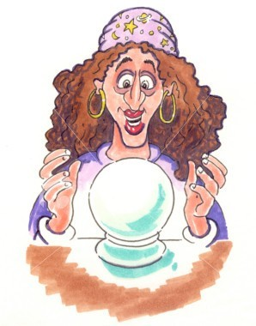
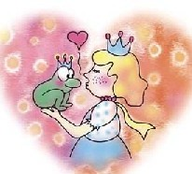
The Dianarella’s Future

Slide 11
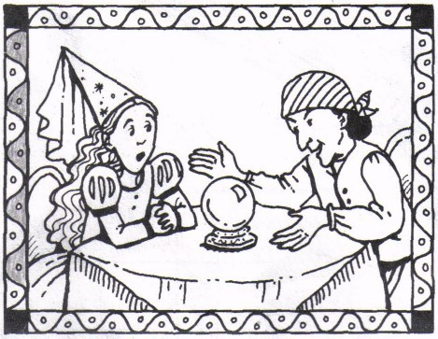
Dianarella is a princess. She wants to know what will happen to her in the future, so she goes to visit a fortune teller.
D: Can you see my future?
FT: I certainly can. D: Tell me about it!
FT: You will marry a rich prince.
D: Auch! Can you see him?
Is he handsome?
FT: Well … Not when you first meet him…He looks like a frog!

Slide 12
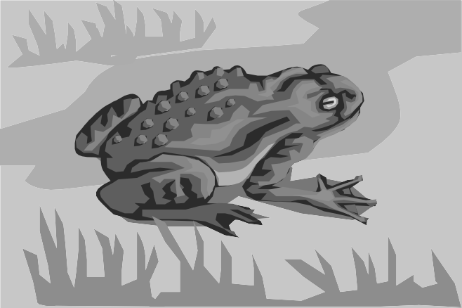
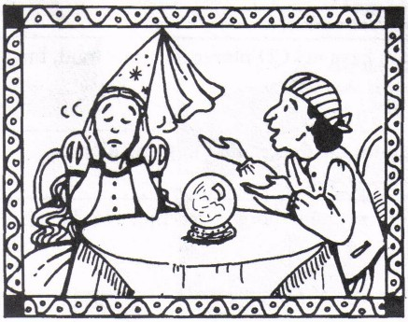
P: A frog?
F: Yes…Some day you will meet a frog! And you will kiss it.
P: I will not!
F: Yes, you will and it will turn to a handsome prince!
FT: What are you doing?
P: I’m not going to listen to any more! I’m going to back to the palace!
FT: You can’t change the future my dear…

Slide 13
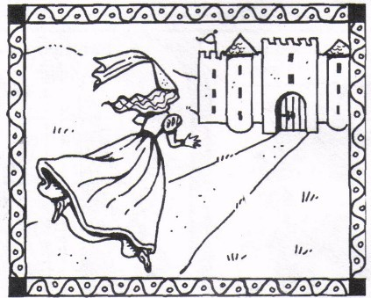
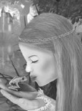
(When Dianarella returns to the palace…)
FT: Oh!! My dear, you will have to kiss a lot of frogs before to find the right one.

