Slide 1
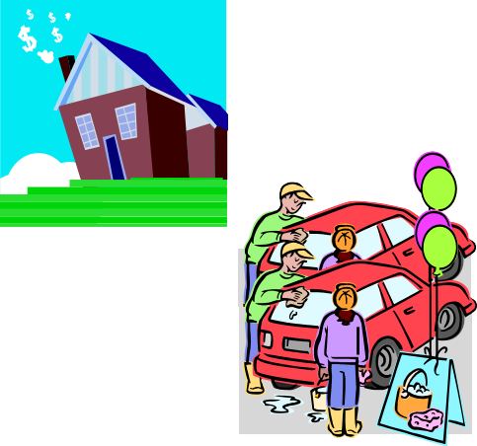
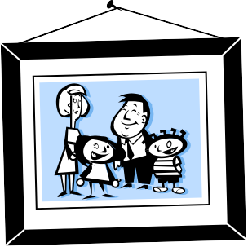
Have/ have got.
Uses.
We don’t have a house in spain. Paul has a car. |  | We haven’t got a house in spain. Paul’s got a car.
Jane has a brother and a sister. |  | Jane’s got a brother and a sister.

Slide 2
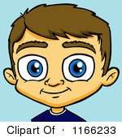
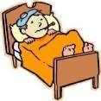
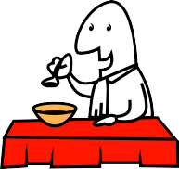


Have/ have got.
Uses.
He has blue eyes. Does your brother have long hair or short hair? |  | He’s got blue eyes. Has your brother got long hair or short hair?
I have a headache |  | I’ve got a headache
Do you normally have a big breakfast? Have a good holiday! He’s having a bath at the moment.

Slide 3
Verb “To have”
SIMPLE PRESENT
Affirmative | Negative
I have You have He/ she/ it has | I don’t have You don’t have He, she, it doesn’t have
We have You have They have | We don’t have You don’t have They don’t have
Interrrogative
Do I have? Do you have? Does he, she, it have? |  | Yes, I do Yes, you do Yes, he/ she/ it does | No, I don’t No, you don’t No, he/ she/ it doesn’t
Do we have? Do you have? Do they have? |  | Yes, we do Yes, you do Yes, they do | No, we don’t No, you don’t No, they don’t

Slide 4
Verb “To have got”
SIMPLE PRESENT
Affirmative |  |  | Negative
I have got You have got He/ she/ it has got | I’ve got You’ve got He’s/ she’s/ it’s* got |  | I haven’t got You haven’t got He, she, it hasn’t got
We have got You have got They have got | We’ve got You’ve got They’ve got |  | We haven’t got You haven’t got They haven’t got
Interrrogative
Have I got? Have you got? Has he, she, it got? |  | Yes, I have Yes, you have Yes, he/ she/ it has | No, I haven’t No, you haven’t No, he/ she/ it hasn’t
Have we got? Have you got? Have they got? |  | Yes, we have Yes, you have Yes, they have | No, we haven’t No, you haven’t No, they haven’t

