Slide 1
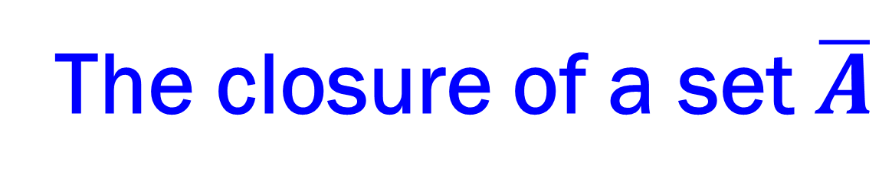
Lecture 4
The closure of a set $\overline{A}$

Slide 2
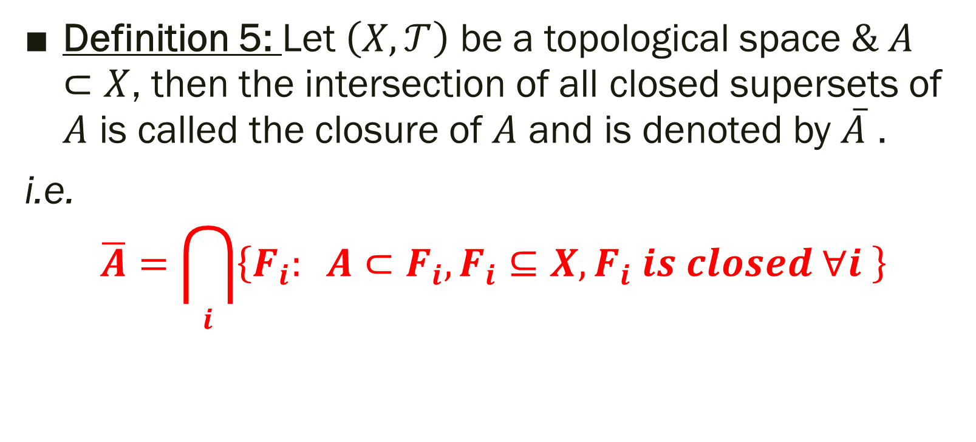
The closure of a set
Definition 5: Let $\left(X, 𝒯\right)$ be a topological space $\& A⊂X$, then the intersection of all closed supersets of $A$ is called the closure of $A$ and is denoted by $\overline{A}$ .
i.e.
$$\overline{A}=\bigcap_{i}{\left\{F_{i}: A⊂F_{i}, F_{i}⊆X, F_{i} is closed ∀i \right\}}$$

Slide 3
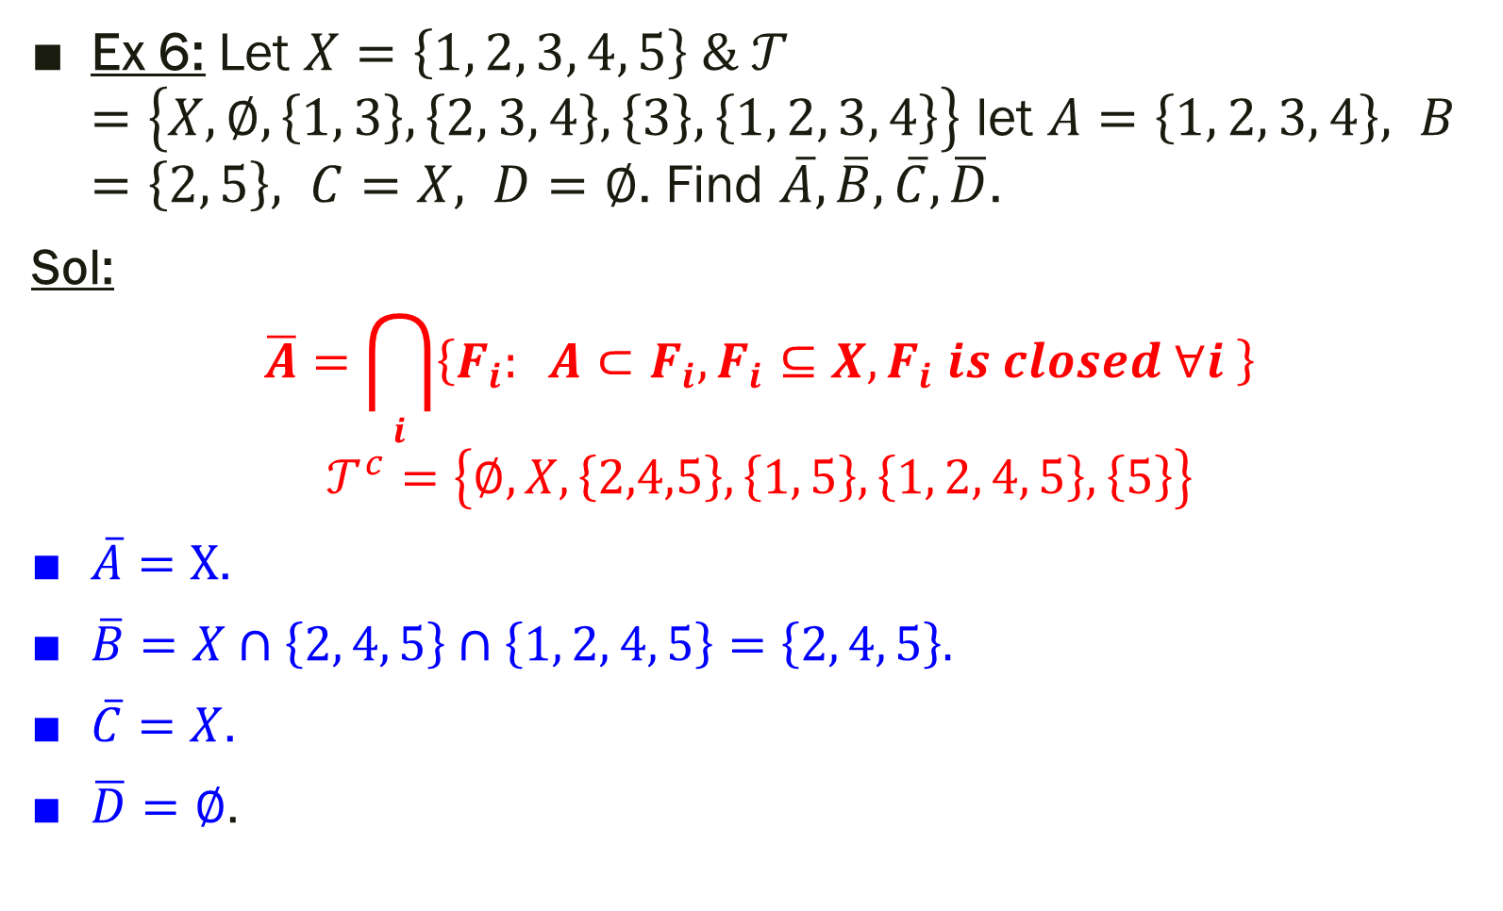
Ex 6: Let $X=\left\{1, 2, 3, 4, 5\right\} \& 𝒯=\left\{X, ∅, \left\{1, 3\right\}, \left\{2, 3, 4\right\}, \left\{3\right\}, \left\{1, 2, 3, 4\right\}\right\}$ let $A=\left\{1, 2, 3, 4\right\}, B=\left\{2, 5\right\}, C=X, D=∅$. Find $\overline{A}, \overline{B}, \overline{C}, \overline{D}$.
Sol:
$$\overline{A}=\bigcap_{i}{\left\{F_{i}: A⊂F_{i}, F_{i}⊆X, F_{i} is closed ∀i \right\}}$$
$$𝒯^{c}=\left\{∅, X, \left\{2,4,5\right\}, \left\{1, 5\right\}, \left\{1, 2, 4, 5\right\}, \left\{5\right\}\right\}$$
$\overline{A}=X$.
$\overline{B}=X∩\left\{2, 4, 5\right\}∩\left\{1, 2, 4, 5\right\}=\left\{2, 4, 5\right\}.$
$\overline{C}=X$.
$\overline{D}=∅$.

Slide 4

Theorem 5:
$\overline{A}$ is the smallest closed set contains $A$.
Proof:
From definition of $\overline{A}$ , we get
$∵\overline{A}$ is the intersection of all closed set supersets of $A$.
$∴$ $\overline{A}$ is the smallest.
$\overline{A}$ is closed set
$A⊂F_{i} ; ∀ F_{i}$is closed (by definition)
$∴A⊂∩F_{i}$.
$∴A⊂\overline{A}$.

Slide 5

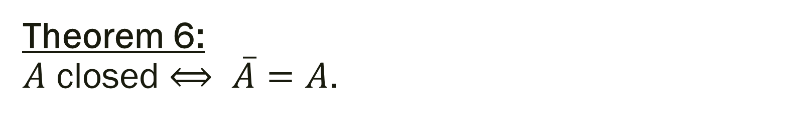
Theorem 6:
$A$ closed $⟺ \overline{A}=A$.
Proof:
The right side :
$A$ is closed (given)
$∴A$ is the smallest closed set contains itself.
$∴\overline{A}=A$ (by (i) from 1)
The left side:
$\overline{A}=A$ (given)
$∵\overline{A}$ is closed (from 1)
$\& \overline{A}=A$
$∴A$ is closed.

Slide 6
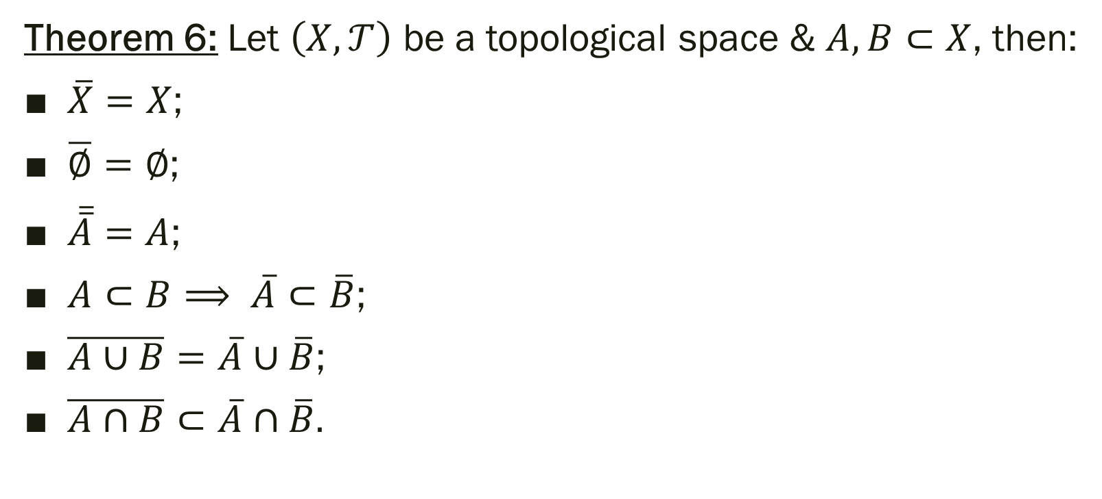
* Properties of closures of sets:
Theorem 6: Let $\left(X, 𝒯\right)$ be a topological space & $A, B⊂X$, then:
$\overline{X}=X$;
$\overline{∅}=∅$;
$\overline{\overline{A}}=A$;
$A⊂B⟹ \overline{A}⊂\overline{B}$;
$\overline{A∪B}=\overline{A}∪\overline{B}$;
$\overline{A∩B}⊂\overline{A}∩\overline{B}.$

