Slide 1
الطاقة الكلية في الحركة الدائرية
المحاضرة الثالتة عشر

Slide 2
الطاقه في الحركة الدائرية
When a body of mass m moving with speed v in circular orbit around another body of mass M where M>>m as the earth around the sun or satellite around the earth, the body of mass M is at rest with respect to the frame of reference. The total energy of the two body system is the sum of the kinetic energy and the potential energy.
E = K + U

Slide 3
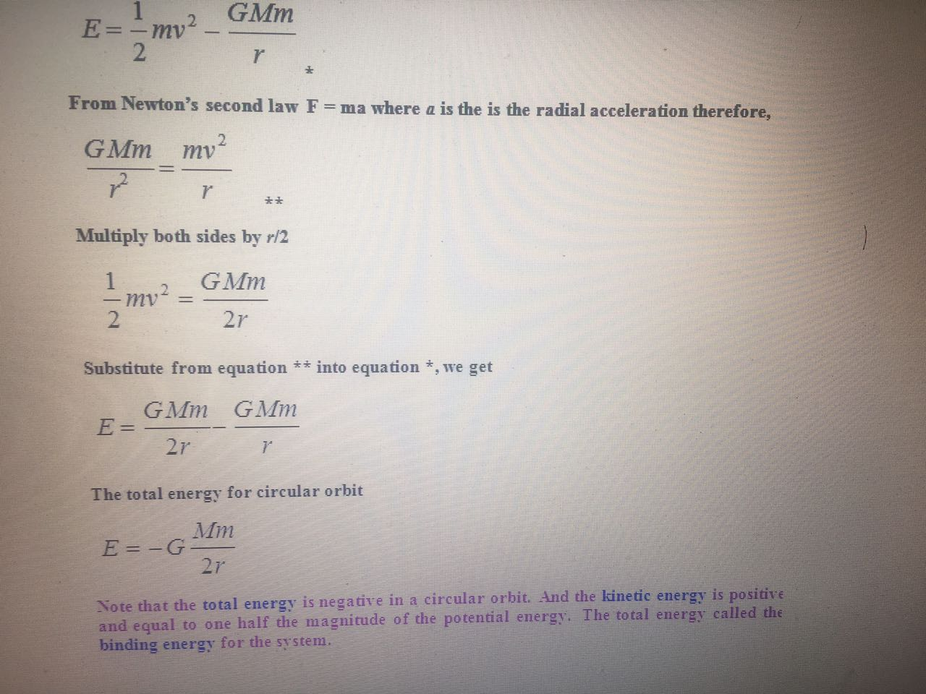

Slide 4
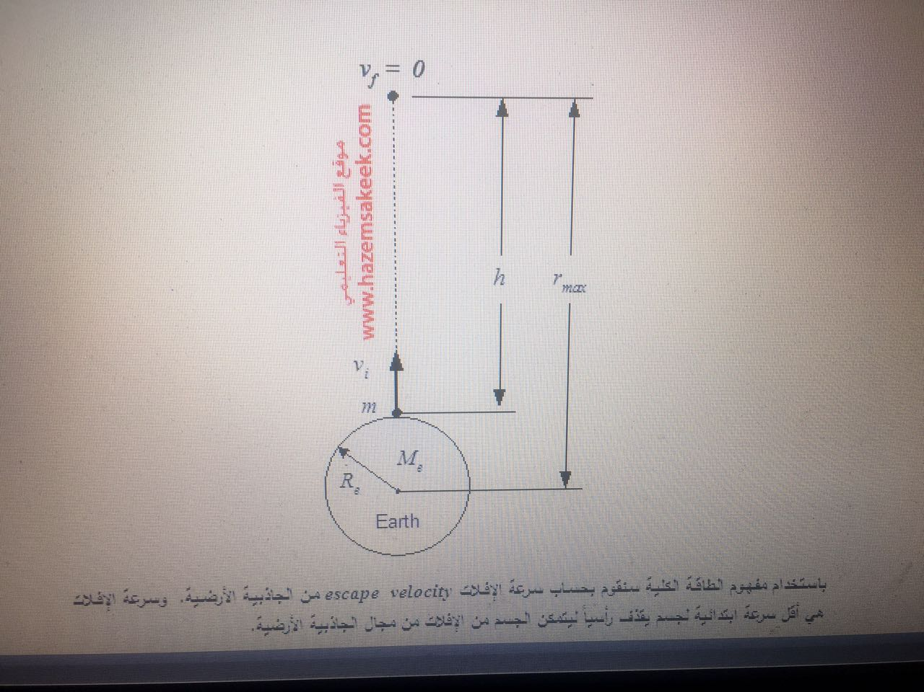

Slide 5
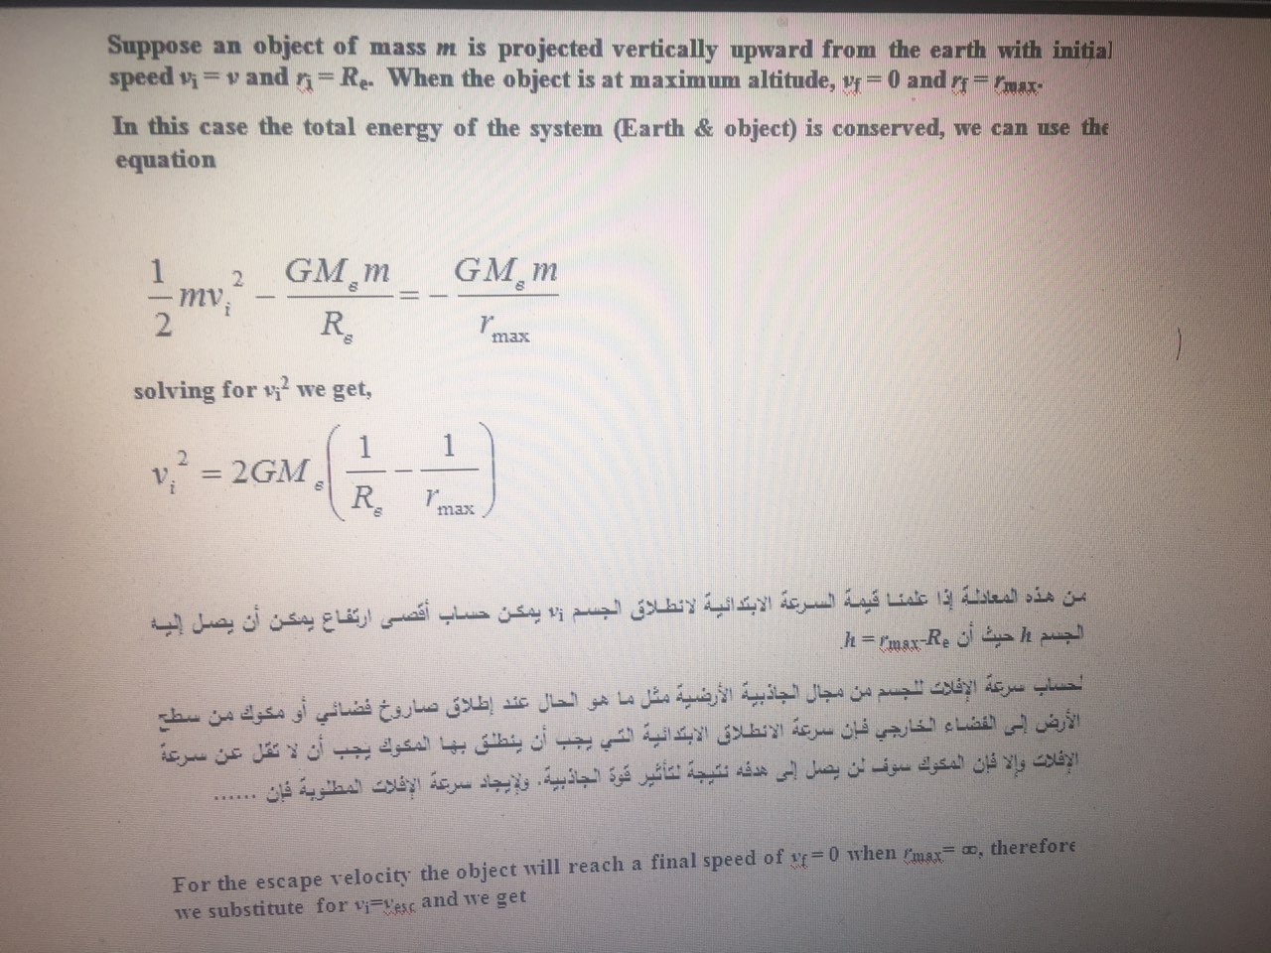

Slide 6
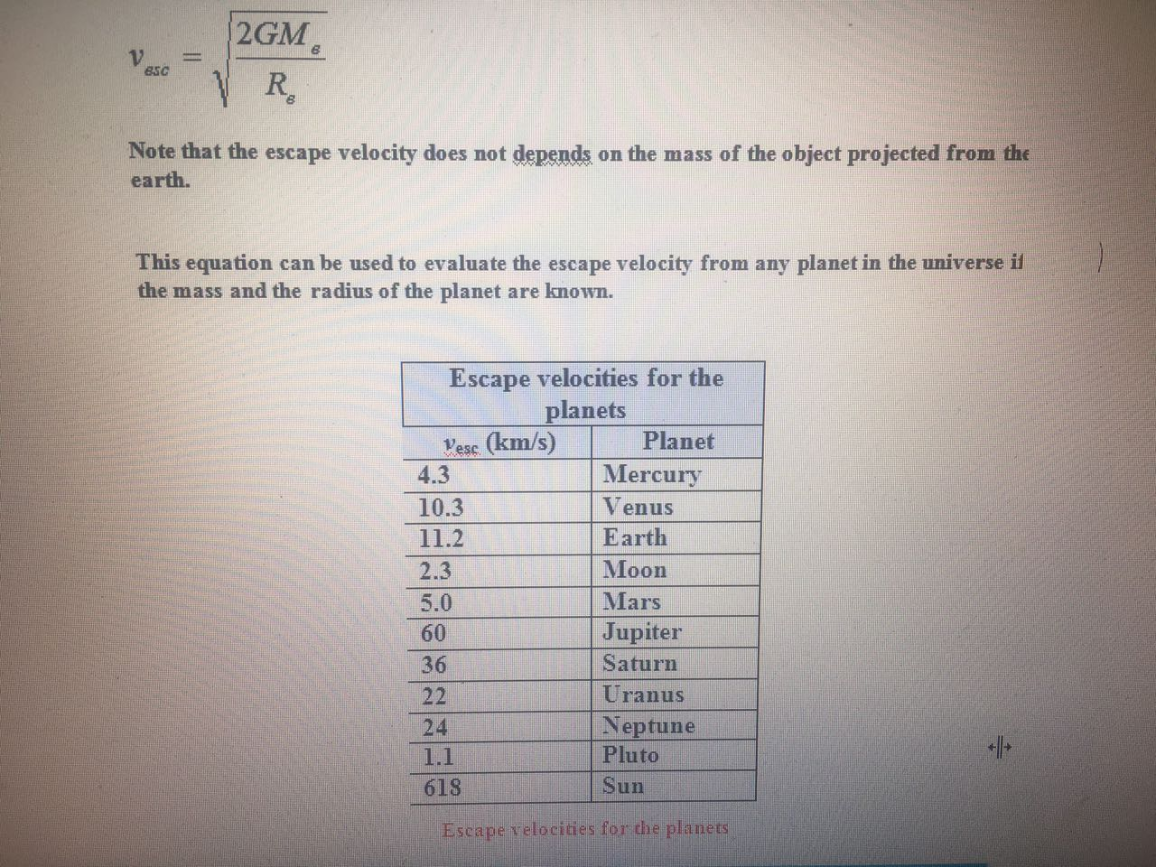

Slide 7
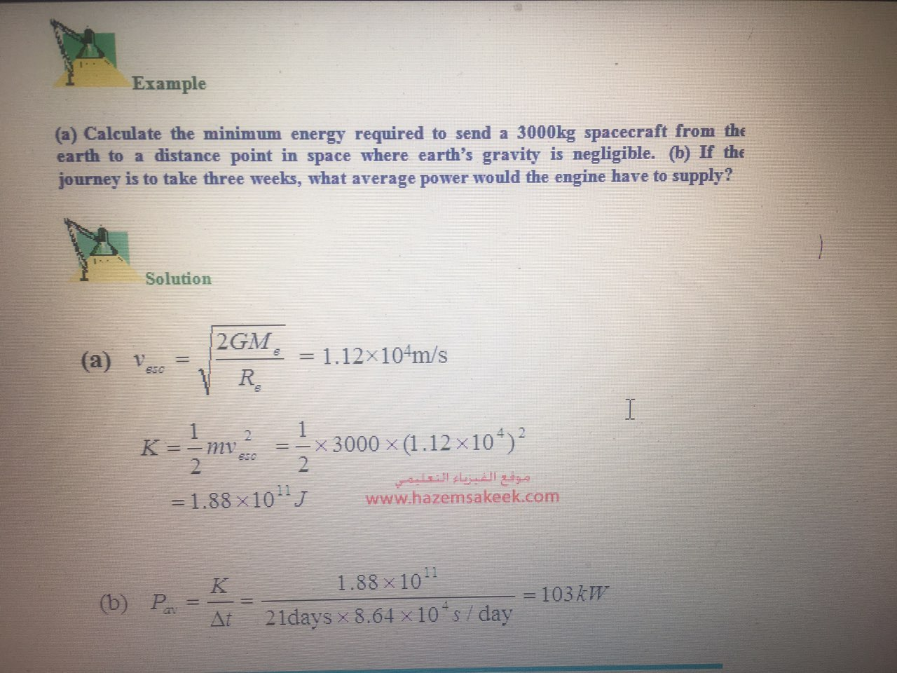

Slide 8
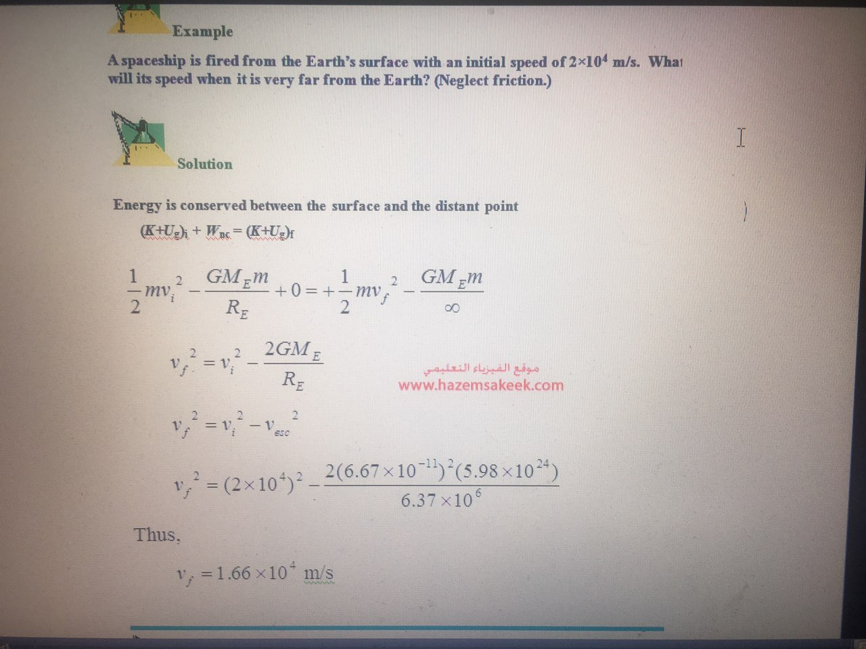

Slide 9
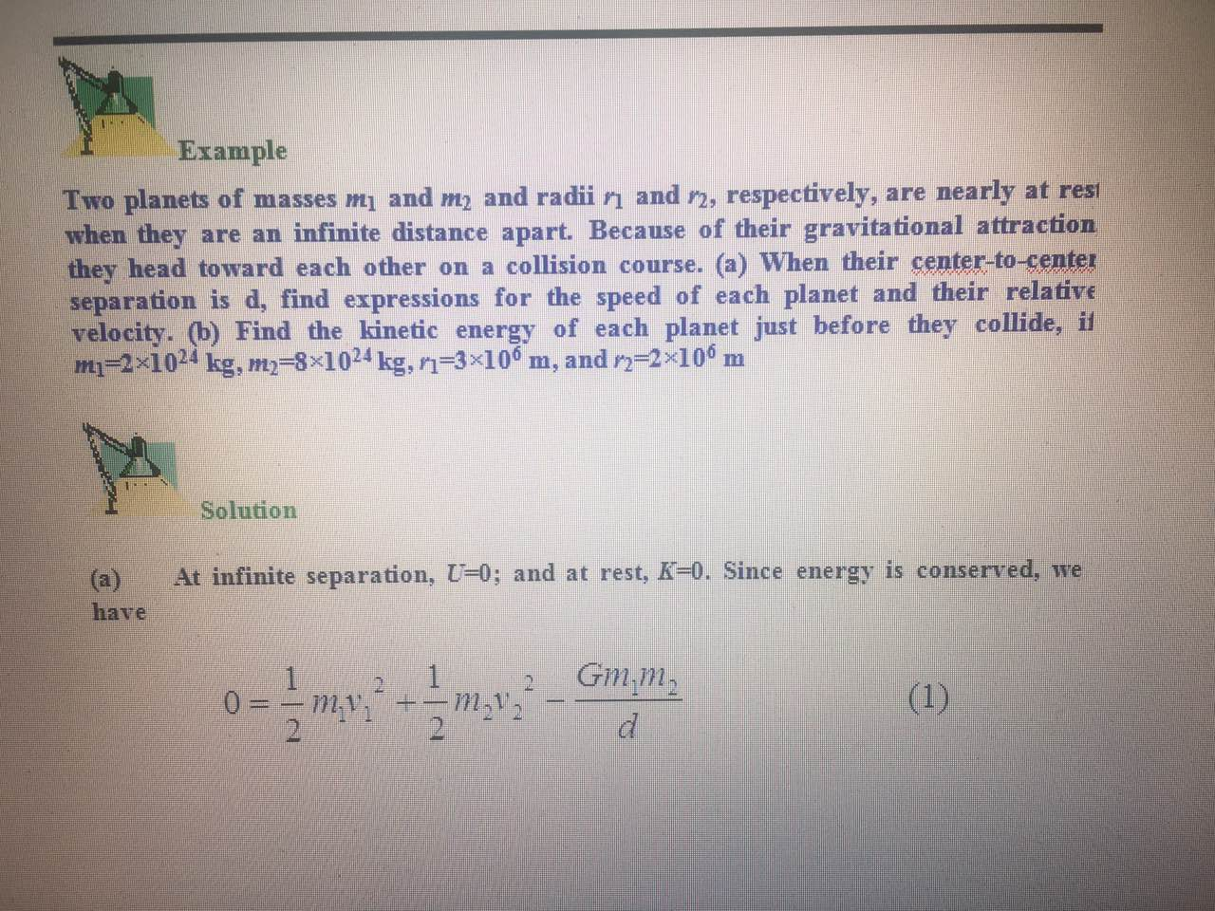

Slide 10
