Slide 1
International Portfolio Management Business Administration PH.D program
Prof. Dr. Haider Alfuraijy
14-4-2020

Slide 2
Chapter outline
1-Risk and return of single asset.( case study)
2-Risk measurement ( web working)
3-Risk and return of portfolio.(case study)
4-Diversification, correlation and return.(case study)
5-Optimal portfolio.(case study)
6-Portfolio strategies ( web working)
7-New Challenges in portfolio Optimization (web working)
8-International Diversification
9-Optimal International Asset Allocation
10-Measuring the Total Return from Foreign Portfolio Investing
11-Measuring Exchange Risk on Foreign Securities

Slide 3
L E A R N I N G G O A L S
1- Understand the meaning and fundamentals of risk, return, and risk preferences.
2- Describe procedures for assessing and measuring the risk of a single asset.
3- Discuss the measurement of return and standard deviation for a portfolio and the various types of correlation that can exist between series of numbers.
5- Understand the risk and return of a portfolio in terms of correlation and diversification, and the impact of international assets on a portfolio.
6- Review the two types of risk and the derivation and role of beta in measuring the relevant risk of both an individual security and a portfolio.
7- Explain the capital asset pricing model (CAPM), its relationship to the security market line (SML), and shifts in the SML caused by changes in inflationary expectations and risk aversion
8- Explain the risk and benefits of international portfolios
9-Measuring Exchange Risk on Foreign Securities

Slide 4
Case study CITIGROUP TAKES ON NEW ASSOCIATES
(source: GITMAN,ET, ALL, principle of managerial finance, 2015,213)
Every student should read it carefully and determined HOW CITIGOUP deal with risk and the effect of diversification on the group risk and return.

Slide 5
As they chased after hot new financial services businesses that boosted earnings quickly, many banks ignored a key principle of risk management: Diversification reduces risk. They expanded into risky areas such as investment banking, stock brokerage, wealth management, and equity investment, and they moved away from their traditional services such as mortgage banking, auto financing, and credit cards.
Although adding new business lines is a way to diversify, the benefits of diversification come from balancing low-risk and high-risk activities. As the economy changed, banks ran into problems with these new, higher-risk services. Banks that had “hedged their bets” by continuing to offer a variety of services spread across the risk spectrum earned higher returns. Citigroup is a case study for the benefits of diversification. The company, created in 1998 by the merger of Citicorp and Travelers Group, provides a broad range of financial products and services to 100 million consumers, corporations, governments, and institutions in over 100 countries.
These offerings include consumer banking and credit, corporate and investment banking, commercial finance, leasing, insurance, securities brokerage, and asset management. Under the leadership of Citigroup CEO Sandy Weill, the company made acquisitions that reduced its dependence on corporate and investment banking. In September 2000, Citigroup bought Associates First Capital Corp for $31 billion.

Slide 6
With the acquisition of Associates, Citigroup shifted the balance of its business more toward consumers than toward institutions. Associates' target market is the lower-middle economic class. Although these customers are riskier than the traditional bank customer, the rewards are greater too, because Associates can charge higher interest rates and fees to compensate itself for taking on the additional risk. The existing consumer finance businesses of both Associates and Citigroup know how to handle this type of lending and earn solid returns in the process.
A more diversified group of businesses with greater emphasis on the consumer side should reduce Citigroup’s earnings volatility and improve shareholder value. Commenting in spring 2001 on the corporation’s ability to weather the current economic downturn, Weill said, “The strength and diversity of our earnings by business, geography, and customer helped to deliver a strong bottom line in a period of market uncertainty.” Citigroup’s return on equity (ROE) for the first quarter 2001 was 22.5 percent, just above fiscal year 2000’s 22.4 percent and better than its average ROE of 19 percent for the period 1998 to 2000. Citigroup and its consumer business units demonstrate several key fundamental financial concepts: Risk and return are linked, return should increase if risk increases, and diversification reduces risk. As this chapter will show, firms can use various tools and techniques to quantify
and assess the risk and return for individual assets and for groups of assets.

Slide 7
Risk and return of single asset.( case study)
Risk and Return Fundamentals
To maximize share price, the financial manager must learn to assess two key factors : risk and return.
Each financial decision presents certain risk and return, and the unique combination of these factors has an impact on share price. Risk can be viewed as it is related either to a single asset or to a portfolio—a collection, or group, of assets. We will look at both, beginning with the risk of a single asset. First, though, it is important to introduce some fundamental ideas about risk, return, and risk preferences.

Slide 8
Philosophy Question?
Is there ( a free lunch) frim portfolio??
How we can confirm that?
Here we need to discuss these points:
1- return of single asset
2- risk of single asset (Sensitivity Analysis, Probability Distributions)
3- the common sources of risk that affect both firms and their shareholders
4- Risk Preferences

Slide 14
Risk and return of portfolio.(case study)
In real-world situations, the risk of any single investment would not be viewed independently of other assets.
New investments must be considered in light of their impact on the risk and return of the portfolio of assets.
The financial manager’s goal is to create an efficient portfolio, one that maximizes return for a given level of risk or minimizes risk for a given level of return

Slide 15
Here we need to discuss these points:
1- PORTFOLIO EXPECTED RETURNS
2- Portfolio Variance and Standard Deviation
3- SYSTEMATIC AND UNSYSTEMATIC RISK

Slide 17
Diversification, correlation and return.(case study)
We’ve seen earlier that portfolio risks can, in principle, be quite different from the risks of the assets that make up the portfolio. We now look more closely at the riskiness of an individual asset versus the risk of a portfolio of many different assets.
We will once again examine some market history to get an idea of what happens with actual investments.

Slide 18
Philosophy Question? Is diversification work??
Here we need to discuss these points:
1- THE PRINCIPLE OF DIVERSIFICATION
2-The effect of Correlation in risk and return of portfolio

Slide 22
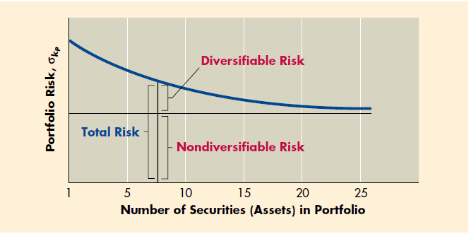

Slide 24
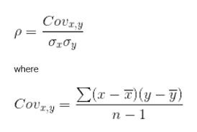

Slide 26
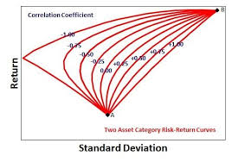

Slide 27
Optimal portfolio.(case study)
Given the full set of potential portfolios that could be constructed from the available assets, which portfolio should actually be held?
This choice involves two separate decisions: (1) determining the efficient set of portfolios and (2) choosing from the efficient set the single portfolio that is best for the specific investor.

Slide 28
Here we need to discuss these points:
1- CAPM model
2- Beta of portfolio
3- SML & CML
4-The Efficient Frontier
5- Risk–Return Indifference Curves
6- The Optimal Portfolio for an Investor

Slide 30
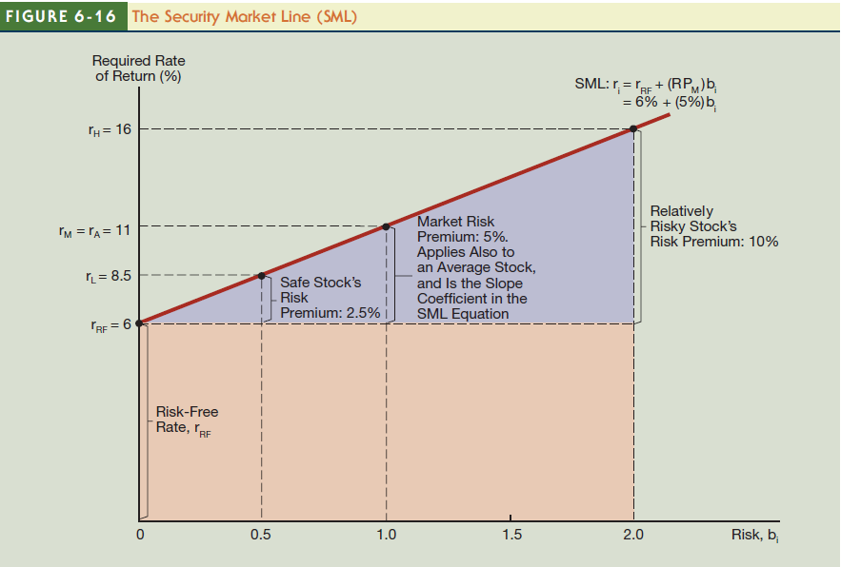

Slide 33
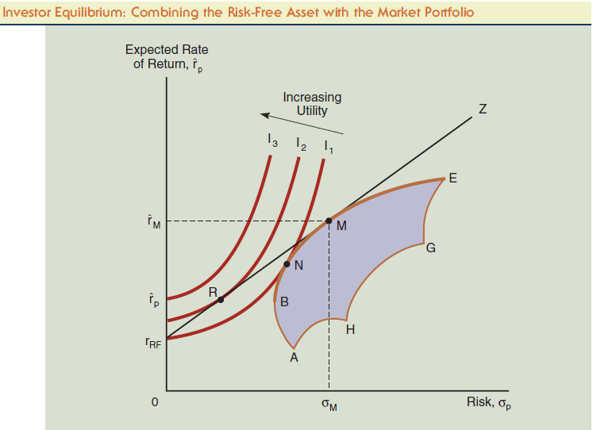

Slide 34
International Diversification
The expanded universe of securities available internationally suggests the possibility of achieving a better risk-return tradeoff than by investing solely in local securities.
That is, expanding the universe of assets available for investment should lead to higher returns for the same level of risk or less risk for the same level of expected return.
This relation follows from the basic rule of portfolio diversification: The broader the diversification, the more stable the returns and the more diffuse the risks.

Slide 35
Philosophy Question?? Is going abroad work?? Here we need to discuss these points
1- Correlations and the Gains from international Diversification
2- Barriers to International Diversification
3- Optimal International Asset Allocation
4-Measuring the Total Return from Foreign Portfolio Investing
5-Measuring Exchange Risk on Foreign Securities

Slide 39
Web work
1-Risk measurement
2- -Portfolio strategies
3- New Challenges in portfolio Optimization
4- Wall street journal (all students)

Slide 40
Sources
Managerial finance , Gitman , 2015-2018
Fundamental of financial management , Eugene F. Brigham, 2015-2018
International financial management, Madura, 2018
International Finance THEORY & POLICY ,ELEVENTH EDITION , GLOBAL EDITION ,Paul R. Krugman , Maurice Obstfeld ,Marc J. Melitz , 2018
Multinational financial management / Alan C. Shapiro. –Tenth Edition,2014
Stephen A. Ross , Randolph W. Waterfield and Bradford D. Jordan , Ninth Edition, 2010- 2019
Any other modern sources.

Slide 41
Thank you for your listening
Prof.Dr.Haider Alfuraijy

