Slide 1
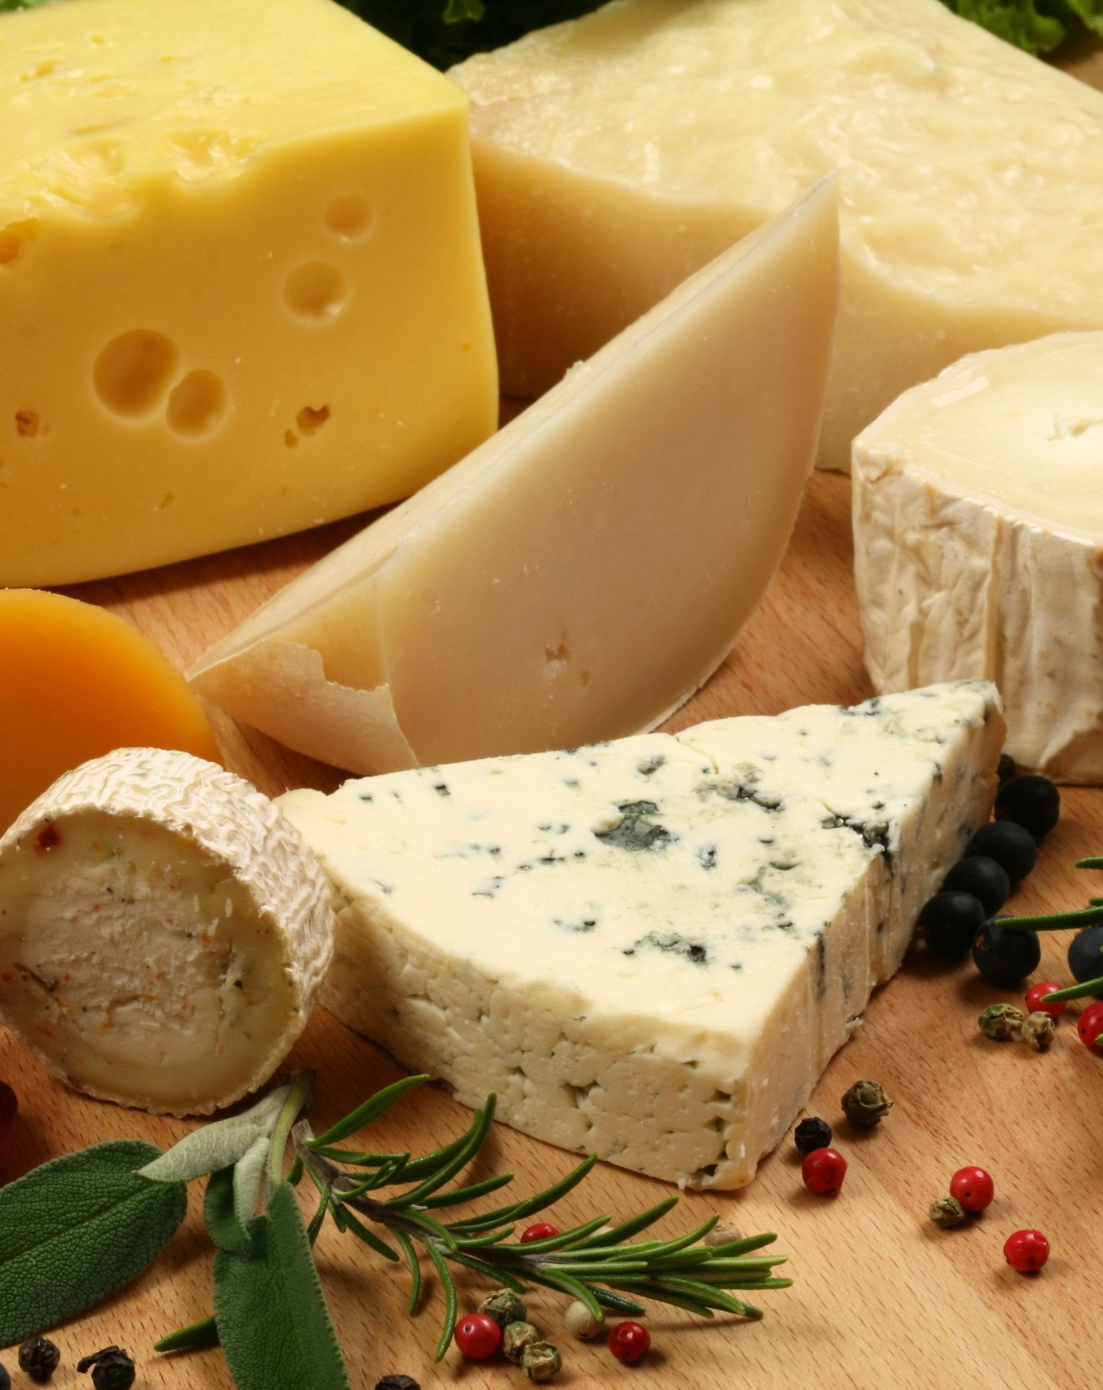
Create a cheese factory
Feasibility study
Notes:
لتغيير الصورة على هذه الشريحة، حدد الصورة واحذفها. ثم انقر فوق أيقونة «الصور» في العنصر النائب لإدراج صوتك.

Slide 2
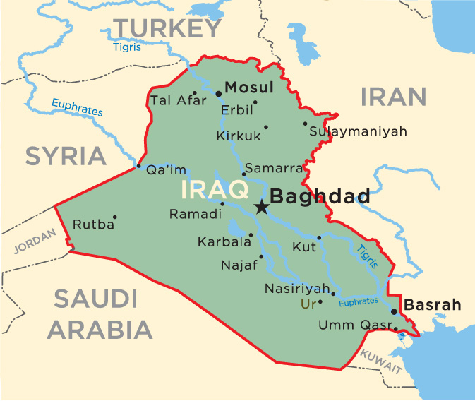
Overview of Iraq Republic
Iraq is a West Asian country rich with oil, natural resources and rivers, with an average wage of US $ 6,000.
location
Iraq has an important geographical location. It is one of the countries bordering the Arabian Gulf. It is bordered to the south by Kuwait and Saudi Arabia, to the north by Turkey, to the west by Syria and Jordan, and from the east by Iran.

Slide 3
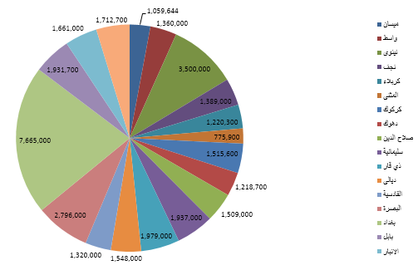
Overview of Iraq Republic
Population
Iraq's population will reach 40 million at the end of 2017, with 51% for men and 49% for women.
Population distribution (million people)
Baghdad 7.6
Mousl 3.5
Basra 2.8

Slide 4
Industry in Iraq
Iraq has about 2000 government sector factories and more than 3500 private sector factories in various industries, but the conditions that have passed since the eighties of the last century have been processed on these factories, has been disabled more than 90% of these factories currently for several reasons, including:
Weak infrastructure of factories.
Waste of machinery and non-use of technology.
Random import.

Slide 5


Dairy factories competing in Iraq
Ownership: 100% for the Iraqi government
Location: Diwaniya (200 km south of Baghdad)
Products:
Milk
Natural Cheese (White Cheese)
  Diwaniya Cheese Factory
Ownership: 100% for the Iraqi government
Location: Baghdad Suburbs (Abu Ghraib Area)
Products:
Milk
Natural Cheese (White Cheese)
Cheese cooked 100 g in plastic packaging
  Abu Ghraib Cheese Factory

Slide 6

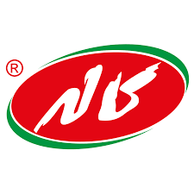
Dairy factories competing in Iraq
Property: : Bunieh family- private Sector
Location: Baghdad
Products:
Milk
Natural Cheese (White Cheese)
Kanoon cheese factory
Ownership: Iranian kalleh company
Location: Karbala (106 km south of Baghdad)
Products:
cream
Milk (450 g, 2500 g)
Cheese cooked 100 g in plastic packaging
  Cheese Factory kalleh

Slide 7
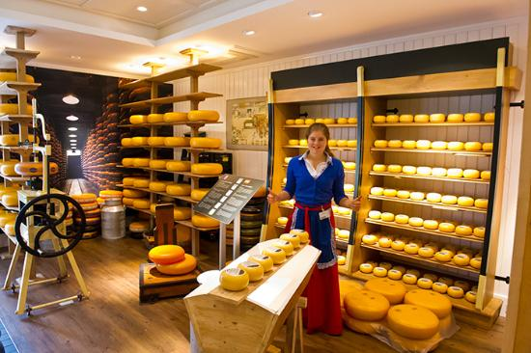
Advantages of establishing cheese factory
Many foreign companies decided to set up factories in Iraq to achieve the following advantages:
Avoid excessive customs duties
  35% Product Protection Fee
  10% customs fee
Benefit from tax exemptions and customs fees granted under the Industrial Investment Law and the Investment Law.
Notes:
لتغيير الصورة على هذه الشريحة، حدد الصورة واحذفها. ثم انقر فوق أيقونة «الصور» في العنصر النائب لإدراج صوتك.

Slide 8
Advantages of establishing cheese factory
Disposal of import license fees ($ 3,350 per 100 tons)
Import from neighboring countries with a capacity of 45 days.
Import from other countries with 90 days validity.
Avoid loss, waste, damage due to poor handling of goods, length of inspection and customs clearance.
Not affected by the controls of ports, which require the destruction of the product that has been in production for a period of one third, which caused the destruction of about 20 thousand cartons during 2018.

Slide 9
Exported quantities and expenses

Slide 10
Goods expenses
Through the data for the last five years we note the increase in the total expenses related to goods from the Iraqi ports to the warehouses of the company.
Total Exp. | Quantity | Year
159821 | 499209 | 2013
122076 | 516634 | 2014
136089 | 598471 | 2015
922895 | 639059 | 2016
1317500 | 432739 | 2017

Slide 11
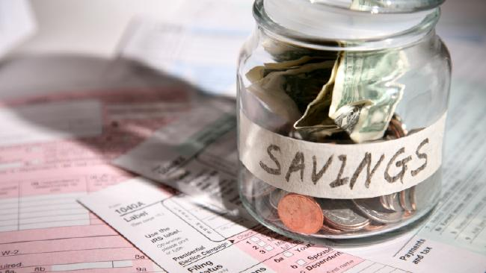
Savings on planned sales in 2018
Under the planned sales for 2018, the following amounts can be saved as shown below:

Slide 12
Savings on planned sales in 2018
JAW IMS target for 2018
8p (120gm ) about 2300 ton (125 container)
Yearly Actual Custom duties paid on JAW 8P by BEL : USD 2.2 Million.
Yearly custom duties that should be paid :
USD 90000 * 125 Container * 45% = USD 5.06 million

Slide 13
Savings on planned sales in 2018
80gm tubs about 1000 ton (87 containers)
Yearly Actual customs paid on JAW 80 gm by BEL :USD 1.35 Million
Yearly custom duties that should be paid :
USD 45000 * 87 containers * 45% = USD 1.75 Million

Slide 14

Investment Law
The investment law included a number of advantages, most notably the exemption from customs duties, the freedom to market the product through the establishment of branches and commercial offices in Iraq, the right to establish a joint commercial entity with an Iraqi or foreign investor, with the possibility of the investor to cooperate with Iraqi partners, As well as facilities for the transfer of funds to and from Iraq, including the amounts invested and profits and finally visa and exit facilities, and residence permits, such as:

Slide 15
Industrial Investment Law
Include industrial projects exempt from all taxes and fees except income tax for a period of (10) years.
The industrial project shall be exempted from income tax for a period of (5) years from the year in which the first profit is achieved after obtaining a license.
The strategic or special industries, as well as projects established for export purposes based on local raw materials and projects that contribute to the transfer of advanced technology to Iraq, have an additional exemption for each case.

Slide 16
Industrial Investment Law
Article (9) of the law includes procedures for allocating land within the industrial sites through coordination with the relevant parties and leasing them throughout the period of validity of the establishment license.
Article 17 of the project's imports of machinery, equipment, raw materials and operating requirements is exempted from the requirement of obtaining the import license.
Participation in draft laws and legislation governing the activities of the private industrial sector that govern foreign investment.

Slide 17

Possibilities of the project owner
The project owner has great capabilities and expertise in production, marketing and as described below:
Provide land in the Iraqi capital Baghdad with an area of ​​(5-10) Acres, near the fast lines Association Baghdad in the rest of the northern and southern provinces of Iraq.

Slide 18
Possibilities of the project owner
The company has refrigerated cars for the transport of goods (46) cars of different sizes connected to each other satellite tracking system, and connected to storage systems with the possibility of increasing these vehicles if necessary.
Possibility to open outlets for the company in the provinces to which the goods reach through delegates.
• The company has its own warehouses and agencies in six governorates spread in the north, center and south of the country.
• The possibility of obtaining an investment license and enjoy the privileges granted by law.

Slide 19

Production plan for the factory
we should start with plastic tubs plant production to be different sizes from 50 gm – 200gm
market size for plastic tubs : about 15000 ton
JAW share of plastic tubs market about 6-7%
With the plant JAW will be able to reach 15-20% of market share (about 3000 ton) in 3-5 years .
Due to cost competitiveness and good margin to do marketing support for the plastic tubs in addition to freshness of the goods (usually tubs reach market with 25-30% of shelf life expired .
After 3-5 years if the project was successful we could study with BEL possibility to start triangle portions to benefit from above points in triangle portions

Slide 20

Why should BEL agree to cooperate with NTDCO in establishing a plant in Baghdad Iraq
NTDCO will 100% responsible for financing the whole project (land , hungers & machinery) without any financial risk on BEL.
NTDCO will be responsible for any security issue or any problem may appear in Iraq that could affect the project
BEL will save yearly about USD 1.50 millions on tubs investment only in the beginning and more than 6 million later if triangle portions were produced.
BEL will be again ready to invest on plastic tubs to gain market share from competitors specially Kalleh .

Slide 21
Why should BEL agree to cooperate with NTDCO in establishing a plant in Baghdad Iraq
BEL will increase its market share in plastic tubs (biggest category in Iraq) be a main player as other SKU
BEL will the first international player to start production of processed cheese in Iraq (Danone started earlier but in Yoghurt and Shanina) and will gain momentum on other local and regional players who are planning to start due to sharp increase of custom duties
BEL will be responsible for providing the plant with the right raw material , required machinery and technical support to maintain JAW quality
BEL can produce LVQR tubs to benefit from all above

Slide 22
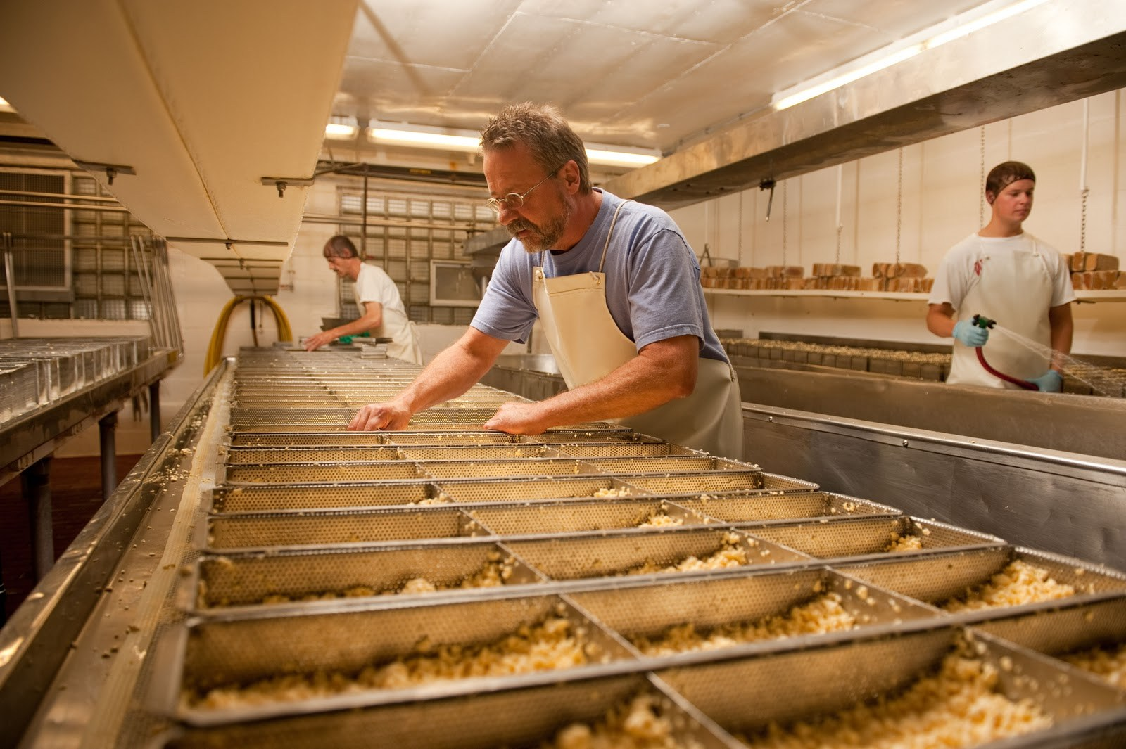
Thanks for watching
The End
Notes:
لتغيير الصورة على هذه الشريحة، حدد الصورة واحذفها. ثم انقر فوق أيقونة «الصور» في العنصر النائب لإدراج صوتك.

