Slide 2
Adrenal hormones

Slide 3
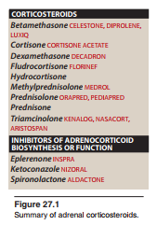

Slide 4
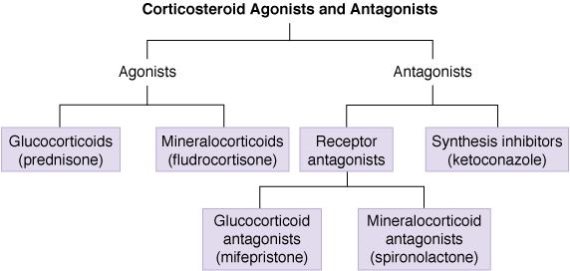

Slide 5
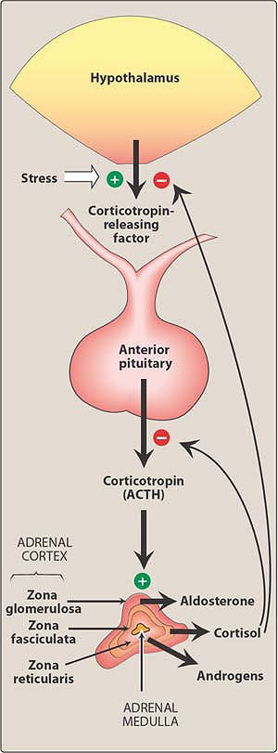

Slide 6
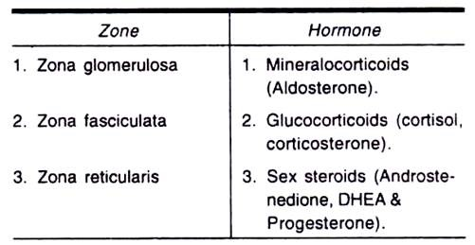

Slide 8
1- Glucocorticoids

Slide 10
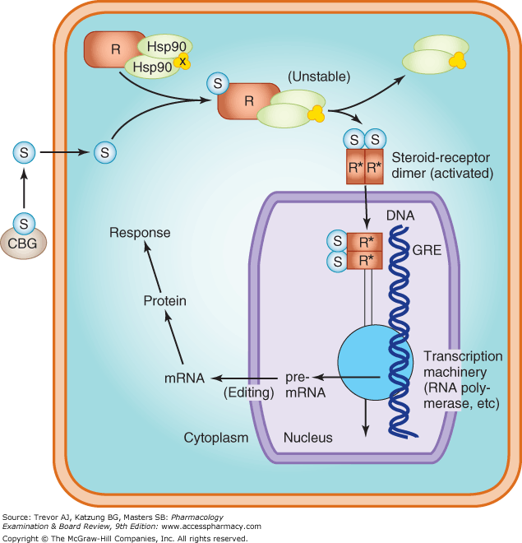

Slide 11
Physiologic and pharmacologic activities of glucocorticoids:
1-metabolic processes
2-stress resistance
3-blood cells
4-anti-inflammatory
5- other systems

Slide 13
2-Mineralocorticoids

Slide 14
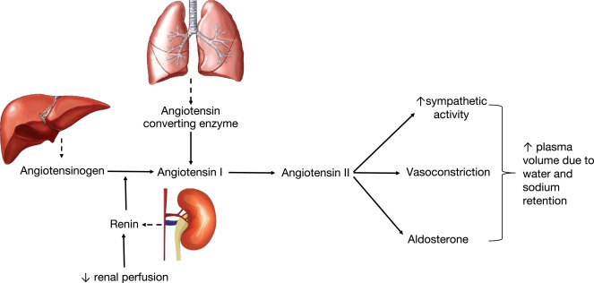
Renin angiotensin aldosterone system

Slide 16
Therapeutic uses of corticosteroids:
1. Replacement therapy for primary adrenocortical insufficiency (Addison disease)
2. Replacement therapy for secondary or tertiary adrenocortical insufficiency
3. Diagnosis of Cushing syndrome
4. Replacement therapy for congenital adrenal hyperplasia (CAH)
5. Relief of inflammatory symptoms
6. Treatment of allergies
7. Acceleration of lung maturation

Slide 17
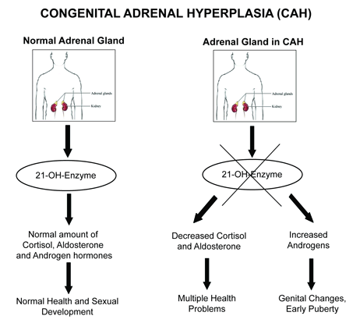

Slide 18
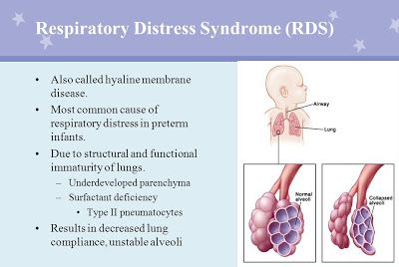

Slide 19
Pharmacokinetics

Slide 20
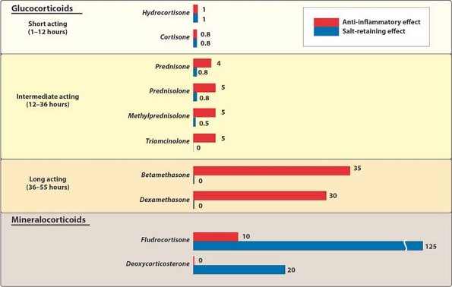

Slide 21
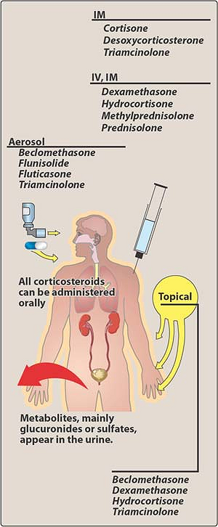

Slide 22
Steroids dose and HPA-axis suppression

Slide 23
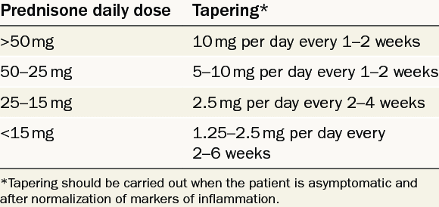
Adrenal suppression and dose tapring

Slide 24
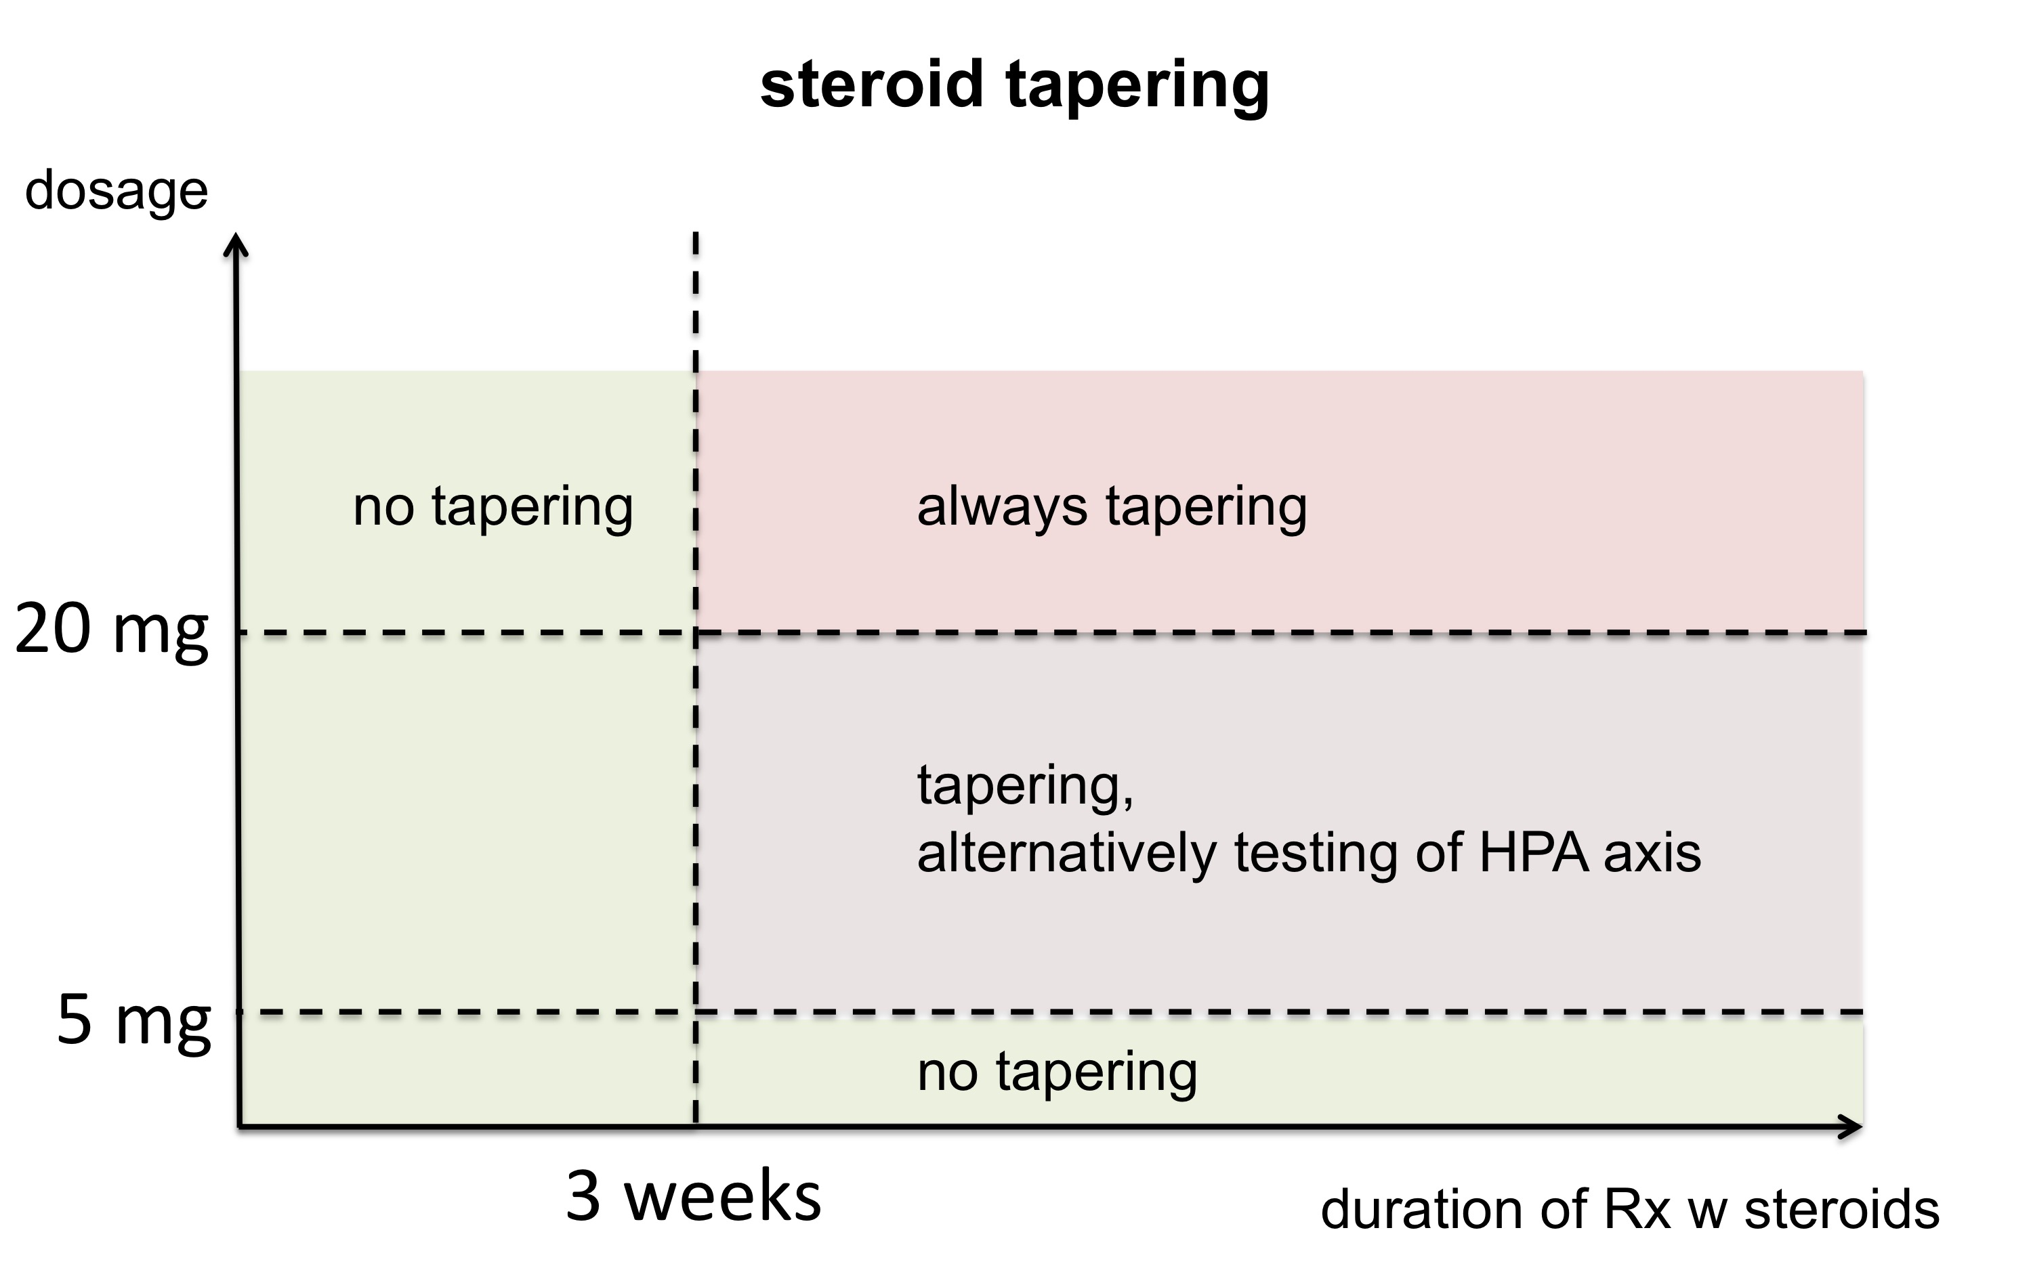

Slide 25
Adverse effects

Slide 26
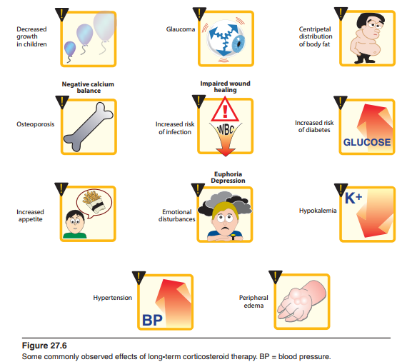

Slide 27
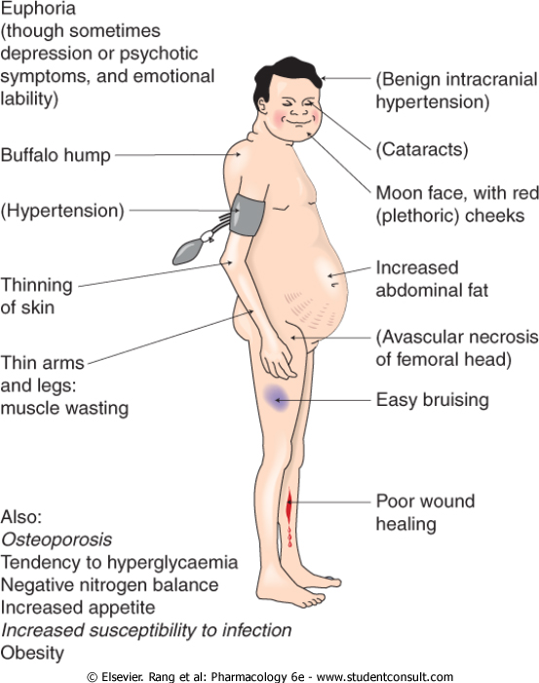

Slide 28
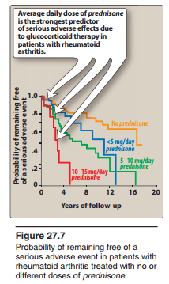

Slide 29
Inhibitors of adrenocorticoid:
1- Biosynthesis (enzymatic pathway):
a) ketoconazole
b) Spironolactone
2- Function (receptor blocker):
a) eplerenone
b) spironolactone

Slide 30
Drug | MOA | Uses | Adverse effects
Ketoconazole (synthesis) | inhibits all gonadal and adrenal steroid hormone synthesis. | 1- antifungal 2-Cushing syndrome | GI upset CNS effects impotence
Spironolactone (both) | 1-Aldosterone antagonist 2-antagonize aldosterone and testosterone synthesis. | 1-hyperaldosteronism 2-hypertension 3-heart failure 4-hirsutism | hyperkalemia gynecomastia irregular mesne skin rashes
Eplerenone (receptors) | Aldosterone antagonist | 1- hypertension 2- heart failure | Like of spironolactone except gynecomastia

Slide 31
Checklist
When you complete this chapter, you should be able to:
Describe the major naturally occurring glucocorticosteroid and its actions.
List several synthetic glucocorticoids, and describe differences between these agents and the naturally occurring hormone.
Describe the actions of the naturally occurring mineralocorticoid and 1 synthetic agent in this subgroup.
List the indications for the use of corticosteroids in adrenal and nonadrenal disorders.
Name 3 drugs that interfere with the action or synthesis of corticosteroids, and, for each, describe its mechanism of action.

Slide 32
Osteoporosis is a major adverse effect caused by the
glucocorticoids. It is due to their ability to:
A. Increase the excretion of calcium.
B. Inhibit absorption of calcium.
C. Stimulate the hypothalamic-pituitary-adrenal axis.
D. Decrease production of prostaglandins.
E. Decrease collagen synthesis.

