Slide 2
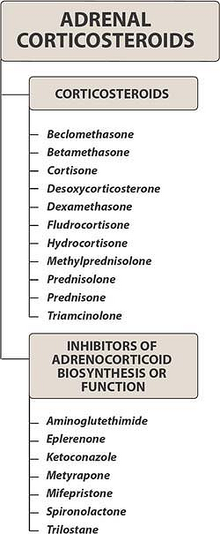

Slide 3
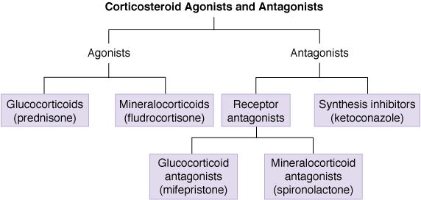

Slide 4
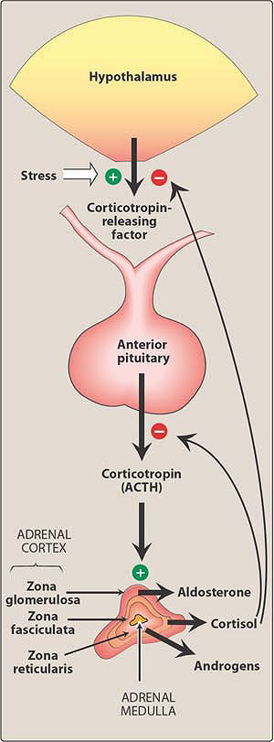

Slide 6
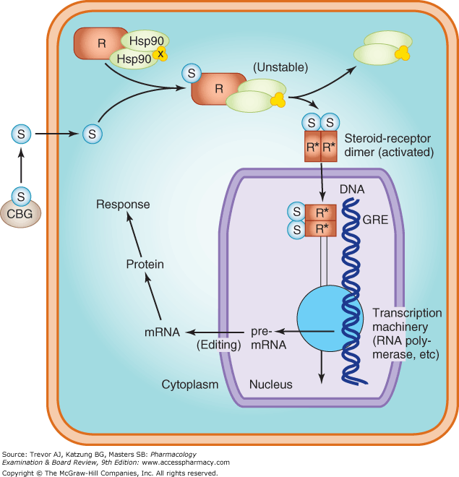

Slide 8
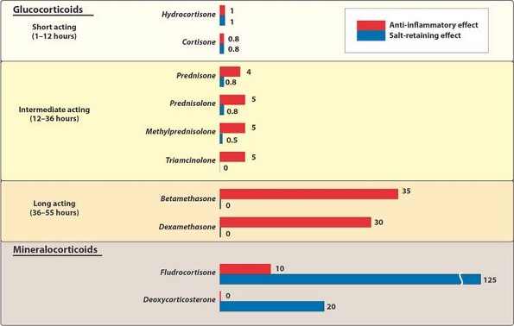

Slide 9
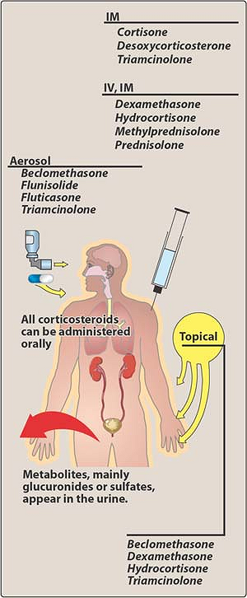

Slide 11
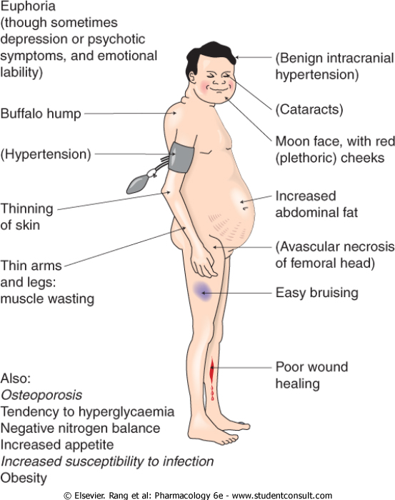

Slide 13
Checklist
When you complete this chapter, you should be able to:
Describe the major naturally occurring glucocorticosteroid and its actions.
List several synthetic glucocorticoids, and describe differences between these agents and the naturally occurring hormone.
Describe the actions of the naturally occurring mineralocorticoid and 1 synthetic agent in this subgroup.
List the indications for the use of corticosteroids in adrenal and nonadrenal disorders.
Name 3 drugs that interfere with the action or synthesis of corticosteroids, and, for each, describe its mechanism of action.

Slide 14
Osteoporosis is a major adverse effect caused by the
glucocorticoids. It is due to their ability to:
A. Increase the excretion of calcium.
B. Inhibit absorption of calcium.
C. Stimulate the hypothalamic-pituitary-adrenal
axis.
D. Decrease production of prostaglandins.
E. Decrease collagen synthesis.

