Slide 1
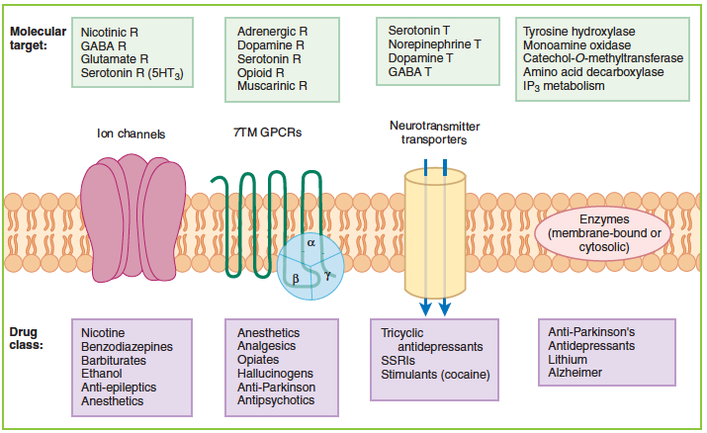

Slide 3
23s2wi

Slide 4
Anxiolytic & Hypnotic Drugs

Slide 5


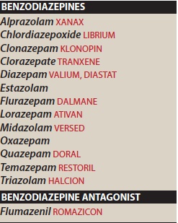
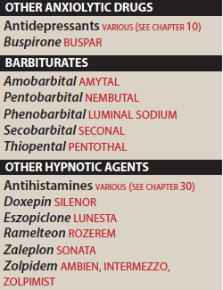

Slide 6
Anxiolytic & Hpnotic Agents
Anxiety: unpleasant state of tension, apprehension or uneasiness
Severe cases; characterized by, tachycardia, sweating, trembling
& palpitation, in addition to sympathetic stimulation
Episodes:
mild, severe, chronic & debilitating anxiety
Many antianxiety drugs cause sedation, they may be used clinically as both anxiolytic and hypnotic (sleepinducing) agents

Slide 7
Benzodiazepines
Safe, preffered over barbiturates & meprobamates
Commonly used for anxiety & insomnia
Other anxiolytics
Antidepressant with anxiolytic / SSRIs are preferred
Nonbenzodiazepine hypnotics & antihistamine

Slide 8
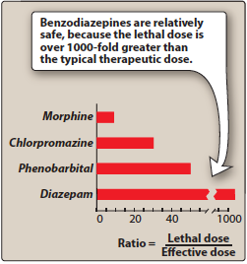
Ratio of lethal to effective dose

Slide 9
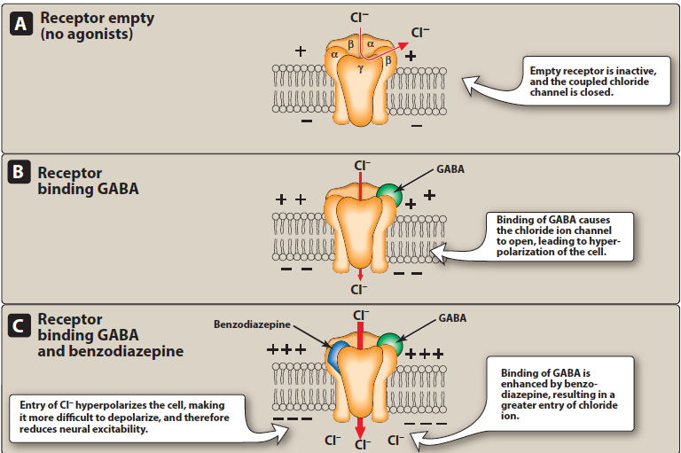

Slide 10
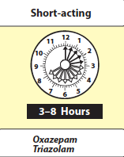
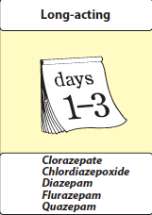
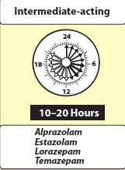

Slide 11
Actions of BZDs
1- Reduction of anxiety, at low doses /anxiolytic /
inhibit circuits in limbic system
2- Sedative / hypnotic (⍺1-GABAA)
3- Anterograde amnesia (⍺1-GABAA)
4- Anticonvulsant (⍺1-GABAA)
5- Muscle relaxant (presynaptic inhibition in spinal cord). (Baclofen / SkM relaxant)

Slide 12
Therapeutic Uses
1- Anxiety disorders
Anxiety secondary to Panic disorder
Generalised anxiety disorder (GAD)
Social anxiety
Post traumatic stress
Obsessive compulsive disorder
Extreme anxiety with phobia
Anxiety related to depression & schizophrenia
Long acting/ clonazepam, lorazepam, diazepam/ ???
Antianxiety effect & tolerance (tolerance???)
Cross tolerance with ethanol
Alprazolam / short & long term treatment of panic disorder (withdrawal reactions???)

Slide 13
Therapeutic Uses, cont.
2- Sleep disorders
Hypnotic effect :
                decrease latency to sleep
                increase (REM) sleep
Insomnia treatment (hangover)
Intermed. acting(temazepam, estazolam)
Short acting (triazolam,)
Long acting ( flurazepam, quazepam)
Temazepam / frequent wakening (1-3hrs)
Triazolam :
                Difficulty in going to sleep
                Tolerance
                Withdrawal symptoms

Slide 14
Therapeutic Uses, cont.
3- Amnesia
premedication for anxiety-provoking & unpleasant
procedures / Midazolam
4- Seizures
Clonazepam / adjunctive therapy
Lorazepam & Diazepam / status epilepticus
Clorazepate, Chlordiazepoxide, Lorazepam,
Diazepam, Oxazepam / cross tolerance with alcohol
5- Muscular disorders
Diazepam / muscle strain, spasticity

Slide 15
Pharmacokinetics
1- Absorption & distribution:
2- Duration of action:
3- Fate:
metabolised by hep. microsomal sys. to active
metabolite
plasma t1/2
excreted in urine as glucor. or oxidised
metabolites
cross placenta
CI: in pregnancy

Slide 16
4- Dependence:
Psychological & physical
Withdrawal symptoms: confusion, anxiety, agitation, restlessness,
insomnia, tension & rarely, seizures
BZDs with short t1/2 (triazolam), induce more abrupt symptoms
5- Adverse effects
Drowsiness, confusion, ataxia, cognitive impairment
Triazolam / tolerance, daytime anxiety, amnesia & confusion
Caution with liver disease, acute angle-closure glaucoma
Alcohol & other CNS depressant???
Relatively safe, overdose ???
Pharmacokinetics

Slide 17
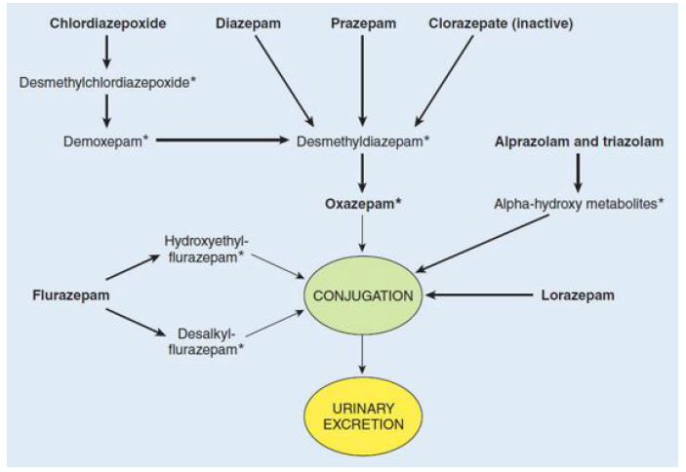

Slide 18
Benzodiazepine Antagonists
Flumazenil / GABA R antag.
IV only, rapid onset, short duration, t1/2 1hr
Frequent admin. is required
May precipitate withdrawal in dependent patients
Seizure may occur/ mixed ingestion with TCA
SE: dizziness, NV & agitation

Slide 19
Other Anxiolytic Agents
Antidepressants
  1st line / avoiding dependence
  SSRIs (escitalopram or paroxetine)
  SNRIs (venlafaxine, duloxetine)
  SSRIs & SNRIs have lower potential for dependence
Buspirone
Chronic GAD
Slow onset
5-HT1A, 5-HT2A, D2
No anticonvulsant, M relaxant
Few SE
Doesn’t potentiateCNS depressants

Slide 20
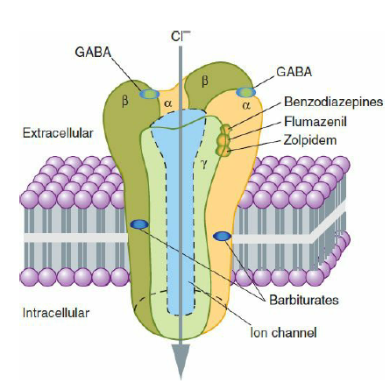
Barbiturates
Used to induce & maintain sleep
Replaced by BZDs because they induce tolerance & physical dependence & associated with very severe withdrawal symptoms
All are controlled sub.
Thiopental ( very short-acting)used to induce anaesthesia

Slide 21
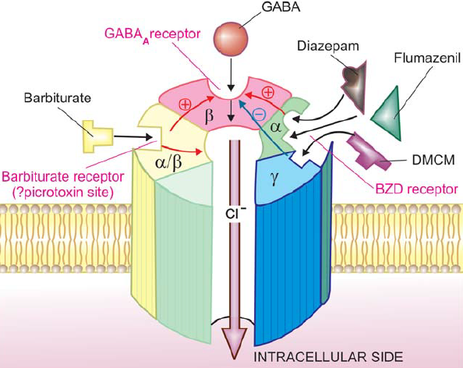
Pr
Prolong duration of Cl⁻ channel opening
Block excitatory glutamate receptors
Anesthetic conc. of pentobarb. block high-frequency Na⁺ channel

Slide 22
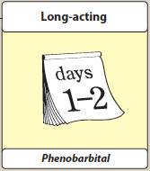
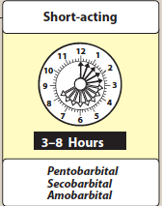
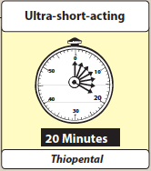
Classification of Barbiturates

Slide 23
Actions of Barbiturates
CNS depression
    low doses (sedation)
    higher doses (hypnosis, anaesthesia???, coma & death)
    Don’t raise pain threshold
    chronic use lead to tolerance
Respiratory depression
    Suppress hypoxic & chemoreceptor response to CO2

Slide 24
Therapeutic uses of Barbiturates
Anaesthesia, thiopental
Anticonvulsant, phenobarbital (tonic-clonic seizure, refractory status eplepticus))
Sedative / hypnotic (Butalbital, acetaminophen &caffeine or aspirin & caffeine)
Well tolerated orally, redistribute from brain

Slide 25
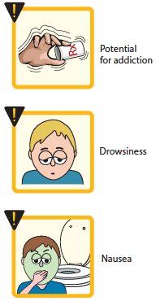
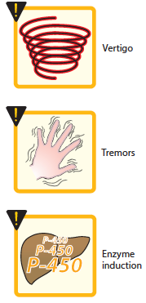
Side effects:
Barbiturates cause drowsiness, impaired concentration, and mental and physical sluggishness
Synergies with ethanol
Hangover effect
NV
E induction
CI: in patients with acute intermittent porphyria.
Abrupt withdrawal from barbiturates may cause tremors, anxiety, weakness, restlessness, nausea and vomiting, seizures, delirium, and cardiac arrest.
Withdrawal is much more severe than opiates

Slide 26
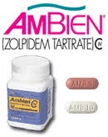
Zolpidem
Non-BZD compound, bind BZD-R subtype selectively
No anticonvulsant or muscle-relaxant effect
Few withdrawal, minimal rebound insomnia, little tolerance
Rapidly abs., rapid onset, short t1/2, oxidized by CYP3A!!!
Unlike BZD, at hypnotic doses, the nonBZD, zolpidem, zaleplon, and eszopiclone, do not significantly alter the sleep stages and, hence, are often the preferred hypnotics

Slide 27
Zalpelon
Oral non BZDs, few residual effects !!!, rapid elimination,
metabolized by liver
Eszopicone
Oral non BZD, act on BZ1 receptor, effective in insomnia,
rapid abs., & metabolism, SE; anxiety, dry mouth, headache,
peripheral edema, somnolence, and unpleasant taste
Ramelton
Selective MT1 & MT2, used for insomnia, No dependence,
SE: ———, prolactin ???

Slide 28
Antihistamines: hydroxyzine, diphenhydramine & doxylamine, !!!!!!
Antidepressants: sedating antidepressants with strong antihistamine
Doxepin, tricyclic agent with SNRI antidepressant and anxiolytic action, was used for insomnia
Trazodone, mirtazapine, tricyclic antidepressants with antihistamine activity

Slide 29
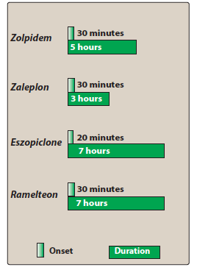

Slide 30
Key Expressions
Generalized anxiety disrder (GAD): excessive, ongoing anxiety and worry that are difficult to control and interfere with day-to-day activities may be a sign of generalized anxiety disorder.
It's possible in children & adults, with symptoms similar to panic disorder, obsessive-compulsive disorder and other types of anxiety
Obsessive-compulsive disorder (OCD) a pattern of unreasonable thoughts and fears (obsessions) that lead you to do repetitive behaviors (compulsions). These obsessions and compulsions interfere with daily activities and cause significant distress.
You may try to ignore or stop your obsessions, but that only increases your distress and anxiety. Ultimately, you feel driven to perform compulsive acts to try to ease your stress.

Slide 31
